Slide 1
Essay Details:
Analytical essay comparing and contrasting specific literary techniques from two texts.
Unique, original work that does not rely on, or draw from widely available internet ideas (Schmoop, Sparknotes, etc.)
Evidence of drafting, editing, and revision.
For a full score one of these texts must be a novel we’ve read: Orwell’s 1984 or Atwood’s The Handmaid’s Tale.
The other can be: the other book from the semester; Black Mirror: “Nosedive;” “Friday Black;” Children of Men; and The Lobster.
*We can talk about Super Sad True Love Story or Brave New World or something else of your choosing
MLA formatted:
Typed (12-point, Times New Roman font; double-spaced).
In-text citations (Orwell, 168).
Works Cited page.
1250 word minimum [approximately 4-6 pages in length, not counting works cited].
Submissions of Outline, Rough Draft, and Final Draft to Turnitin.com

Slide 2
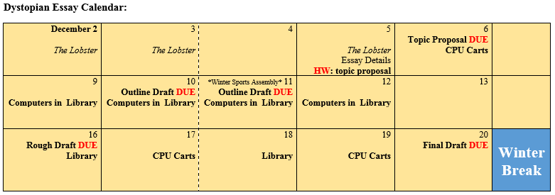
Essay Timeline

Slide 3
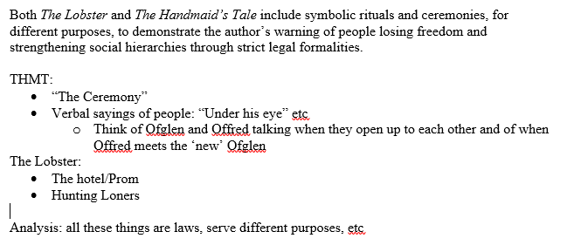
Moderately Developed Idea Example:

Slide 4
TurnItIn.com Codes:
Second Period:
ID: 22329083
Password: Atwood
Fifth Period:
ID: 22329098
Password: Orwell
Outline due tonight needs thesis and body paragraphs outlined with evidence and analysis started.

Slide 5
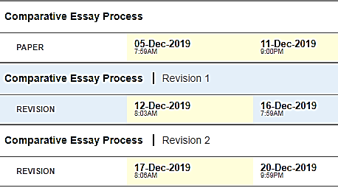
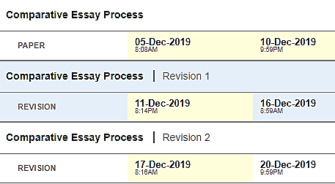
Due Dates:
Second Period:
Fifth Period:

Slide 6
Bring your topic proposal to Smith, if you have developed some specific ideas with literary devices under the synthesis heading. If you haven’t you are behind schedule. Outline of body paragraphs is due Monday at 10pm.

