Slide 1
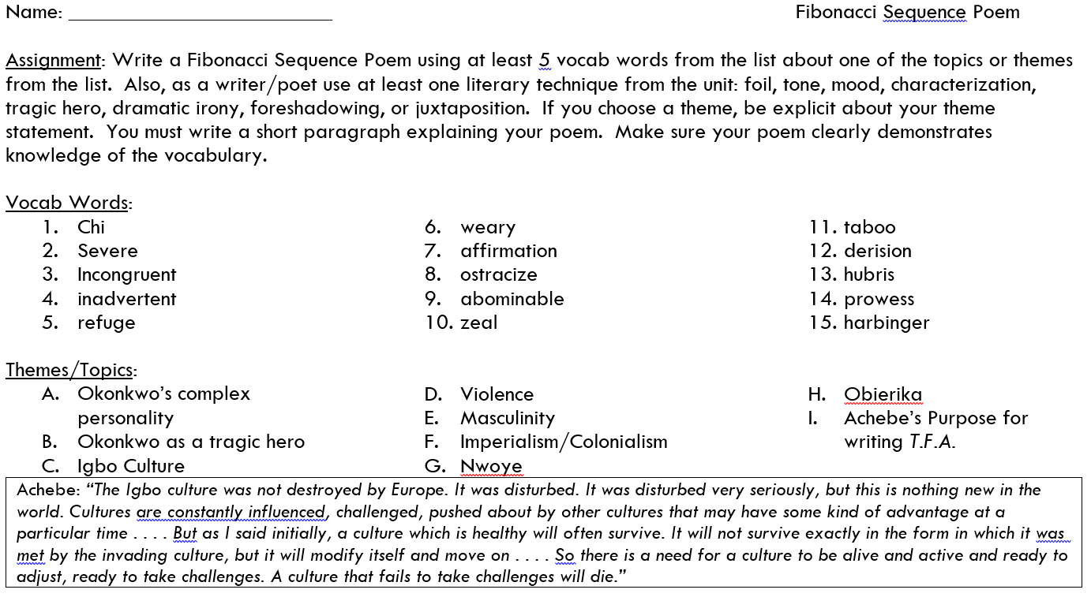

Slide 2
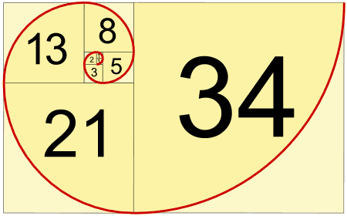
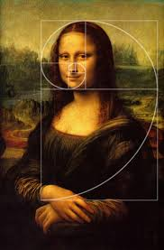
Fibonacci Sequence
Used in computer algorithms and classical art. Also appears in nature.
The Fibonacci sequence is named after Italian mathematician Fibonacci. His 1202 book Liber Abaci introduced the sequence to Western European mathematics, although the sequence had been described earlier in Indian mathematics.

Slide 4
Example Fibonacci Sequence Poem about Things Fall Apart part 1
Title: Okonkwo’s Hubris
Okonkwo
Fall
severe Chi
ignored warning; Ikemefuna
dramatic irony, misfire, misfortune: banishment
incongruent with Okonkwo’s hopes, inadvertent exile from Umuofia

Slide 5
Good Poetry: Less words more meaning?
“In a Station of the Metro”
By Ezra Pound
The apparition of these faces in the crowd;
Petals on a wet, black bough.

Slide 6
“Poetry is a lot like truth… and American’s f****** hate the truth.”

