Slide 1
Chapter 22: https://youtu.be/ohwdA3xas6I?t=5h42m30s 16 minutes
Reverend Smith “saw things as black and white. And black was evil. He saw the world as a battlefield in which the children of light were locked in a mortal conflict with the sons of darkness. He spoke in his sermons about sheep and goats and about wheat and tares*. He believed in slaying the prophets of Baal**.” (Achebe 184).
*wheat and tares= allusion to biblical separation of good people (wheat) from evil ones (tares or weeds). Interestingly, some interpretations of this passage conclude that part of the point is that it can be hard to tell the two plants apart.
**Baal= new testament word for evil/false god, literally means “lord” or “master”

Slide 2
Journal 23: Foils
Learning Targets:
Students will be able to define foil.
Students will be able to identify foils in a text and explain the effect.
Students will be able to relate foil to juxtaposition and characterization.

Slide 3
Juxtaposition
What is juxtaposition? What different things can be juxtaposed?
How and why do authors create juxtaposition in a text?
What examples of juxtaposition can you think of from our reading?

Slide 4
Juxtaposition → Foil
There is a different word for juxtaposition when it is applied to characters: foil
→Can you write a definition for foil based off what you already know about juxtaposition?

Slide 5
Foil

Slide 6
Foils
A foil is a pair of characters that show some opposite or similar qualities, thus emphasizing the qualities of each.
However, the it is not always the ‘bad guy’ that foils the ‘good guy.’
Foils are not literary ‘fact.’ Readers identify foils.
The purpose of using a foil is to highlight the traits of the main character and create new meaning based on the comparison/contrast.
→ Can you think of examples?

Slide 7
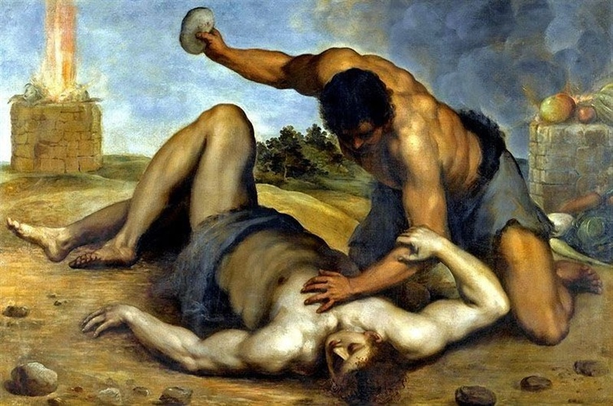
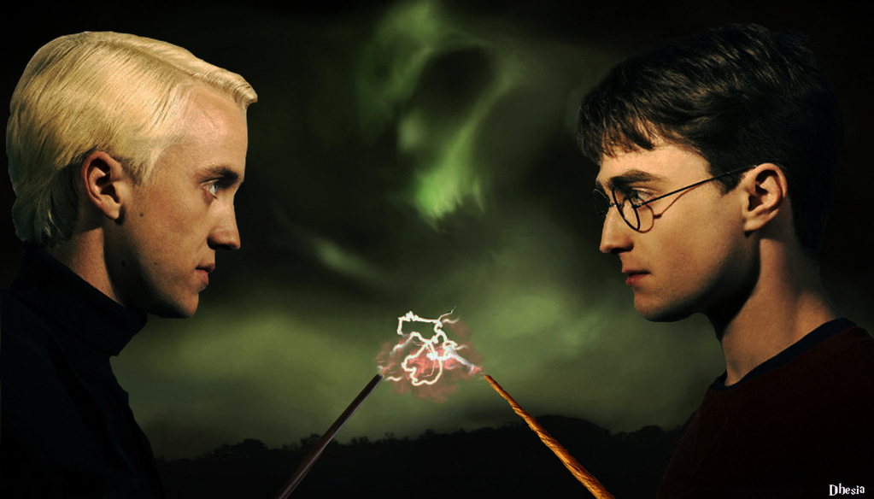
Example Foils in Literature and Film
Cain and Abel
Harry Potter and Draco Malfoy

Slide 8
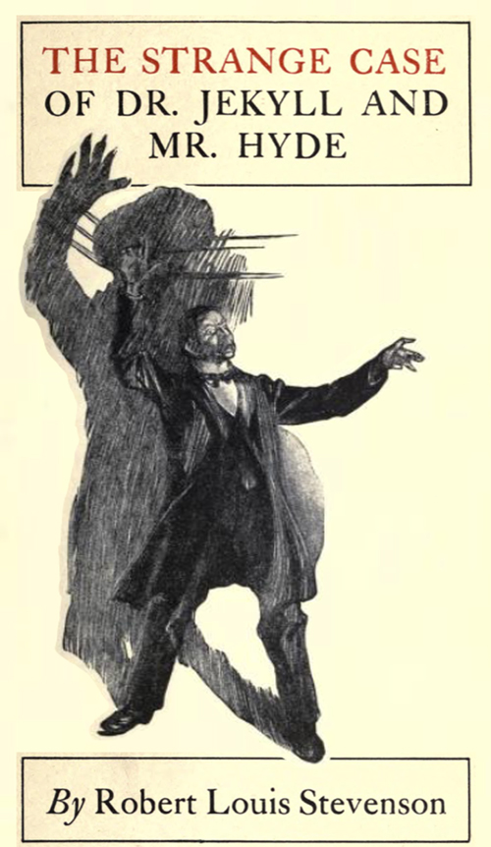
Foils → Characterization
What is characterization? How do you think it relates to the idea of characters being foils?
Foils can be an important part of characterization and character development.
The comparison of the opposite traits of characters helps the readers to not only understand their personalities but also to comprehend the importance of their roles in a work of literature.

Slide 9
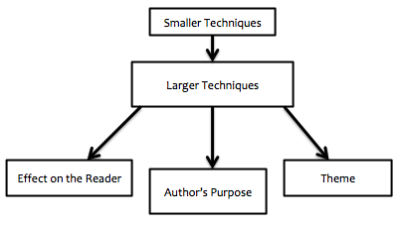
Characterization and the literary analysis pyramid…
Characterization: how writers create or reveal the personality of their characters. This includes how characters are represented by the author or narrator. Two Kinds:
Direct Characterization: readers are explicitly told what the personality of a character is
Indirect Characterization: readers implicitly discover the personality of characters through the 5 methods

Slide 10
Examples
Direct Characterization: readers are explicitly told what the personality of a character is using adjectives and other rhetorical methods
Example:
“I looked at the three of them standing there, and I felt I was seeing them for the last time: Ultima in her wisdom, my mother in her dream, and my father in his rebellion.” (Anaya, 52).

Slide 11
Methods of Indirect Characterization
What a character does
What a character says
What a character thinks
What others’ say about a character
What a character looks like
Link to practice analysis from Disney’s Frozen
Can be a larger technique…

Slide 12
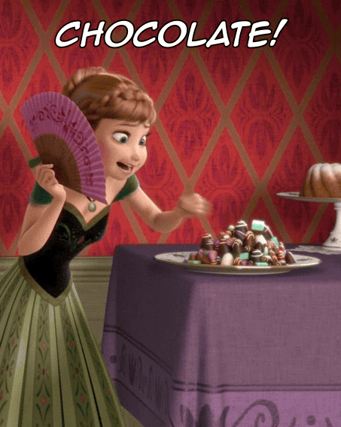
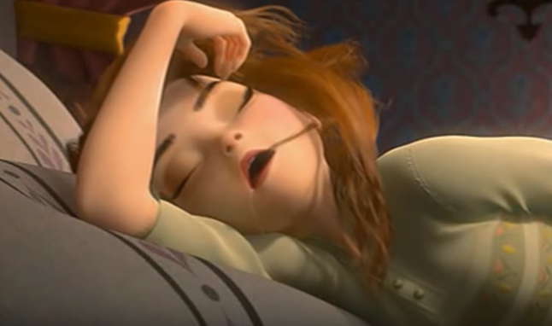
Example: Indirect Characterization
What a character does
What a character says
What a character thinks
What others’ say about a character
What a character looks like (appearance)

Slide 13
Foils → Characterization
What is characterization? How do you think it relates to the idea of characters being foils?
Foils can be an important part of characterization and character development.
The comparison of the opposite traits of characters helps the readers to not only understand their personalities but also to comprehend the importance of their roles in a work of literature.

Slide 14
Foils → Characterization
In Things Fall Apart there a few potential major foils.
FOIL Relationship
Okonkwo
Okonkwo
Nwoye
Mr. Brown

Slide 15
Foils → Characterization
How does this foil develop the complexity of Okonkwo’s characterization?
In Things Fall Apart there a few potential major foils.
FOIL Relationship
Okonkwo | Unoka
Okonkwo | Obierika
Nwoye | Ezinma
Mr. Brown | Reverend Smith

Slide 16
Foils → Characterization
Task:
List 3-4 details about each of Mr. Brown and Reverend Smith.
Reverend Smith | Mr. Brown

Slide 17
Reverend Smith / Mr. Brown
***On the TFA section of the final you will want to be able to differentiate between quotes from them***
Reverend Smith | Mr. Brown
“Mr. Brown's successor was the Reverend James Smith, and he was a different kind of man. He condemned openly Mr. Brown's policy of compromise and accommodation.” (Achebe 184). “He saw the world as a battlefield in which the children of light were locked in mortal conflict with the sons of darkness.” (Achebe 184). | “Mr. Brown preached against such excess of zeal. Everything was possible, he told his energetic flock, but everything was not expedient. And so Mr. Brown came to be respected even by the clan, because he trod softly on its faith.” (Achebe 178). “In this way Mr. Brown learned a good deal about the religion of the clan and he came to the conclusion that a frontal attack on it would not succeed. And so he built a school and a little hospital in Umuofia.” (Achebe 181).
→What NEW information can we gain about Reverend Smith because of the FOIL with Mr. Brown? What kind of men are they both?

Slide 18
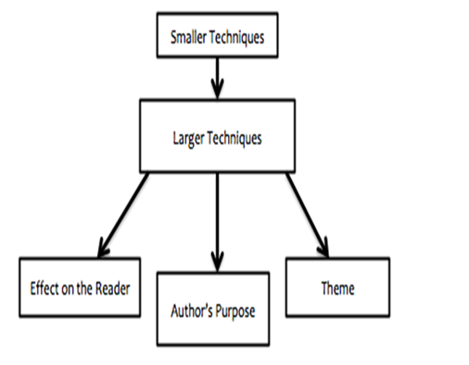
Foils → Characterization
Task:
List 4 details about each of Mr. Brown and Reverend Smith.
Write a thesis statement about what the foil shows about Reverend Smith and what it could mean for the Igbo people.
Reverend Smith | Mr. Brown
characterization will be your smaller technique
Foils will be a larger technique

Slide 19
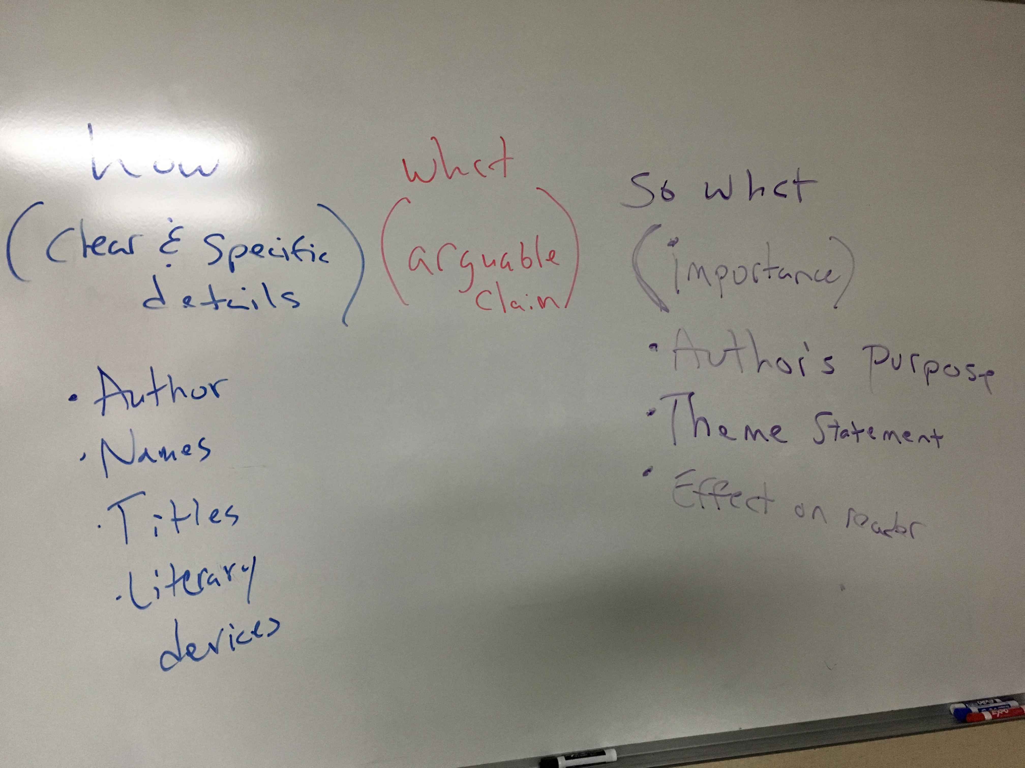
Thesis Editing & Development
Share your thesis statement with a partner
Do they have the three elements?

