Slide 1
Journal #11: Graphic Novel Terms
Learning Targets:
Students will be able to define and identify graphic novel terms from Persepolis.
Students will be able to analyze graphic novels.

Slide 2
Graphic Novel Terms
Graphic Novel Terms:
Icon
Gutter
Universality
Amplification through Simplification
Splash
Bleed
Speech and/or Thought Balloons
Emanata
Graphic Weight
Pannel Depth
Foreground, Midground, & Background
Transitions
Moment to Moment
Action to Action
Subject to Subject
Scene to Scene
Aspect to Aspect
Non-Seqitur

Slide 3
Graphic Novel Terms
Graphic novels pair sequential visual art with minimal text to tell a story.
Taken individually, the pictures in a cartoon are merely that– pictures.
However when pictures are part of an intentional sequence, the ‘art of the picture’ is transformed into the art of comics.

Slide 4
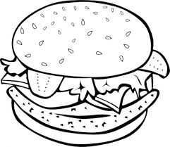
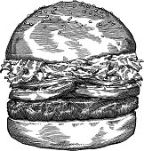
Icon: any image used to represent a person, place, thing, or idea
In a graphic novel we would call all of the following “icons” not images, symbols, or characters…
A

Slide 5
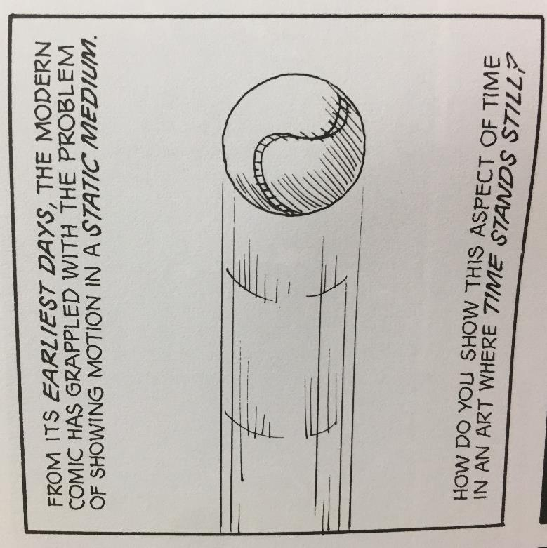
Icon: any image used to represent a person, place, thing, or idea

Slide 6
Icon: any image used to represent a person, place, thing, or idea

Slide 7
A
“Less Iconic” “More Iconic”
We can say picture meanings are more iconic because their meanings are “fluid and variable.”
Why is the less detailed cheeseburger more iconic than the more detailed cheeseburger?

Slide 8
Pg 46

Slide 9
Amplification Through Simplification:
What does Amplification through Simplification mean?

Slide 10
Amplification Through Simplification & the Universality Effect
The “cartoon” face appeals to wider audiences; it could describe a character who’s young or old, male or female, etc.

Slide 11
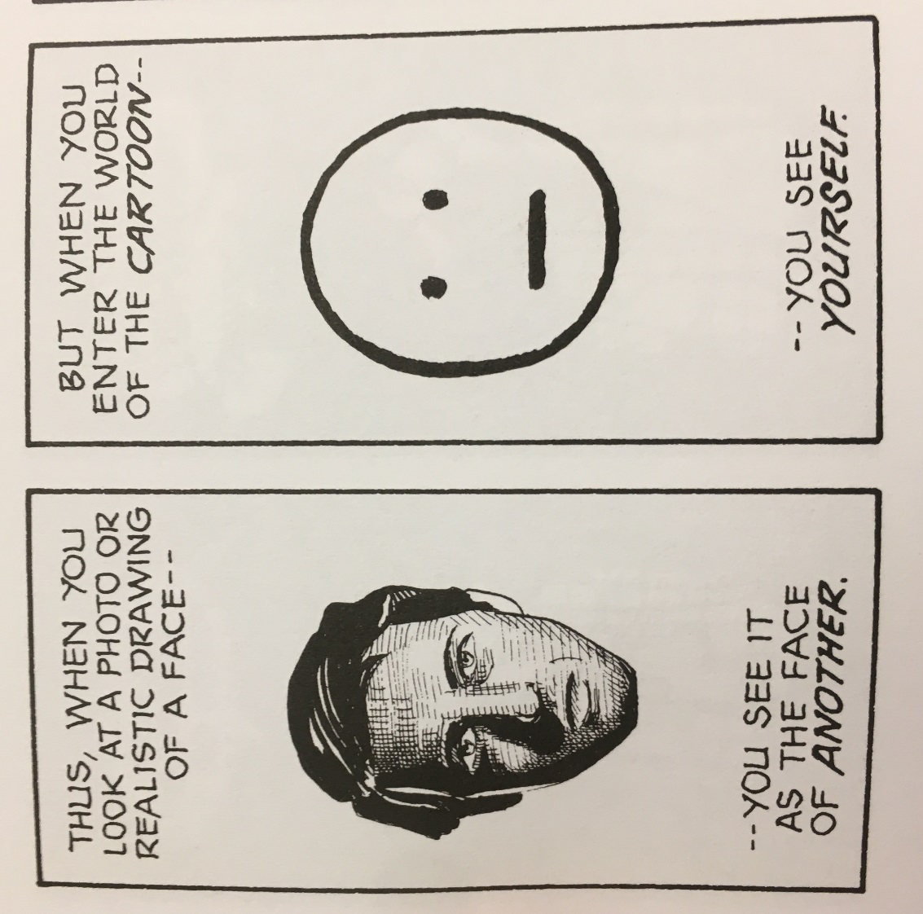
Amplification Through Simplification & the Universality Effect

Slide 12
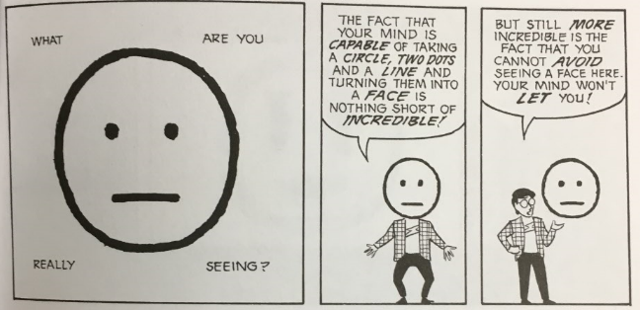
Why cartoons can be more powerful than words…

Slide 13
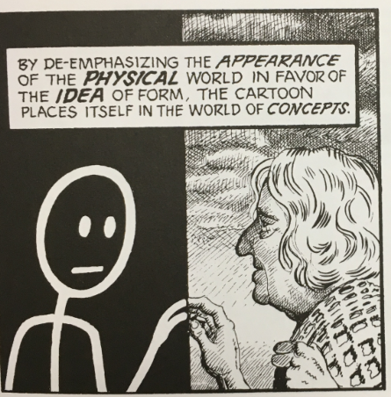
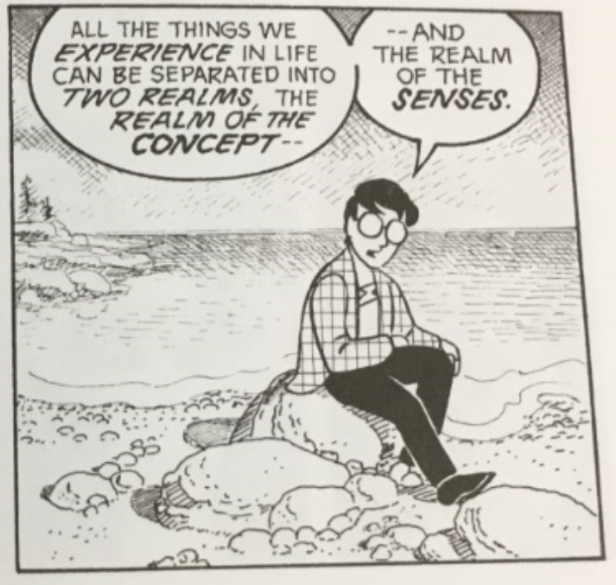
Why cartoons can be more powerful than words…

Slide 14
PANELS
PANELS: each framed image
Panels offer the reader a specific perspective (P.O.V.) through which they view the subject

Slide 15
GUTTERS
GUTTERS: the space between each panel
GUTTERS provide transitions; something happens in that gutter space, but the reader must “fill in” that information
GUTTER

Slide 16
PANELS + GUTTERS

Slide 17
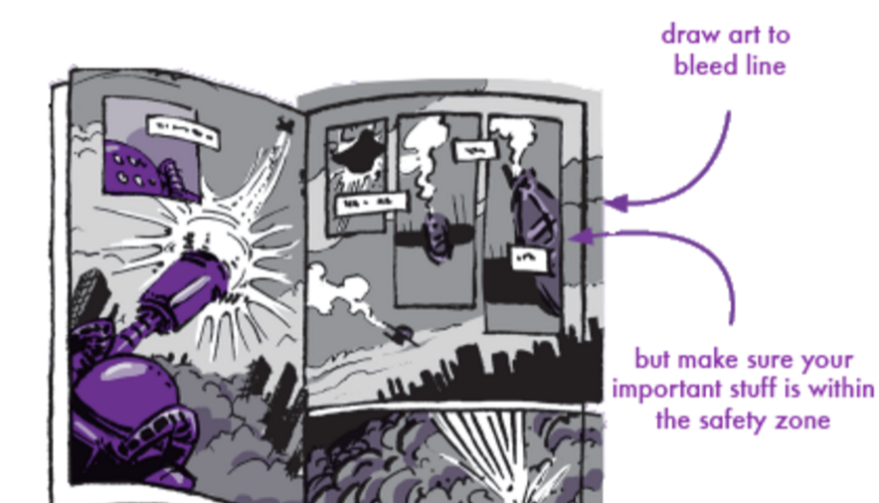
SPLASH & BLEED
SPLASH: A splash is a type of panel that spans the width of the page; a splash is used to grab the reader’s attention, and often establishes setting/time/place/mood
BLEED: A panel that runs off the page—or seems to “bleed” beyond the edges of the paper—is called a BLEED.

Slide 18
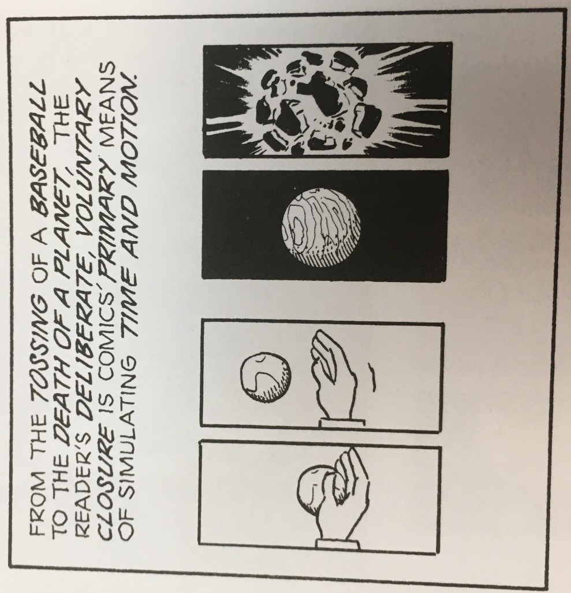
“Closure”:
Closure in comics is the "phenomenon of observing the parts but perceiving the whole" (McCloud 63). In other words, closure is the act of mentally filling in the gaps of what we observe, thus allowing readers to comprehend the action and meaning between two seemingly unrelated panels.

Slide 19
CAPTIONS, SPEECH BALLOONS, & EMANATA
CAPTIONS: (Boxed) words that give voice to the narrator.
SPEECH BALLOONS: Balloons extending from characters’ mouths which contain dialogue (aka, character speech); if the speech balloon is drawn using jagged lines, the character is shouting.
EMANATA: Artistic representations of feelings, emotions or movement, such as: tear drops, sweat drops, exclamation marks, question marks, and/or motion lines.

Slide 20
THOUGHT BALLOONS
THOUGHT BALLOONS: Clouds that contain a character’s thoughts.

Slide 21
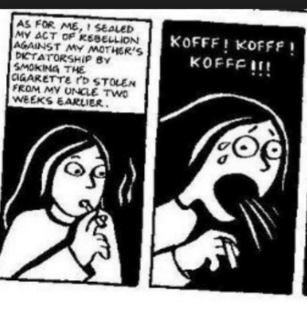
EMANATA & CAPTION (A COUPLE EXAMPLES…)
CAPTION

Slide 22
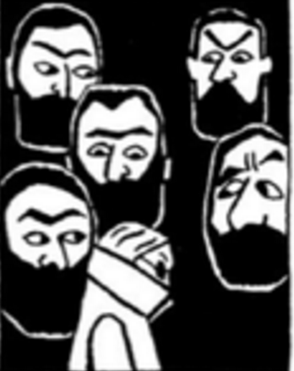
GRAPAHIC WEIGHT
GRAPHIC WEIGHT: The term used to discuss the amount of contrast in an image; are blacks offset with whites? Is vivid color used amidst muted colors? What stands out?
Adds emphasis to certain icons within a panel
Creates comparison

Slide 23
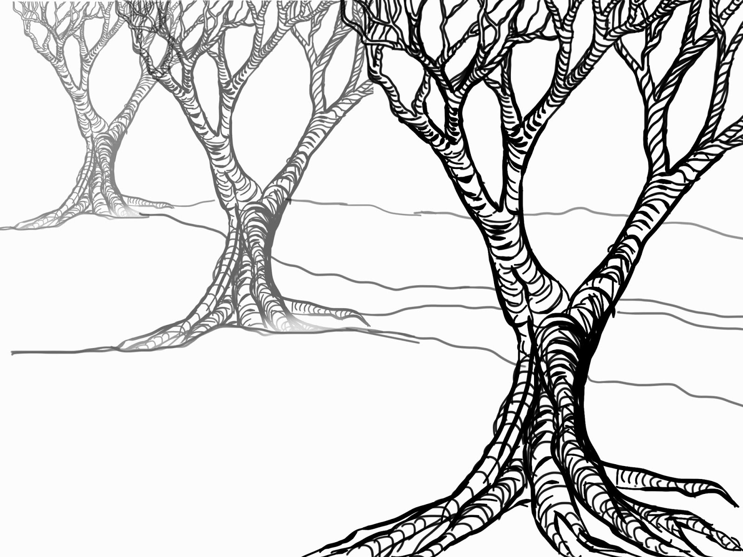
PANEL DEPTH
FOREGROUND: What’s depicted
closest to the reader; this is usually the subject.
MIDGROUND: Subjects depicted in the middle of the scene, in front of a background/setting
BACKGROUND: The objects that are furthest from the reader, usually conveying setting/ contextual details.

Slide 24
TRANSITIONS
TRANSITIONS occur within the “gutter” space between panels. Artists rely on the reader’s ability to create “closure” (aka, infer what happened during the gutter) to fill in missing information.

Slide 25
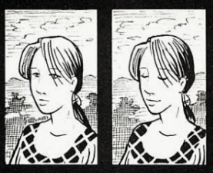
1) THE “MOMENT TO MOMENT” TRANSITION
transitions cover a few seconds in time; thus, they require very little from readers, and make the story’s pace seem rather slow. That said, each moment has an important feel, as its given it’s own panel.

Slide 26
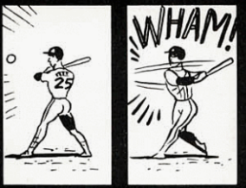
2) THE “ACTION TO ACTION” TRANSITION
transitions use the gutter to cover the bulk of a specific action. The first panel shows the start of an action, and the next panel shows the action being completed.

Slide 27
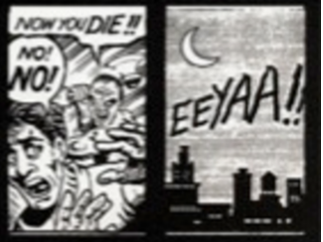
3) THE “SUBJECT TO SUBJECT” TRANSITION
this transition shifts both time and subject; in this case, the viewer sees another ‘subject’ in the story, offering a different perspective

Slide 28
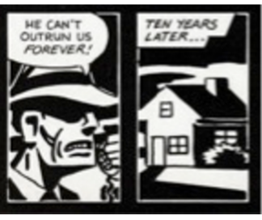
4) THE “SCENE TO SCENE” TRANSITION
A jump in time and/or place. This type of transition forces the reader to fill in a lot of information, because shifts in time and/or place occurred in the gutter space.

Slide 29
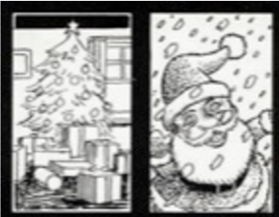
5) THE “ASPECT TO ASPECT” TRANSITION
This transition provides a “wandering eye”, as time is frozen, and the panels provide various perspectives or aspects of the same place, idea, or mood.

Slide 30
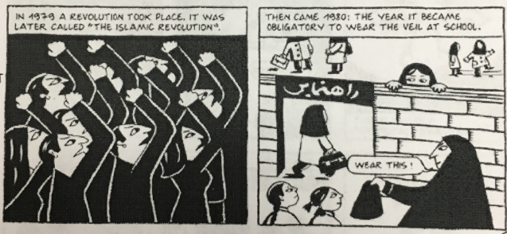
6) THE “NON-SEQUITUR” TRANSITION
This transition jumps from one moment and subject, to something seemingly unrelated. The connection between the two panels might not become clear until much later in the story.

