Slide 1
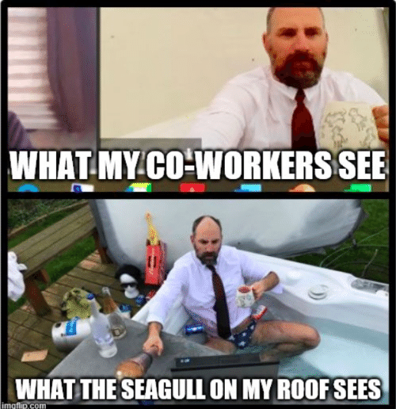
Group Video Conference Discussions
In this PPT:
Purpose
Procedures
Grading
Etiquette
Technology
FAQ
Groups

Slide 2
Group Video Conference Discussions
Purpose/Rationale:
interpersonal communication and collaboration are essential to learning
social distancing has left many people feeling lonely
most of the judgements people make about us are based off our verbal communication skills
practice teamwork, leadership, and other soft skills

Slide 3
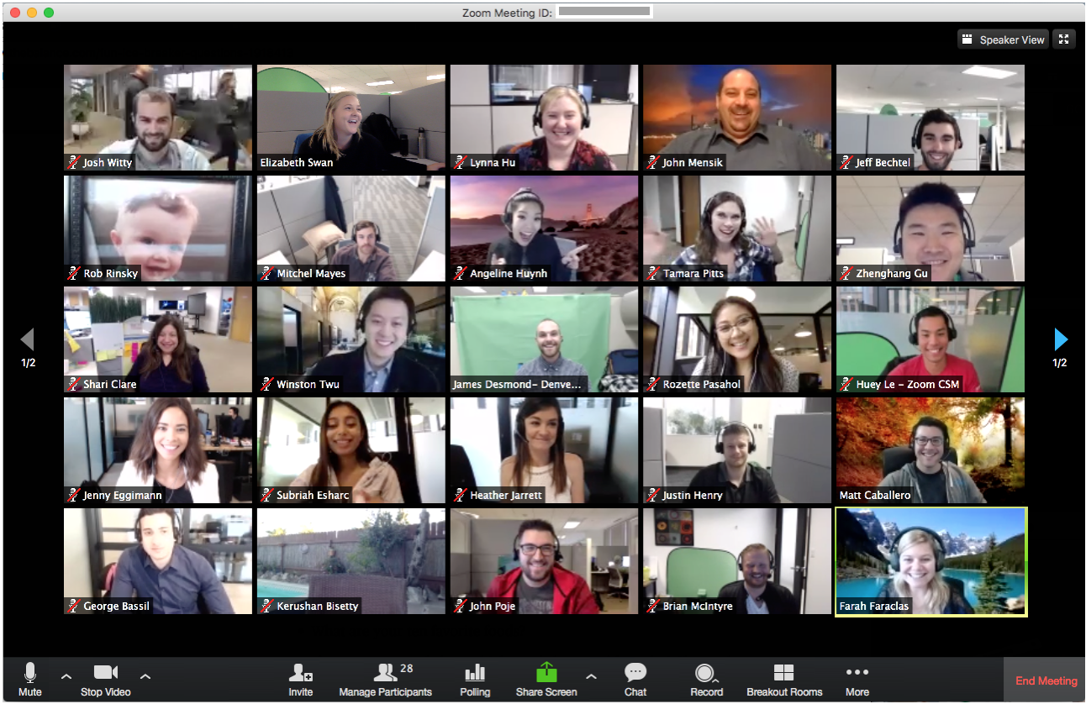
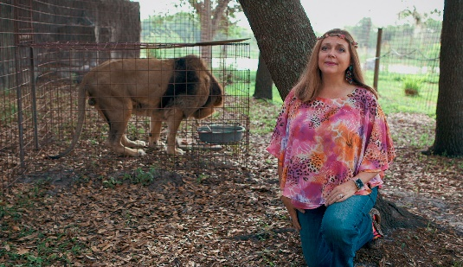
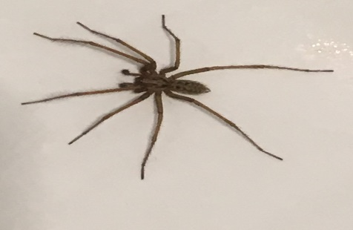
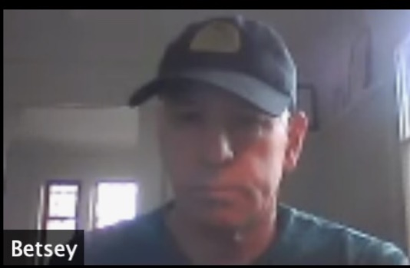
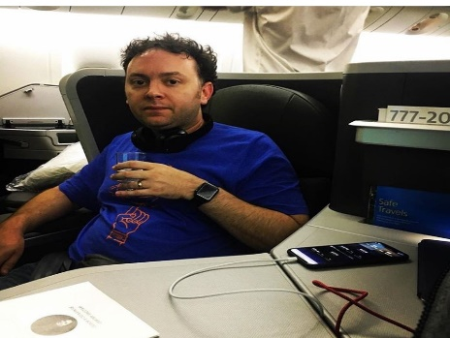
Smith’s Worst Zoom Group Ever??

Slide 4
Group Video Conference Discussions
Procedure(s):
Groups will coordinate a time between Friday and Monday that works for everyone*
Only one person needs to share with Smith
Groups will decide what platform to use.
Smith doesn’t care, as long as it can be recorded (audio and video) and shared**
Discussions must last at least 20 minutes
There are 8-10 of you, you’ll be talking about a whole week’s worth of content each time.
First week can be 15 minutes.

Slide 5
Group Video Conference Discussions
Grading:
I plan on giving individual grades for most discussions, similar to how Socratic Seminars are scored:
Analysis and Evidence and Interesting Comments are more important.
Summary, questions, and plot aren’t worth much.
Process/Participation points, esp. for now.

Slide 6
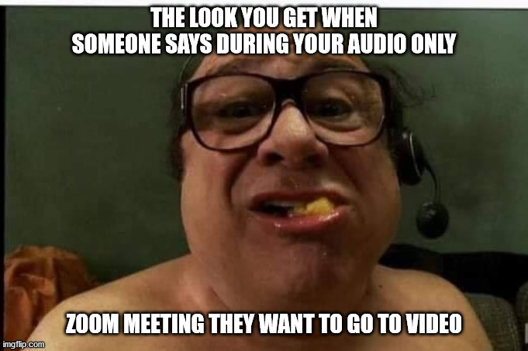
Group Video Conference Discussions
Etiquette:
Wear pants and a shirt, even if you are outside enjoying the sun.
Be on time and be prepared.
Avoid loud chewing.
BE NICE.
Utilize a group leader to keep the conversation flowing smoothly and coordinate.
This is not multitasking time.
Try and have fun. Feel free to be silly*, showoff your pets, do icebreakers, etc. before or after. (Does not count as graded content). *no jokes which disparage classes of people, ethnicity, ability, gender, etc.

Slide 7
Group Video Conference Discussions
Technology:
How to Record Meeting:
Zoom: https://www.youtube.com/watch?v=lZHSAMd89JE
MS Teams: https://www.youtube.com/watch?v=UlSxTqi5dKs
Test your audio/video
If the file of your conversation is too large to attach to an email, upload to Onedrive or google drive and share with smithk5@issaquah.wednet.edu

Slide 8
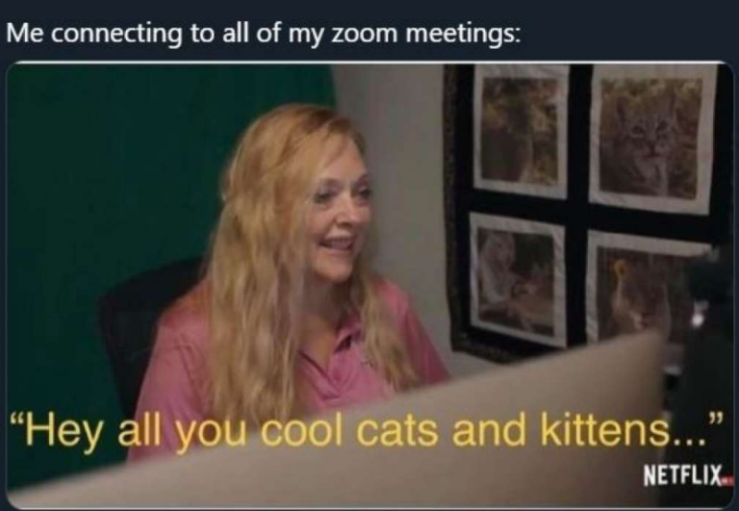
Group Video Conference Discussions
Technology: (CONT.)
Zoom has less than stellar privacy settings, so think about using these settings:
https://drive.google.com/file/d/1aAzbOWdnEb1oEfq0XVGqkAj_hvcdG_5h/view?fbclid=IwAR1CiPCXIqW6QqwDHOfiGfrNBK8GM2PlP2521n4sU9RFpWi-pNB4BihYb9Q

Slide 9
Group Video Conference Discussions
FAQ:
Q: What if I miss my group’s discussion?
A: You need to let Smith know before your group discusses, but you really should be able to make it. Smith will tell you to find another group to join. Think about this like ‘excused’ or ‘not excused’ attendance.
Q: Do I have to have my camera on?
A: No, you do not; you safety and privacy are important to Smith. However, some week’s discussion might require you to ‘show’ your work. Also consider people find it more enjoyable when everyone is visible, and it is easier to participate if people can see you.
Q: What if someone in my group isn’t responding to planning communications?
A: Give them a reasonable amount of time to respond, especially the early weeks. Then let Smith know and move on. If this is for your first chat then Smith will pass on contact info.

Slide 10
Group Video Conference Discussions
Groups: Second (2nd) period
Group 1
Emma P.
Anna Z.
Julia W.
Zach F.
Markus T.
Emilio B.
Brayden A.
Mak R.
Group 2
Ethan K.
T.J. Y.
Ben M.
Steve B.
Zoe C.
Rapha G.
Lydia K.
Olivia M.
Group 3
Aryaman J.
Enya S.
Seher T.
Emmet B.
Julia J.
Quinn E.
Chloe K.
Brooke O.
Group 4
Nick M.
Josh S.
Trevor G.
Addison R.
Saul R.
Hugo M.
Mansi J.
Mariya B.

Slide 11
Group Video Conference Discussions
Groups: Fifth (5th) period
Group 1
Leo S.
Suraj N.
Aniket T.
Noah F.
Cole F.
Will B.
Ethan B.
Luke R.
Group 2
Jaylen H.
Andrew W.
Dennis B.
Maddie R.
J. Peter
Lauren P.
KT S.
Elena S.
Group 3
Evelyn S.
Parker A.
Olivia E.
Haydn F.
Colby B.
Peyton H.
Annaliese R.
Donby M.
Group 4
Carlos G.
Garrett S.
Cooper C.
Eric Y.
Tyler R.
Ibrahim N.
Kyle K.
Bill H.

