Slide 1
Why are quiz grades SO low??
Class | AF 4-6 + Satire and Humor | AF 1-3 + Russian Revolution
2nd | 55.6% | 62.0%
4th | 64.2% | 72.3%
5th | 58.4% | 65.8%

Slide 3
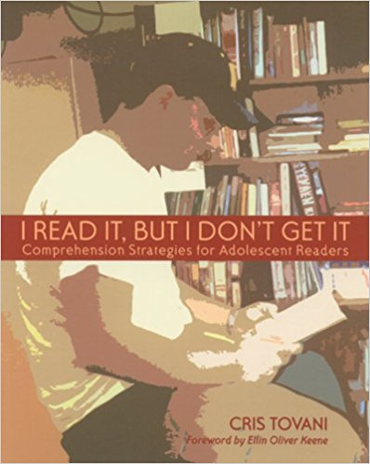
Journal #12: I Read It, But I Don’t Get It
Learning Targets:
Students will be able to monitor their own reading and realize when they are reading ineffectively.
Students will be able to apply reading strategies to produce better results.

Slide 4
What is reading? What is going on in your head while you read?

Slide 5
What do good readers do?

Slide 6
How do you know when you are stuck while reading?
“If students can recognize signals that indicate confusion, they can stop temporarily and decide how to help themselves.”
Second voice in “reader’s head isn’t interacting with the text.” [First voice reads the words]
No picture in head of what they are reading
“Mind begins to wander”
“Reader can’t remember what has been read.”
“Literal questions to clarify meaning can’t be answered.”
Can’t identify when a familiar character was introduced/can’t remember a character

Slide 7
The Seven Strategies that Successful Readers Use (from I Read It, But I Don’t Get It)
“They use existing knowledge to make sense of new information”
“They ask questions about the text, before, during, and after reading”
“They draw inferences from the text”
“They monitor their comprehension”
“They determine what is important”
“They synthesize information to create meaning”

Slide 8
The Seven Strategies that Successful Readers Use (from I Read It, But I Don’t Get It)
7. “They use ‘fix-it’ strategies when meaning breaks down” Fix-it strategies:
Make a connection between the text and your life, your knowledge of the world, or another text
Make a prediction: “Good readers anticipate what’s coming next (events, information, etc.)… if it doesn’t happen like you expect, then you need to check your understanding”
“Stop and think about what you already read”
“Ask a question”: when the text answers these questions it clarifies meaning or if there isn’t an answer maybe the question wasn’t important
Write about what you’ve read: summary or questions
“visualize”: what can you ‘see’?
“use print conventions”: tables and bold words can help to determine what is important
Retell what you have read
“Reread”
“Speed up or slow down your reading”: either too fast OR too slow can hurt your comprehension

Slide 9
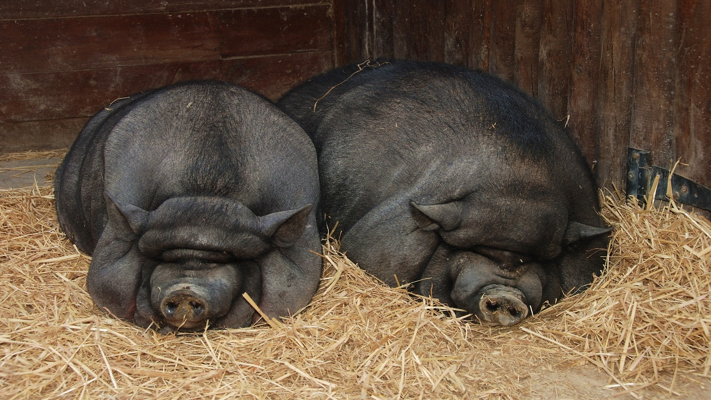
HW: Read Chapter 8 of Animal Farm
Follow the highlighting directions
and
Apply two different Fix-It Strategies

