Slide 1
What should the goals of any piece of writing be?
Be direct and clear
Prove your own ethos, knowledge, and reading
Be succinct, yet complex and nuanced* in analysis
*a subtle difference in or shade of meaning, expression, or sound.

Slide 2
Teaching Analysis feels like…

Slide 3
Improving Analysis
What is analysis?
What is good analysis?
What isn’t analysis?
Analyze the following passage:
“Obedience is not enough. Unless [mankind] is suffering, how can you be sure that he is obeying your will and not his own? Power is in inflicting pain and humiliation. Power is in tearing human minds to pieces and putting them together again in new shapes of your own choosing.” (266).

Slide 4
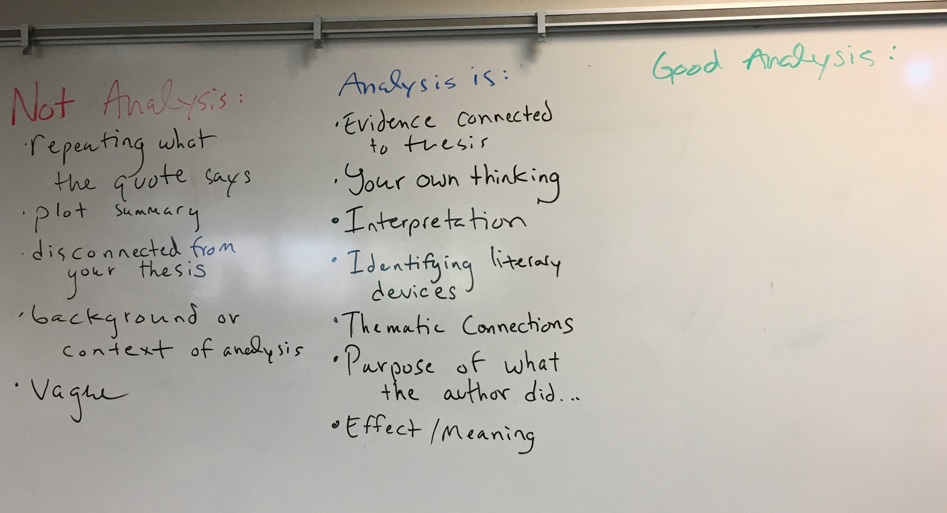
Improving Analysis
What is analysis?
What is good analysis?
What isn’t analysis?

Slide 5
Students say good analysis is…
Your own thinking and interpretation that is unique and abstract.
Not only connecting evidence to your claim, but also explaining HOW and WHY.
WHY this quote is what you claim it is.
“Quote” is an example of juxtaposition or characterization or symbolism, because…
HOW it impacted the text.
Identifying and explaining literary devices & techniques, as well as the effects and purpose.
Choices the author made and their significance/impact.
Synthesis of multiple ideas and places from the text.
Detailed and very specific.
Shows your deeper understanding clearly.
Focused on your thesis statements’ “SO WHAT” and themes.

Slide 6
Smith says good analysis is…
Synthesize other elements together
Interpret deeper meaning
From literal/narrative to figurative or analytical meanings
How is your evidence prove your claim?
Justify its value and relevance to your point→ how is this an allusion?
Explain:
Connections
Conclusions
Interpret the meaning of specific words → When O’Brien says “power” what he means is dominance and control.
literary terms → if evidence includes irony, mention it! Even if writing about symbolism.
Explain the connection of evidence to thesis’ “so what”
Explains development of ideas, or progression
ANALYSIS IS FROM YOUR BRAIN– not things explicitly said in the text.

Slide 7
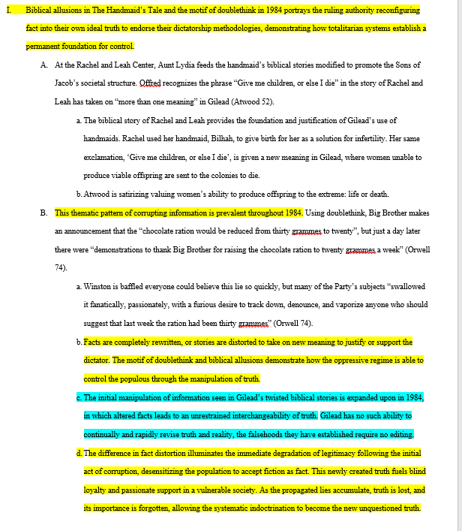
Visualization of an outline body paragraph with comparative analysis highlighted
Look at the outline on my website.
Try and classify what types of analysis this student did.
What types of comparisons?
What connections are made?
What percentage of this body paragraph is comparative?
How did the writer use nuance?

Slide 8
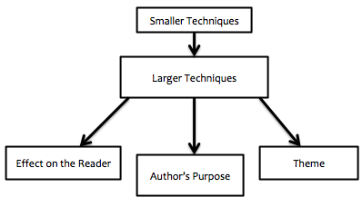
Smith says good analysis is…
Evidence →
Analysis →

Slide 9
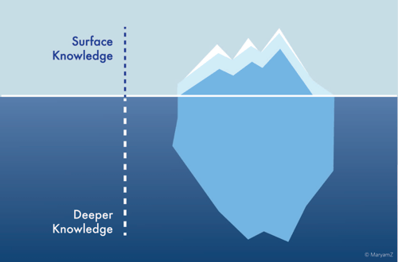
Iceberg Metaphor
The iceberg metaphor states that any work of literature has two different levels of complexity and meaning.
The first level is the Surface Knowledge.
The second level is Deeper Knowledge.
Why might an iceberg be a good metaphor for literature?

Slide 10
Iceberg Metaphor
Let’s look at Bless Me, Ultima:
The top of the iceberg contains the plot of BMU.
A boy’s magical friend comes as he grows up. He becomes confused about religion and experiences many gods. There are witches and a bad guy. Ultima dies.
According to the Iceberg Theory this only makes up about 10% of the novel.

Slide 11
Iceberg Metaphor
Let’s look at Bless Me, Ultima:
What sort of things would the bottom; or hidden deeper knowledge of the novel contain?

Slide 12
Iceberg Metaphor
What relationship might the Iceberg Theory have to writing Body Paragraphs?
In body paragraphs we can think that our EVIDENCE is surface level information from the text, i.e. a quotation.
Our ANALYSIS is explaining how that evidence works to prove our thesis’ claim on a deeper level. We are essentially explaining the deeper contents of the literary work.

