Slide 1
Integrated Essay: Introduction Paragraph
Think of your introduction paragraph as a funnel, it should gradually get more focused and specific as it funnels from you engaging HOOK to YOUR THESIS.

Slide 2
Integrated Essay: Introduction Paragraph
HOOK: Engage your readers.
PURPOSE: Briefly explain the context and/or purpose for you essay.
ETHOS: Show the reader your knowledge by explaining key term(s, phrase(s), or people.
Thesis Statement.
Ethos: means the credibility, trustworthiness, or knowledge of the speaker or writer. Prove to your readers you understand the literary, cultural or other terms/techniques you’re writing about by explaining them in your own words.

Slide 3
A. HOOK
A successful hook will be broad, interesting, and engaging for readers. An amazing hook will be very meaningful even after the reader has finished reading your essay. There are a few main strategies to do this:
An interesting quotation backwards integrated.
Don’t do a random person or someone unrelated. Example: Don’t use Nelson Mandela unless your paper is about South Africa.
An anecdote (short story), can be personal, needs to be on topic.
A surprising fact related to your topic.
Note: the order of these things is your teachers’ preference. The farther down you go, the more words it takes (bad) plus a hook is worth approximately between 0-1% of your final grade.
Please never ever:
Ask a rhetorical question. Seriously. There has never been a good one.
Give a dictionary definition. This isn’t 8th grade.

Slide 4
HOOK Examples
Quotes:
Martin Luther King Jr. once said “we must learn to live together as brothers, or we will perish as fools.” (Citation). American in the 1960’s was a divided state.
Notice the integration and citation (good)
Notice the lack of transition (bad) – author did not address the quote.
Notice the ‘Person once said’ structure (bad)
“‘Gentlemen,’ concluded Mr. Pilkington, ‘gentlemen, I give you a toast: To the prosperity of Animal Farm!’” in the narratives Animal Farm and Persepolis the working class is mistreated to benefit those governing them (Orwell 138).
Notice how it is ‘backwards’ integrated (good)
“There is power here, power that can fill a man with satisfaction,” in Bless Me, Ultima Antonio is surrounded by a world with competing powers that call into question his beliefs and identity (Anaya 229).

Slide 5
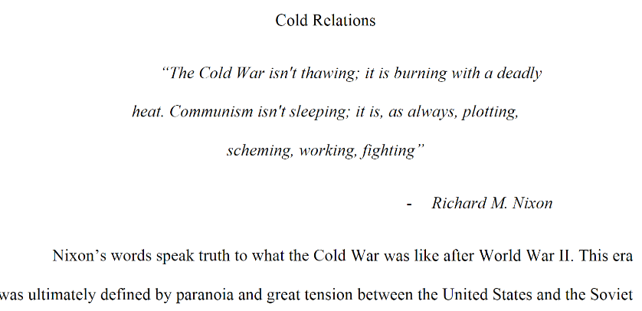
Not OK
Not Integrated if it is your sub title

Slide 6
HOOK Examples
Ancedote:
My great grandmother, ​Бронислава, nearly spent half of her life in the Gulag, an organized labor camp that many people died in, just because she only slightly voiced her dissent to the false grounds of arresting for her classmates. This small act that nearly ended my great grandmother's life accentuates the brutal tendencies that follow totalitarian governments. In both Animal Farm and Persepolis by…
Notice how this student has a clear and short personal connection (good)
We won’t all have this sort of personal connection to make but an impersonal anecdote is fine, but it should be something you read about in your research.
Notice how the author did not stay in third person (“My great…”) (bad, but barely okay)

Slide 7
B. Context/Purpose
For your context/purpose component you’ll need to decide first: Is my paper primarily about history or literature? The answer is what you will focus on here, however you’ll want to connect the two together as best you can. Introduce your reader to:
WHO: what people are you discussion in your paper and broadly, who are they? Definitely consider including Achebe if he makes up a lot of your essay.
WHAT: what events are relevant to you topic? Do not spend too much time broadly describing colonialism or missionaries, be specific to your paper.
WHERE: duh.
WHEN: timeframe, chronology. Doesn’t need to be it’s own sentence.
WHY: what is your purpose for making the topic, research, and task choices you’ve made? Example: why are you comparing South Africa to Nigeria?

Slide 8
C. ETHOS
Develop your own ethos and show your reader your intelligence. What terms do they need to know? Think about the terms in your thesis, context/purpose, and body paragraphs. Explaining these things clearly here helps you write better analysis and it helps clarify your individual ideas. Historians and academics of all fields spend a lot of time setting up the definitions and key terms of phrases the way which will strengthen their arguments and analysis. These terms will probably be things Smith, Santos, or your research taught you. Examples:
Literary Terms
Historical terms, like ‘homogenization’
Ideas like the ‘stereotypes of Africa’ (explain what that is)
Phrases you invented in your thesis, like “culturally weakened society” in this thesis: “Imperialism in Africa was spread by Christian missionaries through the promise of purpose and the normalization of Christianity, consequently creating a culturally weakened society that was able to be manipulated and profited from.”

Slide 9
Example Introduction Paragraph: [Since this is a new paper, this example is a past things Fall Apart Essay Color-coded]
“The single story creates stereotypes, and the problem with stereotypes is not that they are untrue, but that they are incomplete. They make one story become the only story,” while the single story of Africa created many negative stereotypes, Achebe wrote ​Things Fall Apart ​ to refute not only the single story of African culture, but also of colonialism (Adichie). A single story is the repeated use of one perspective to create a superficial reality. For three years Ikemefuna, an ill-fated boy, lives with Okonkwo, a man of high status, in Umuofia. Ikemefuna bonds with Okonkwo and his family. However, after Okonkwo kills Ikemefuna under the orders of the Oracle, Nwoye, Okonkwo’s eldest son, is haunted by questions of his culture’s choices. When Christianity is introduced to the tribe, Nwoye abandons Igbo tradition. Allusions are a brief and indirect reference to a person, place, thing or idea of historical, cultural, literary or political significance. The use of allusions enables writers or poets to simplify complex ideas and emotions. In ​Things Fall Apart, Achebe’s denunciation of single stories is shown through his Christian bias and biblical allusions, demonstrating his criticism of Igbo culture and his idealization of the church.

Slide 10
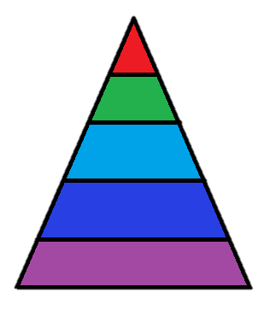
Introductions and conclusions: A Visual
HOOK:
CONTEXT/ PURPOSE.
ETHOS.
Thesis Statement.
Restated, in different words, your argument or thesis.
Summarize the evidence you used (body paragraphs) to prove your thesis
A citation from a piece of research: OPTIONAL
Final explanation of the “so what”
Concluding Final Thought:
NOTE: C. and D. can be flipped, if it makes more sense for your conclusion.

Slide 11
Conclusion Paragraph
Restated, in different words, your argument or thesis.
Summarize the evidence you used (body paragraphs) to prove your thesis
A citation from a piece of your research: not more evidence, just anything left over. OPTIONAL!
Final explanation of the “so what”
Concluding Final Thought: broad, universal final thought that feels like a conclusion.
Purpose of a conclusion:
Restate your thesis
Synthesize your evidence together, don’t repeat.
Closure.
Think of your conclusion paragraph as the opposite of your introduction funnel, it should gradually get more universal and culminating as it funnels from your specific YOUR THESIS to a satisfying, FINAL THOUGHT.

Slide 12
BMU Conclusion Paragraph Example (NOTE: not aligned with earlier example of INTRO)
Restated, in different words, your argument or thesis: Anaya’s novel Bless Me, Ultima was able to create a meaningful example of juxtaposition between Ultima’s cures and Catholicism, which showed Antonio the advantages from incorporating syncretism into life; teaching Antonio to grow by accepting his own truths.
Summarize the evidence you used (body paragraphs) to prove your thesis: Anaya proved god was not the only way to resolve problems, a mixture of religion and culture is necessary for growth, and that judgment is part of syncretism.
A citation from a piece of research: The juxtaposition found in Bless Me, Ultima is an enlightening creation, able to bring harmony between two distinct cultures without war: “wisdom and experience allow one to look beyond difference to behold unity,” (Kanoza 1999).
Final explanation of the “so what”: Anaya’s purpose of promoting syncretism was exceptionally described through Ultima’s cures juxtaposed with Catholicism in his novel.
Concluding Final Thought: For this reason, Anaya’s novel disseminated a whole new genre among American readers: Chicano Literature.

Slide 13
Horrible Conclusion paragraph from a real historian

Slide 14
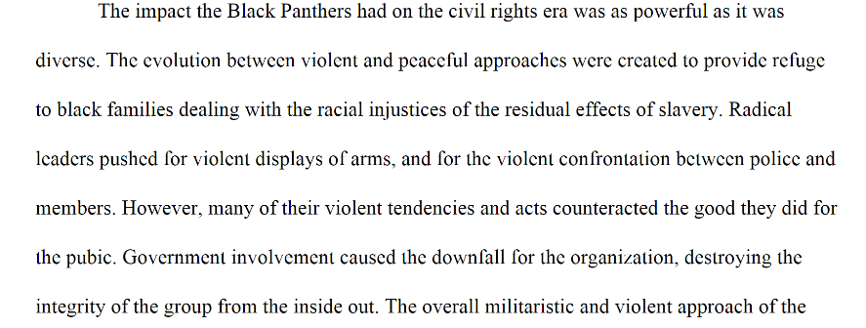
Conclusion

Slide 15
Phrases to Avoid
To begin with
In Conclusion
All in all/overall
First, secondly, thirdly, lastly (you are not making a list, you are proving an argument)
This shows that, This proves, etc…
Clearly, Obviously, …

Slide 16
Phrases to Watch
It is clear (must be supported)
Opinion statements!!
Don’t say things like obviously evil/corrupt OR make assumptions without backing it up with clear facts!
Especially with modern issues, don’t take speculation and opinion as fact. Unless there is definitive proof, it is not fact.
Your speculation about the intentions of another country’s leader is NOT fact!!
Ex: North Korea is an obvious threat. Their actions clearly show that they are corrupt and will send the world into war.
This has not been proven!! This is speculation. It is an ongoing conflict that is yet to be resolved (and is currently leaning the opposite way…)

