Slide 1
Journal #8 Writing: Thesis and Outlines
Learning Targets:
Students will be able to identify the parts of a thesis.
Students will be able to create an MLA Outline as a step to prewriting.
Students will be able to write a literary analysis paragraph outline.
Students will be able to follow MLA rules and directions.
Students will be able to write analysis.

Slide 2
Thesis Statements
Three distinct parts:
Clear + Specific Details:
HOW DOES THE AUTHOR?
proper nouns, clear phrasing, titles, author names, lit devices, etc.
Argument/Claim:
WHAT EFFECT DOES IT CREATE?
Cannot be factual, lit analysis, often the answer to your Q
So What:
WHY DOES IT MATTER?
Author’s purpose, theme statement, etc.
Additionally:
third person (no “I” or “you”).
NO evidence or proof
ONLY 1 sentence
Formal writing! (no contractions)

Slide 3
Color Coded Example
In the song, “The Big Parade” by the Lumineers, the parade symbolizes the hidden flaws and fractures within everyday life, ultimately showing that society is flawed, and that people should not take everything at face value.

Slide 4
Difficulty with our language thesis statements:
With your table break your thesis statement into the different columns
Missing something? That’s okay
Work together!
What were your “WHATS”s? I.E. what was your argument about the technique and effect that created Cisnero’s theme statement?
HOW | WHAT | SO WHAT

Slide 5
Difficulty with our language thesis statements:
Many of you failed to make an arguable claim without being given one in a question…
Focus on literary analysis and you’ll always be making a claim that is debatable.
Clear/Specific Details: HOW DOES THE AUTHOR…
Arguable Claim: WHAT EFFECT DOES IT CREATE
SO WHAT?: WHY DOES IT MATTER?

Slide 6
Literary Analysis: it’s all about the effect
Reread “No Speak English” (76-7)
What do you feel?
How does Cisneros make it sad?
“But if it aches in your heart That means that something is working Don't think for once it ain't worth it Don't think for once there's no purpose”
“Run it Up” by Coast Modern*
*song isn’t actually about literary analysis

Slide 7
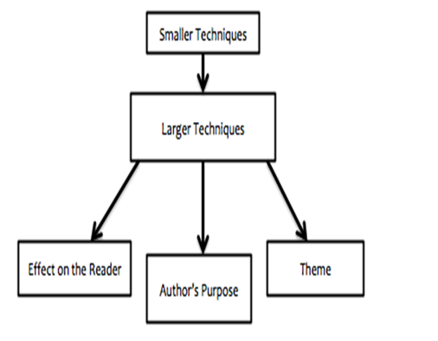
Literary Analysis: it’s all about the effect
??
WHAT techniques makes it sad?
??
=SAD

Slide 8
Read: “Marin” (26-7)
What is the effect of how Sandra Cisneros writes about her?
Who is Marin?
What kinds of words would you use to describe her?
What does she want?

Slide 9
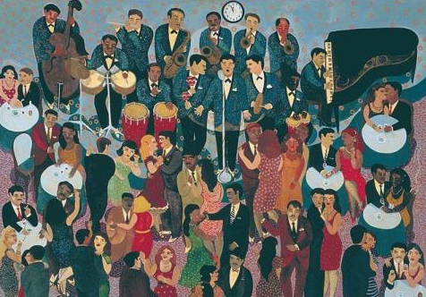
ReRead: “Geraldo No Last Name” (65)
Who was Geraldo? How would you describe him?
How do people describe him?
“brazer”= racist name for a person of Mexican descent
“wetback” = racist name for an immigrant from Mexico
Why would Sandra Cisneros use racist words? What is the purpose for the story? What effect does it create?
Does learning about Marin develop this vignette for us?

Slide 10
“Geraldo No Last Name” (65)
HOW
In “Geraldo No Last Name” Sandra Cisneros uses racist language to…
Practice thesis
??
WHAT
??
??
So What

Slide 11
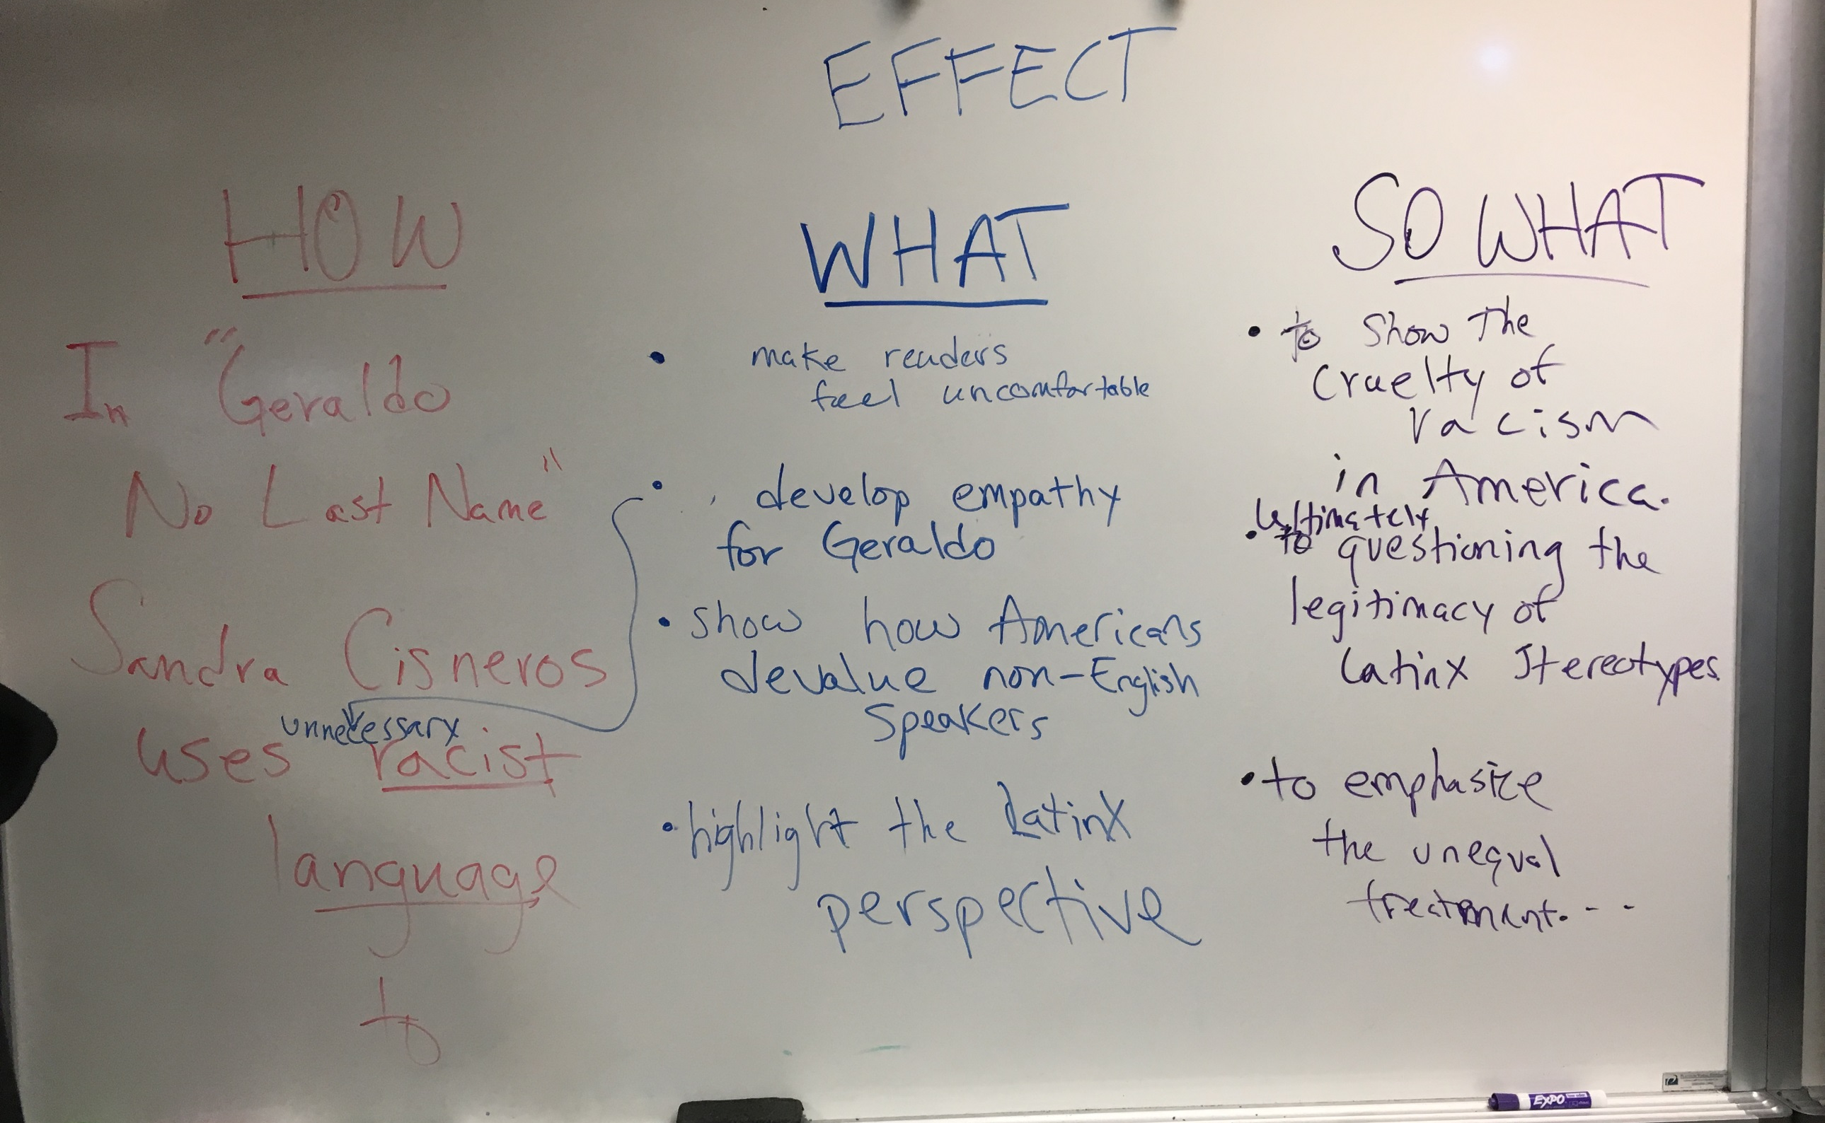

Slide 12
Pull out your symbolism drawing HW
What is life like for these women?
Esperanza in “Four Skinny Trees”:
Mamacita in “No Speak English”:
Rafaela in “Rafaela Who Drinks Coconut & Papaya Juice on Tuesdays”
Minerva in “Minerva Writes Poems”
Esperanza’s great-grandmother in “My Name”:
What do you think a woman sitting by a window symbolizes? How would you explain this?
How does this relate to an effect, purpose or theme statement?
The House On Mango Street is dedicated to “A las Mujeres/To the Women.” Why did Sandra Cisneros do this?

Slide 13
On the back of your drawing write a thesis answering the following question:
What do women sitting by windows symbolize in The House on Mango Street? How does this create or develop a theme or the author’s purpose?

Slide 14
Back to Journal #8 Outlines
For your first big writing assignment, you will be you will be creating an outline. There are rules to follow!
Many teachers assign graded outlines.
For the rest of your high school career in the Humanities department, composing an outline will be one of the first and most important steps you must complete when writing major essays. Think of this assignment as us officially teaching you the future expectations for those papers (and an understanding that you are doing this properly and well now).

Slide 15
First & Last Name Last Name pg#
Teacher Name
Class Name and Period
Due Date Written Out
Title: ________
Thesis Statement: ____________
Body Thesis (Topic) Sentence #1: ____________
Evidence (BTS #1) #1: ____________
Analysis Sentence (Ev. #1) #1: ____________
Analysis Sentence (Ev. #1) #2: ____________
Analysis Sentence (Ev. #1) #3: ____________
Evidence (BTS #1) #2: ____________
Analysis Sentence (Ev. #2) #1: ____________
Analysis Sentence (Ev. #2) #2: ____________
Analysis Sentence (Ev. #2) #3: ____________
Body Thesis (Topic) Sentence #2:

Slide 16
First & Last Name Last Name pg# Teacher Name
Class Name and Period
Due Date Written Out
Title: ________
Thesis Statement: ____________
Body Thesis (Topic) Sentence #1: ____________
Evidence (BTS #1) #1: ____________
Analysis Sentence (Ev. #1) #1: ____________
Analysis Sentence (Ev. #1) #2: ____________
Analysis Sentence (Ev. #1) #3: ____________
Evidence (BTS #1) #2: ____________
Analysis Sentence (Ev. #2) #1: ____________
Analysis Sentence (Ev. #2) #2: ____________
Analysis Sentence (Ev. #2) #3: ____________
Body Thesis (Topic) Sentence #2:
MLA Heading and Title
Order of symbols:
Bullets
Roman Numeral
Uppercase Letters
Lowercase Letters

Slide 17
First & Last Name Last Name pg#
Teacher Name
Class Name and Period
Due Date Written Out
Title: ________
Thesis Statement: ____________
Body Thesis (Topic) Sentence #1: ____________
Evidence (BTS #1) #1: ____________
Analysis Sentence (Ev. #1) #1: ____________
Analysis Sentence (Ev. #1) #2: ____________
Analysis Sentence (Ev. #1) #3: ____________
Evidence (BTS #1) #2: ____________
Analysis Sentence (Ev. #2) #1: ____________
Analysis Sentence (Ev. #2) #2: ____________
Analysis Sentence (Ev. #2) #3: ____________
Body Thesis (Topic) Sentence #2:
Thesis Statement comes first.
Body Thesis/Topic Sentences Come Next.
At least 2 pieces of evidence per paragraph.

Slide 18
First & Last Name Last Name pg#
Teacher Name
Class Name and Period
Due Date Written Out
Title: ________
Thesis Statement: ____________
Body Thesis (Topic) Sentence #1: ____________
Evidence (BTS #1) #1: ____________
Analysis Sentence (Ev. #1) #1: ____________
Analysis Sentence (Ev. #1) #2: ____________
Analysis Sentence (Ev. #1) #3: ____________
Evidence (BTS #1) #2: ____________
Analysis Sentence (Ev. #2) #1: ____________
Analysis Sentence (Ev. #2) #2: ____________
Analysis Sentence (Ev. #2) #3: ____________
Body Thesis (Topic) Sentence #2:
In outlines evidence doesn’t need to be integrated*, though it does need in text citations. *Integrated means attached to your own writing, which is a requirement for rough and final drafts
At SHS we expect 2-3 sentences of analysis for each piece of evidence.

Slide 19
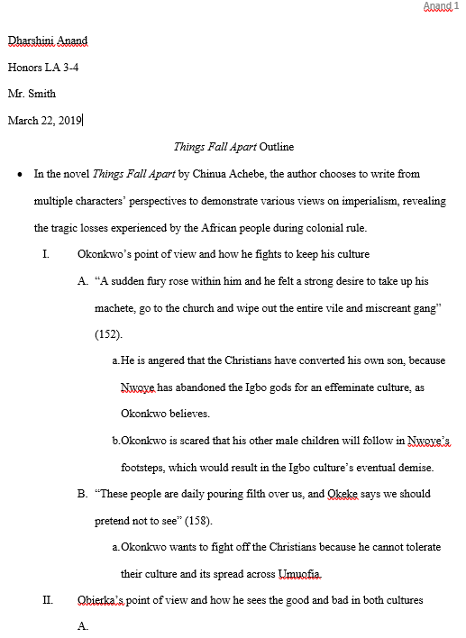
Example

Slide 20
Practice: in your journal create an outline about the symbolism of women sitting by windows.
Use the thesis you just wrote!
For your body topic sentences pick 3 different vignettes and list them!
Find and use evidence from the vignettes.
Write analysis*
*What is analysis?? What kind of ideas or writing make good analysis?

Slide 21
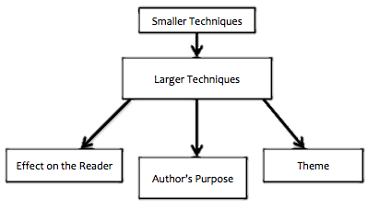
Basic Analysis:
ANALYSIS IS FROM YOUR BRAIN– not things explicitly said in the text.
ONLY IF UNCLEAR: explain what it means in context to narrative.
Elaboration
Interpret evidence’s deeper meaning
From literal/narrative to figurative or analytical meanings
Explain your citation’s relation to the claim
How is your evidence an example of your arguable claim?
Justify its value and relevance to your point
Make a ‘leap’ in explaining:
Connections
Conclusions
cause and effect
literary term
Explain the connection of evidence to thesis’ “so what.”

Slide 22
Practice: in your journal create an outline about the symbolism of women sitting by windows.
Use the thesis you just wrote!
For your body topic sentences pick 2 different vignettes and list them!
Find and use evidence from the vignettes.
Write ACTUAL analysis* supporting your work!
*What is analysis?? What kind of ideas or writing make good analysis?
For this practice, do 1 thesis, 2 BTS, 4 evidence, and 8 analysis total.

