Slide 1
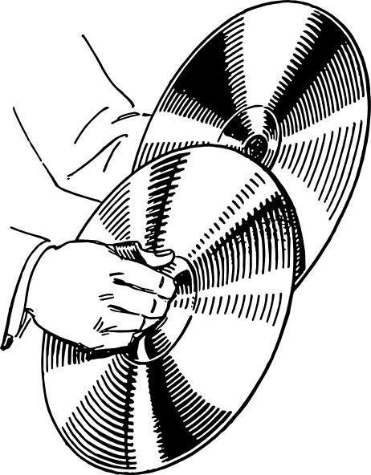
Journal #3: Symbolism
Learning Targets:
Students will be able to identify and explain the meaning of symbols in literature and symbolism’s connection to theme.
Students will be able to define symbolism.

Slide 2
Symbolism Definition:
Any reoccurring object (thing, person, animal, etc.) incorporated into a piece of literature to represent an idea figuratively. Symbolism always relates to theme or the author’s purpose.
What is figurative language?
Symbolism can take different forms. Generally, it is a physical thing representing an idea to give a meaning that is much deeper and more significant.

Slide 3
Example of Symbolism connected to Theme: Kong: Skull Island (2017)
What does the AK-47 symbolically represent in Kong: Skull Island?
https://twitter.com/kongskullisland/status/841333046859116544?lang=en
What symbol did you see??
Theme: “Sometimes an enemy doesn’t exist ‘til you go looking for one.” King Kong wasn’t their enemy, until they started fighting him.

Slide 4
Example of Symbolism connected to Theme: Kong: Skull Island (2017)
Symbol | Idea/Concept | Theme Statement
AK-47 |  | “Sometimes an enemy doesn’t exist ‘til you go looking for one.”

Slide 5
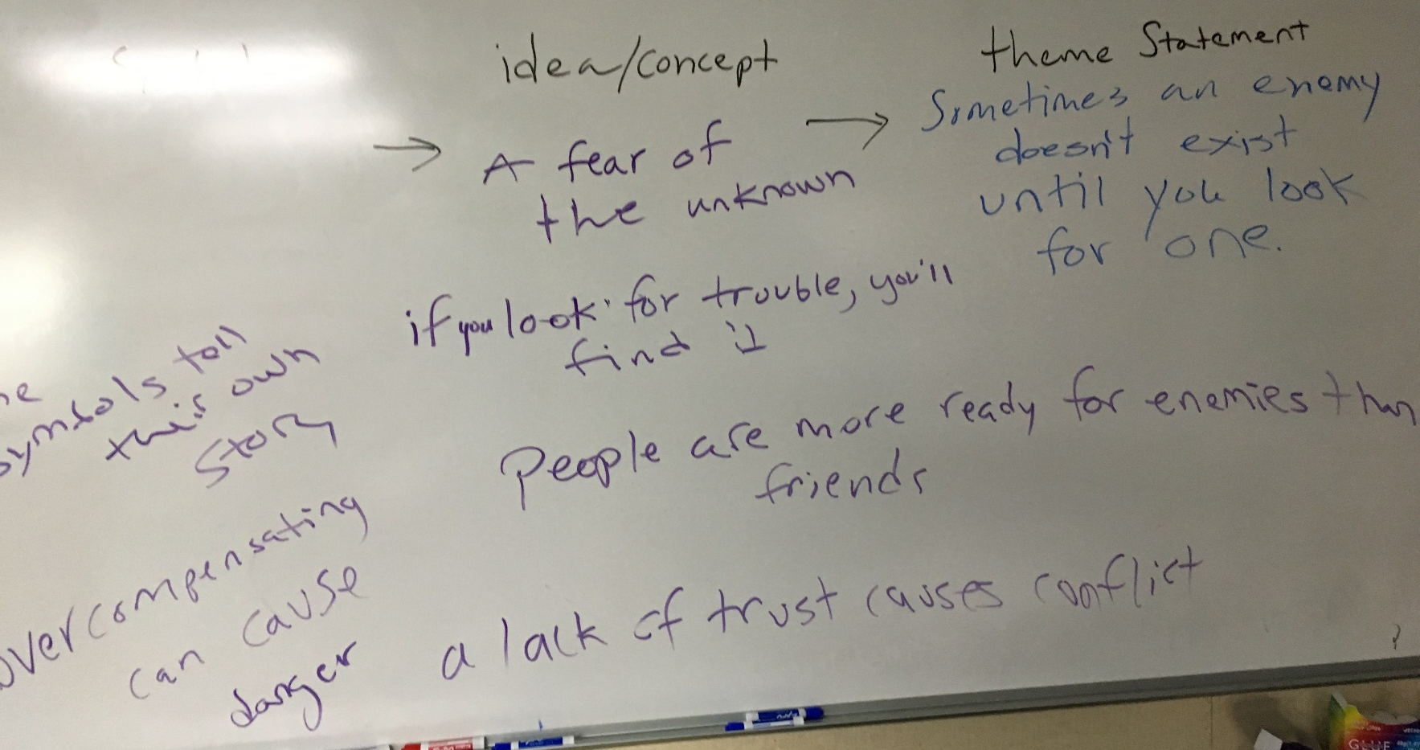

Slide 6
In your own words… what is the relationship between theme and symbolism?

Slide 7
Explain: how theme and symbolism apply to this structure?

Slide 8
Example Symbol
See if you can meet the learning targets from the following video clip from one of Mr. Smith’s favorite movies.
What was the symbol in the clip? How do you know?
What might have been the figurative meaning of the symbol you identified? What did it represent?
What theme does it connect to?
https://www.youtube.com/watch?v=Rsa--lrlw3E

Slide 9
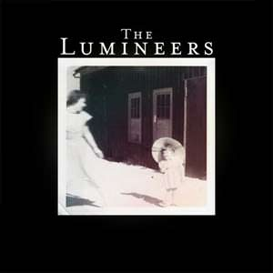
Music! “Big Parade” by The Lumineers
Listen to the song!
What is the song about?
What stands out to you from the lyrics?
What words are confusing?
What’s the structure of the song?
Who’s perspective (“I” voice) is the song from?
What is the theme of the song?
What does the parade symbolize?
What do we know about the Parade?
What is it like?
What feelings do people normally have about parades?
Treat this like a test:
Write a thesis statement about the symbolism and purpose of the song.

Slide 10
After thesis focus questions:
Who is the “I” voice (the person watching the parade)? What do we know about them?
What is the TRUE nature of the parade?
What is the symbol?
What are the theme concepts?
What is significant about “I was blind, I was blind, now I see”?
What do they see?
What are they being saved from?
Is the “I” voice cynical before or after being in love?

Slide 11
Thesis Writing Can Be Hard and Takes Lots of Editing!
In “The Big Parade” the parade symbolizes seeing truth creating the theme of love and truth.
In “The Big Parade” by The Lumineers the parade symbolizes seeing the world how it really is, good or bad, creating the theme statement that love reveals true freedom.
In “The Big Parade” by The Lumineers the parade symbolizes seeing the world as it really is—good or bad—creating the theme statement that love reveals truth.
In “The Big Parade” by The Lumineers the parade symbolizes the singer’s newfound critical eye, after falling in love he can see the cynical quality of the parade; creating the band’s message that love reveals truth—good or bad.

