Slide 1
Directions: Journal #14 HW
Do the learning targets, and heading like normal
Answer the reflection questions
Write, type, or print out the slide with your class’ definition of good analysis.
Apply the knowledge to the sample House on Mango Street outline
Pick 1-2 of the pieces of evidence from the Animal Farm + Persepolis classwork poster and practice writing analysis… Your goal should be to include all the types of analysis on your class’ list.

Slide 2
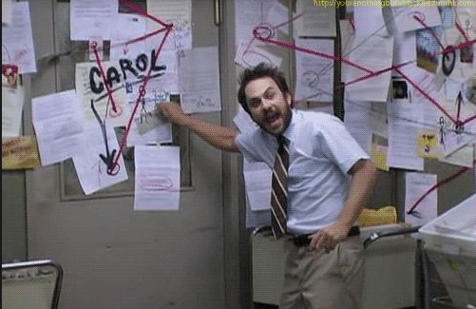
Journal 14: Reflection on Writing
Nobody: *nothing*
Analysis:
Students will be metacognitive about their own writing.
Students will be able to improve their writing of analysis.
Students will be able to apply writing lessons across disciplines.

Slide 3
Reflection on Outlines: YOUR WORK
What’s your reaction to your writing feedback and score as a whole? Avoid writing too much about the score.
What do you need to do to improve according the feedback? Focus on thesis and analysis.
What is a specific goal for your next writing assignment?
What did you do well?
What did you learn from looking at everyone’s feedback?

Slide 4
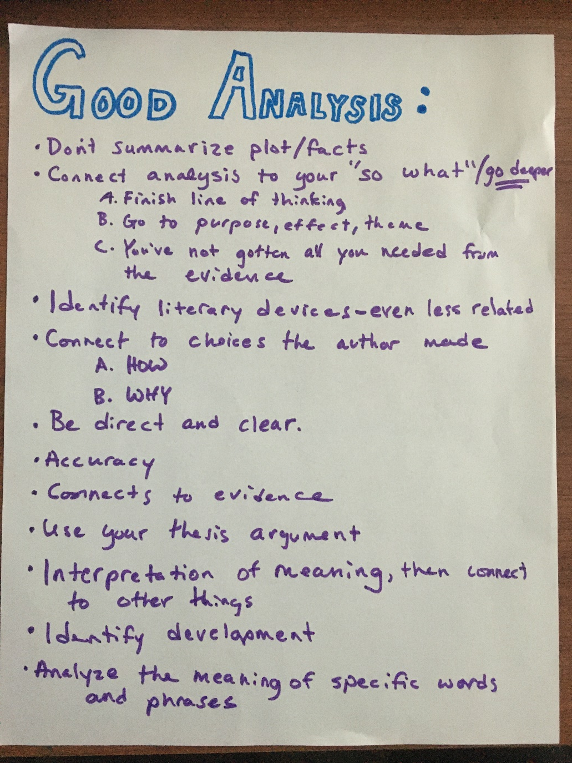
Students Say Good Analysis is:

Slide 5
Reflection on Outlines: Analysis
Some of you introduced analysis really well:
“By using figurative language like similes, Cisneros…”
“The simile allows the cat-calling to be more noticeable and alarming”
“This illustrates how society sexualizes women by…”
“The meaning of the word ‘dangerous’ shows…”
“This is connected to earlier in the novel…”
“Cisneros creates the feeling of sadness here by…”
What do you notice about these introductions? Come up with 3 claims about introducing analysis with your table.
Where did you best introduce analysis?

Slide 6
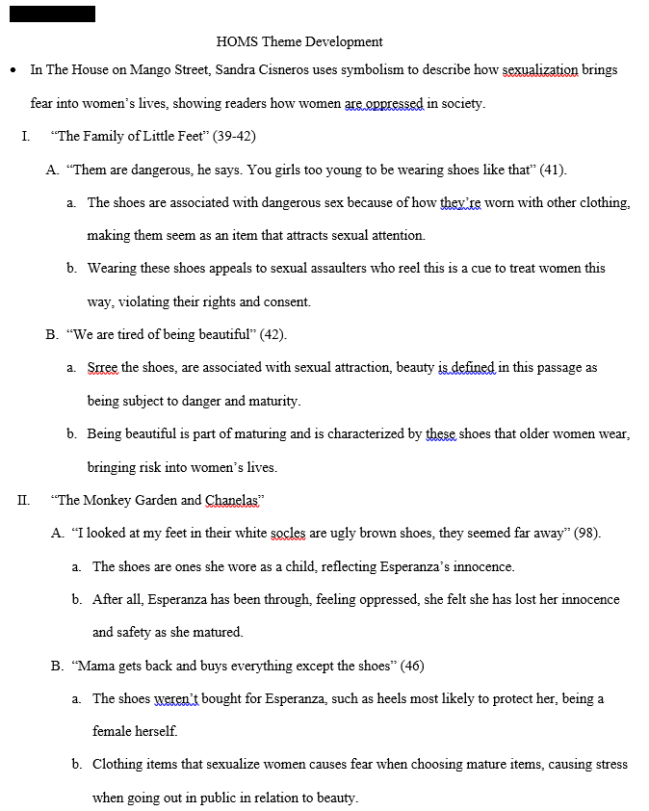
Example
What of the student created analysis techniques did the student use? Identify them.
What can they do to improve their analysis?
Try and write something specific.

Slide 7
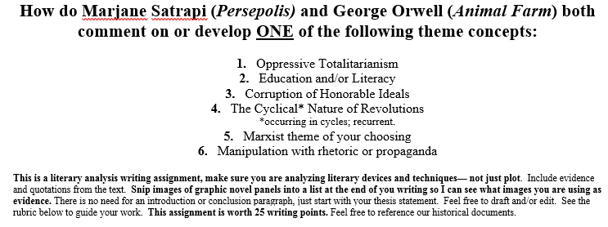
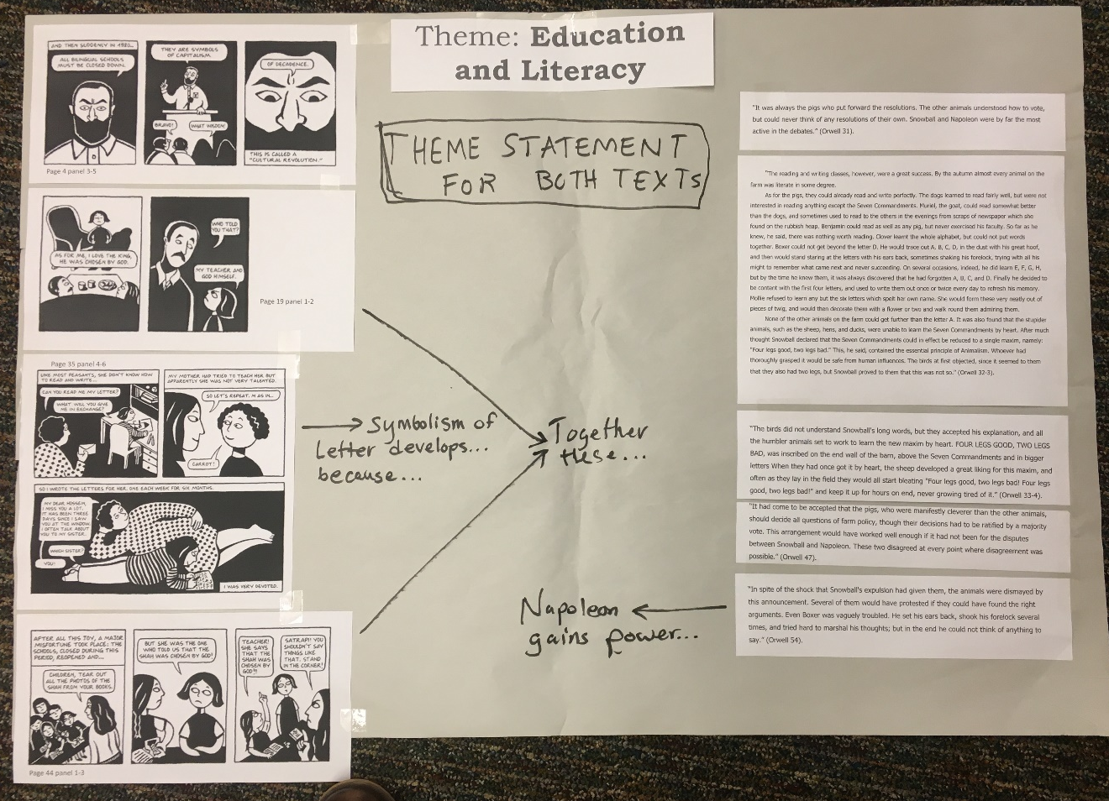
Practice
Pick 2-3 of the chunks of “evidence” from each text and tape them onto your butcher paper.
Come up with ONE theme statement about education or literarcy.
Practice writing different types of analysis, especially showing development from the pieces of evidence.

Slide 8
Practice writing analysis and a theme statement for 2-4 total of the following pieces of evidence
Example
“These three had elaborated old Major's teachings into a complete system of thought, to which they gave the name of Animalism. Several nights a week, after Mr. Jones was asleep, they held secret meetings in the barn and expounded the principles of Animalism to the others. At the beginning they met with much stupidity and apathy.” (Orwell 16).
Example
“In spite of the shock that Snowball's expulsion had given them, the animals were dismayed by this announcement. Several of them would have protested if they could have found the right arguments. Even Boxer was vaguely troubled. He set his ears back, shook his forelock several times, and tried hard to marshal his thoughts; but in the end he could not think of anything to say.” (Orwell 54).

Slide 9
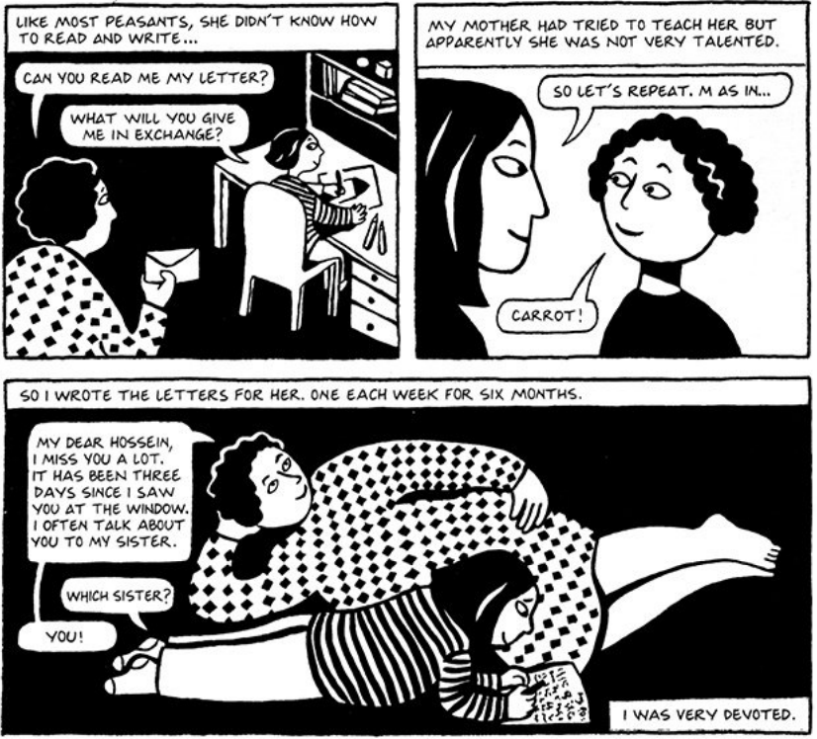
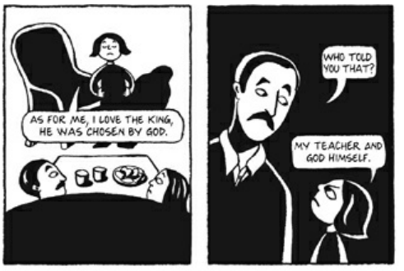
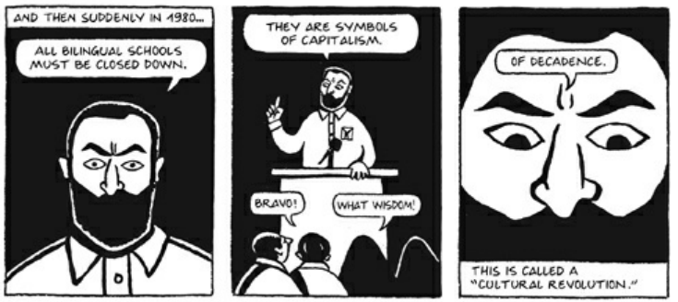
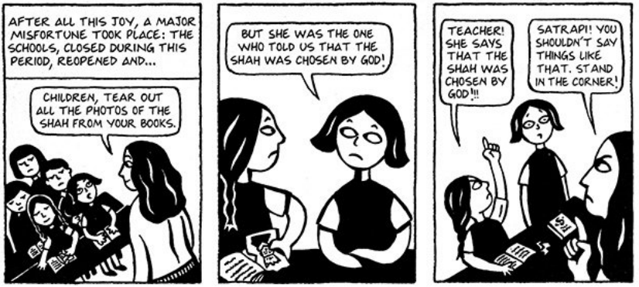
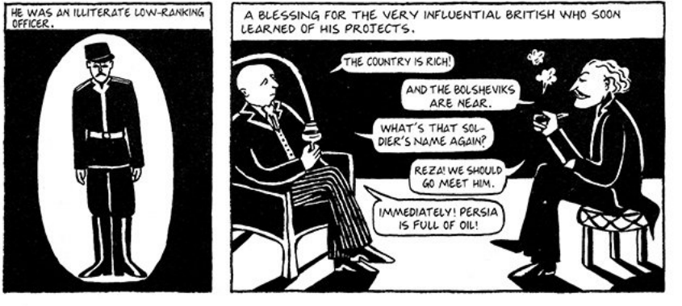
Persepolis Evidence
Page 19 panel 1-2
Page 4 panel 3-5
Page 44 panel 1-3
Page 35 panel 4-6
Page 20 panel 5-6

Slide 10
Animal Farm Evidence– just copy/print the ones you need
“The work of teaching and organising the others fell naturally upon the pigs, who were generally recognised as being the cleverest of the animals. Pre−eminent among the pigs were two young boars named Snowball and Napoleon, whom Mr. Jones was breeding up for sale. Napoleon was a large, rather fierce−looking Berkshire boar, the only Berkshire on the farm, not much of a talker, but with a reputation for getting his own way. Snowball was a more vivacious pig than Napoleon, quicker in speech and more inventive, but was not considered to have the same depth of character. All the other male pigs on the farm were porkers. The best known among them was a small fat pig named Squealer, with very round cheeks, twinkling eyes, nimble movements, and a shrill voice. He was a brilliant talker, and when he was arguing some difficult point he had a way of skipping from side to side and whisking his tail which was somehow very persuasive. The others said of Squealer that he could turn black into white.” (Orwell 15-6).
“It was always the pigs who put forward the resolutions. The other animals understood how to vote, but could never think of any resolutions of their own.” (Orwell 31).
“The pigs had set aside the harness−room as a headquarters for themselves. Here, in the evenings, they studied blacksmithing, carpentering, and other necessary arts from books which they had brought out of the farmhouse. … On the whole, these projects were a failure. The attempt to tame the wild creatures, for instance, broke down almost immediately. They continued to behave very much as before, and when treated with generosity, simply took advantage of it. The cat joined the Re−education Committee and was very active in it for some days. She was seen one day sitting on a roof and talking to some sparrows who were just out of her reach. She was telling them that all animals were now comrades and that any sparrow who chose could come and perch on her paw; but the sparrows kept their distance.” (Orwell 32).
“The reading and writing classes, however, were a great success. By the autumn almost every animal on the farm was literate in some degree. As for the pigs, they could already read and write perfectly. The dogs learned to read fairly well, but were not interested in reading anything except the Seven Commandments. Muriel, the goat, could read somewhat better than the dogs, and sometimes used to read to the others in the evenings from scraps of newspaper which she found on the rubbish heap. Benjamin could read as well as any pig, but never exercised his faculty. So far as he knew, he said, there was nothing worth reading. Clover learnt the whole alphabet, but could not put words together. Boxer could not get beyond the letter D. He would trace out A, B, C, D, in the dust with his great hoof, and then would stand staring at the letters with his ears back, sometimes shaking his forelock, trying with all his might to remember what came next and never succeeding. On several occasions, indeed, he did learn E, F, G, H, but by the time he knew them, it was always discovered that he had forgotten A, B, C, and D. Finally he decided to be content with the first four letters, and used to write them out once or twice every day to refresh his memory. Mollie refused to learn any but the six letters which spelt her own name. She would form these very neatly out of pieces of twig, and would then decorate them with a flower or two and walk round them admiring them. None of the other animals on the farm could get further than the letter A. It was also found that the stupider animals, such as the sheep, hens, and ducks, were unable to learn the Seven Commandments by heart. After much thought Snowball declared that the Seven Commandments could in effect be reduced to a single maxim, namely: "Four legs good, two legs bad." This, he said, contained the essential principle of Animalism. Whoever had thoroughly grasped it would be safe from human influences. The birds at first objected, since it seemed to them that they also had two legs, but Snowball proved to them that this was not so.” (Orwell 32-3).
“The birds did not understand Snowball's long words, but they accepted his explanation, and all the humbler animals set to work to learn the new maxim by heart. FOUR LEGS GOOD, TWO LEGS BAD, was inscribed on the end wall of the barn, above the Seven Commandments and in bigger letters When they had once got it by heart, the sheep developed a great liking for this maxim, and often as they lay in the field they would all start bleating "Four legs good, two legs bad! Four legs good, two legs bad!" and keep it up for hours on end, never growing tired of it.” (Orwell 33-4).
“Napoleon took no interest in Snowball's committees. He said that the education of the young was more important than anything that could be done for those who were already grown up. It happened that Jessie and Bluebell had both whelped soon after the hay harvest, giving birth between them to nine sturdy puppies. As soon as they were weaned, Napoleon took them away from their mothers, saying that he would make himself responsible for their education. He took them up into a loft which could only be reached by a ladder from the harness−room, and there kept them in such seclusion that the rest of the farm soon forgot their existence.” (Orwell 34-5).
"Comrades!" he cried. "You do not imagine, I hope, that we pigs are doing this in a spirit of selfishness and privilege? Many of us actually dislike milk and apples. I dislike them myself. Our sole object in taking these things is to preserve our health. Milk and apples (this has been proved by Science, comrades) contain substances absolutely necessary to the well−being of a pig. We pigs are brainworkers. The whole management and organisation of this farm depend on us. Day and night we are watching over your welfare. It is for your sake that we drink that milk and eat those apples. Do you know what would happen if we pigs failed in our duty? Jones would come back! Yes, Jones would come back! Surely, comrades," cried Squealer almost pleadingly, skipping from side to side and whisking his tail, "surely there is no one among you who wants to see Jones come back?" (Orwell 35-6).
“It had come to be accepted that the pigs, who were manifestly cleverer than the other animals, should decide all questions of farm policy, though their decisions had to be ratified by a majority vote. This arrangement would have worked well enough if it had not been for the disputes between Snowball and Napoleon. These two disagreed at every point where disagreement was possible.” (Orwell 47).
“The animals listened first to Napoleon, then to Snowball, and could not make up their minds which was right; indeed, they always found themselves in agreement with the one who was speaking at the moment.” (Orwell 51).
“In spite of the shock that Snowball's expulsion had given them, the animals were dismayed by this announcement. Several of them would have protested if they could have found the right arguments. Even Boxer was vaguely troubled. He set his ears back, shook his forelock several times, and tried hard to marshal his thoughts; but in the end he could not think of anything to say.” (Orwell 54).

