Slide 1
March 27-31 Tentative Agenda
Monday:
Chapter 6 [59-71]
Journal 30
HW: Read Chapter 7 [73-89]
Tuesday:
Quiz: Chapter 5, 6, & 7
Politics, Economics, Meat Packing, Jungles and Animal Farm
HW: Read Chapter 8 [91-109]
Wednesday:
Politics, Economics, Meat Packing, Jungles and Animal Farm pt. II
Animal Farm (1954) film
Thursday:
District Summative Post Assessment
Friday:
District Summative Post Assessment
Animal Farm (1954) film

Slide 2
How has Animal Farm changed since Napoleon took over?

Slide 3
Journal 10: Changes on Animal Farm as told by Tone and Mood.
Learning Targets:
Students will be able to define Tone and Mood.
Students will be able to identify Tone and Mood in passages of Animal Farm.
Students will be able to articulate in writing the changes over time in Tone and Mood.
Students will be able to define imagery.

Slide 4
Mood is what the reader feels while reading a scene or story. It’s not the reader’s emotions, but the atmosphere (the vibe) of a scene or story.
Mood is created by (1) setting (physical environment and time period), (2) theme, (3) diction [word choice], (4) imagery, (5) style and (6) tone.
*Style: literary devices

Slide 5
The Raven
BY EDGAR ALLAN POE
Once upon a midnight dreary, while I pondered, weak and weary,
Over many a quaint and curious volume of forgotten lore—
While I nodded, nearly napping, suddenly there came a tapping,
As of some one gently rapping, rapping at my chamber door.
“’Tis some visitor,” I muttered, “tapping at my chamber door—
Only this and nothing more.”
Ah, distinctly I remember it was in the bleak December;
And each separate dying ember wrought its ghost upon the floor.
Eagerly I wished the morrow;—vainly I had sought to borrow
From my books surcease of sorrow—sorrow for the lost Lenore—
For the rare and radiant maiden whom the angels name Lenore—
Nameless here for evermore.

Slide 6
Between the rose bowls the books were duly set out-a row of nursery quartos opened invitingly each at some gaily coloured image of beast or fish or bird….
The babies … began to crawl towards those clusters of sleek colours, those shapes so gay and brilliant on the white pages. As they approached, the sun came out of a momentary eclipse behind a cloud. The roses flamed up as though with a sudden passion from within; a new and profound signficance seemed to suffuse the shining pages of the books. From the ranks of the crawling babies came little squeals of excitement, gurgles and twitterings of pleasure.
The Director rubbed his hands. “Excellent!” he said. “It might almost have been done on purpose.”
The swiftest crawlers were already at their goal. Small hands reached out uncertainly, touched, grasped, unpetaling the transfigured roses, crumpling the illuminated pages of the books. The Director waited until all were happily busy. Then, “Watch carefully,” he said. And, lifting his hand, he gave the signal.

Slide 7
The Head Nurse, who was standing by a switchboard at the other end of the room, pressed down a little lever.
There was a violent explosion. Shriller and ever shriller, a siren shrieked. Alarm bells maddeningly sounded.
The children started, screamed; their faces were distorted with terror.
“And now,” the Director shouted (for the noise was deafening), “now we proceed to rub in the lesson with a mild electric shock.”
He waved his hand again, and the Head Nurse pressed a second lever. The screaming of the babies suddenly changed its tone. There was something desperate, almost insane, about the sharp spasmodic yelps to which they now gave utterance. Their little bodies twitched and stiffened; their limbs moved jerkily as if to the tug of unseen wires.
What is the mood of this passage?

Slide 8
The Head Nurse, who was standing by a switchboard at the other end of the room, pressed down a little lever.
There was a violent explosion. Shriller and ever shriller, a siren shrieked. Alarm bells maddeningly sounded.
The children started, screamed; their faces were distorted with terror.
“And now,” the Director shouted (for the noise was deafening), “now we proceed to rub in the lesson with a mild electric shock.”
He waved his hand again, and the Head Nurse pressed a second lever. The screaming of the babies suddenly changed its tone. There was something desperate, almost insane, about the sharp spasmodic yelps to which they now gave utterance. Their little bodies twitched and stiffened; their limbs moved jerkily as if to the tug of unseen wires.
Mood through word choice + imagery

Slide 9
Tone is the writer’s attitude about a subject or theme.
Tone is created by the way the author uses (1) word-choice [diction], (2) imagery, (3) style*, (4) perspective (narration), (5) Mood, and (6) topic.
*Style: literary devices

Slide 10
Imagery: using figurative language to represent objects, actions and ideas in such a way that it appeals to our 5 physical senses.
Sight
Smell
Touch
Taste
Sound

Slide 11
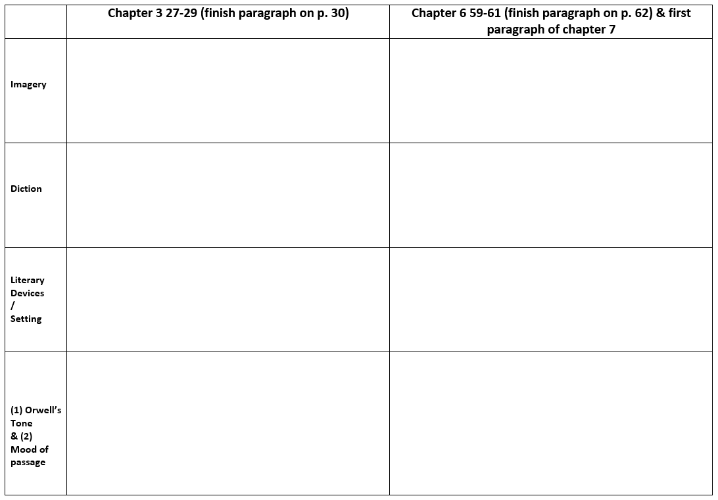

Slide 12
WRITE A THESIS: HOW HAS THE MOOD ON ANIMAL FARM CHANGED SINCE NAPOLEON TOOK POWER?

