Slide 1
Journal #18: Oral Tradition
Learning Targets:
Students will be able to define Oral Tradition.
Students will be able to define proverb, idiom, myth, and folktale.
Students will be able to explain what various proverbs mean in Things Fall Apart.

Slide 2
Thinking Questions
How do we store or keep knowledge today?
What would happen if we couldn't pass knowledge to future generations?
How did early cultures and civilizations pass on their socially constructed norms, learning, and ideas about the world before they developed the written word?

Slide 3
Oral Tradition
Oral Tradition is cultural material and knowledge transmitted in spoken words from one generation to another.
This includes proverbs, idioms, myths, and folktales that have significance to the culture that they come from.
What do you think counts as “cultural material”?
Do civilizations that have written words still have an Oral Tradition?

Slide 4
Things Fall Apart
Is a literary novel written by Nigerian author Chinua Achebe. The story's main purpose concerns pre- and post-colonial life in late nineteenth century Nigeria. It is one of the first African novels in English to receive global critical acclaim.
The novel follows the life of Okonkwo, an Igbo ("Ibo" in the novel) leader and local wrestling champion in the fictional Nigerian village of Umuofia. The novel contains a lot of traditional Igbo Oral Tradition.

Slide 5
Myths
a traditional or legendary story used to explain a cultural ritual or natural phenomenon. Myths are passed down through oral tradition. Myths often feature a hero, god, or supernatural powers. Myths may have some scientific or factual basis– but they normally do not. Most myths are archetypal. Often these stories can form religions.
What kind of natural phenomenon would early people have needed to explain?
Why did early people want to explain the world they lived in?

Slide 6
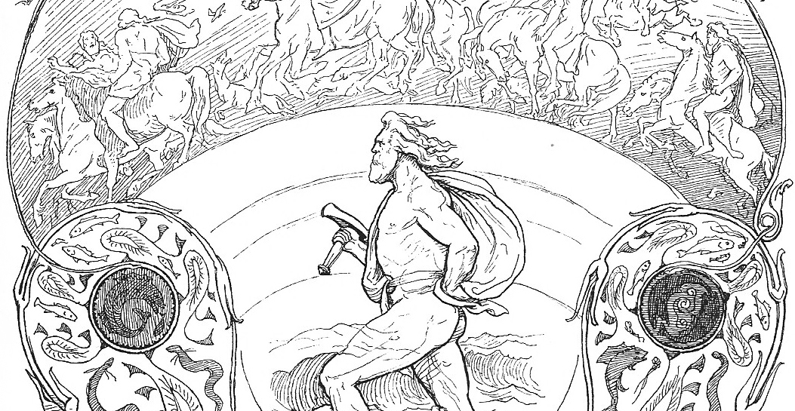
Myths: Examples
In Norse Mythology Thor and his hammer Mjöllnir to explain the sound of thunder (Thor) and lightning (Mjöllnir).

Slide 7
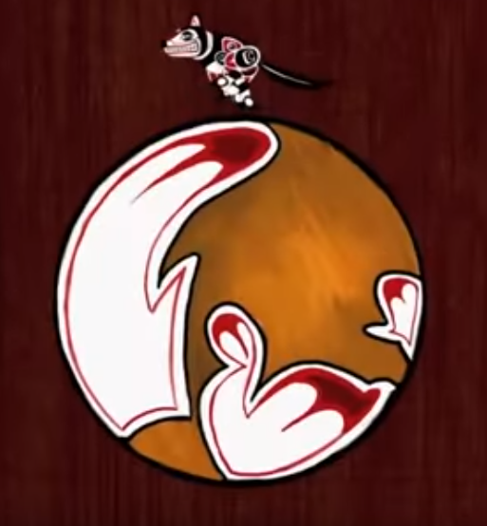
Myths: Examples
Listen to the Native American Myth: https://www.youtube.com/watch?v=5d2Zh318kRY
What things does the story try to explain?
What archetype do you think the coyote is for Native Americans on the west coast?

Slide 8
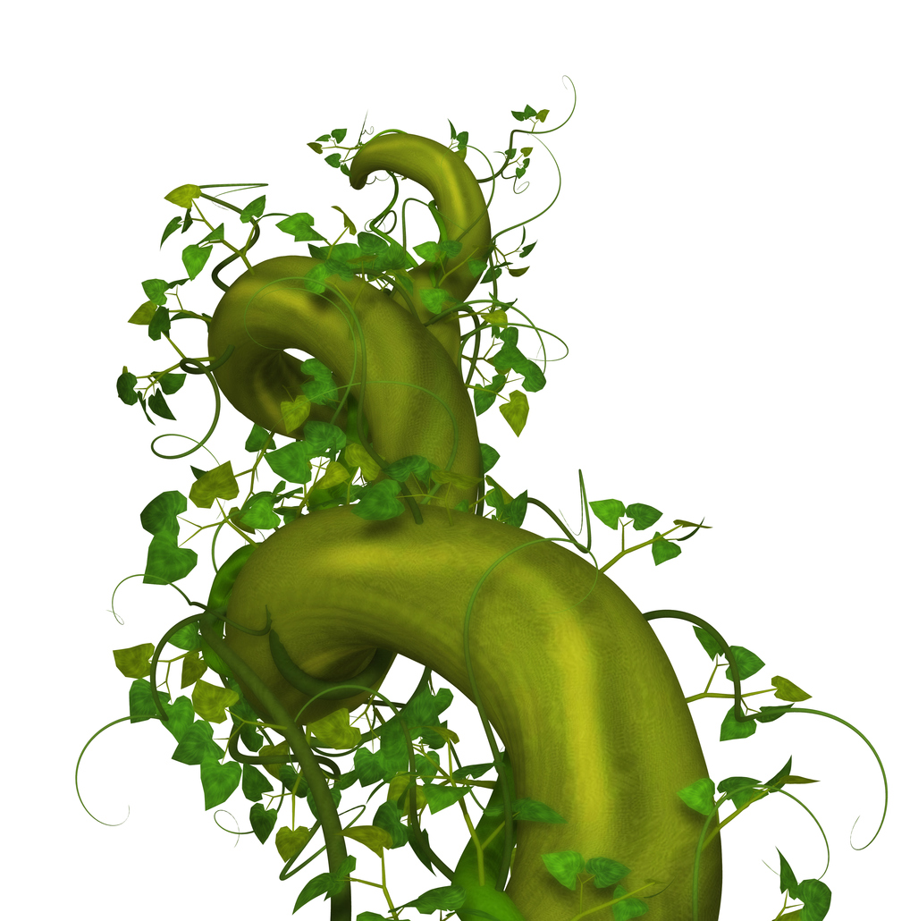
Folktales
a story without a known author that has been preserved through Oral Tradition, also archetypal. Folktales are for entertainment or to teach social norms for behavior. Folktales generally contain ordinary characters who experience extraordinary events.
Example: fairytales

Slide 9
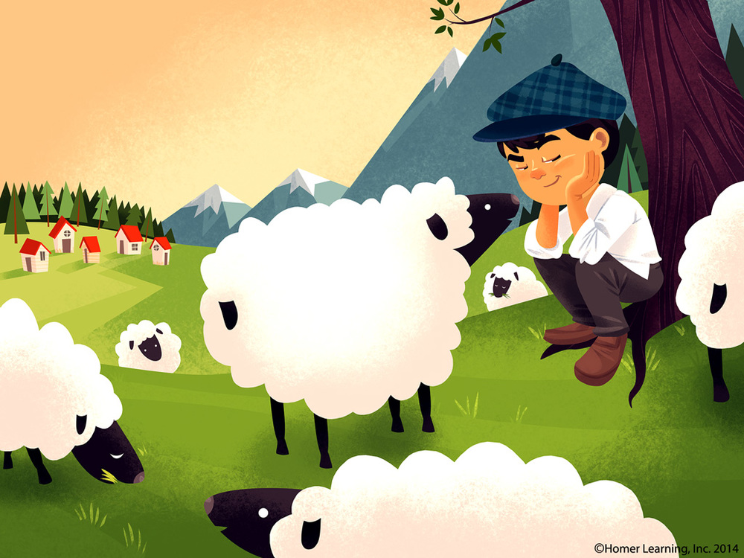
Folktales
“The Boy Who Cried Wolf”

Slide 10
Proverbs
a short saying that describes a universal truth for the people who say it; preserved through Oral Tradition.
Can you think of any examples of a proverb?
What kind of knowledge is a universal truth?

Slide 11
Proverbs: Examples
“The early bird catches the worm.”
“Two wrongs don’t make a right.”
“He who smelt it, dealt it.”
“People who live in glass houses shouldn’t throw stones.”
What kind of knowledge is a universal truth is contained in these proverbs?

Slide 12
Idioms
a short phrase, established by use within a culture, which has a static figurative meaning. To understand an idiom a person needs to know what it means because generally they make no sense.
Can you think of any examples of an idiom?

Slide 13
Idioms: Examples

Slide 14
Idioms: Examples

Slide 15
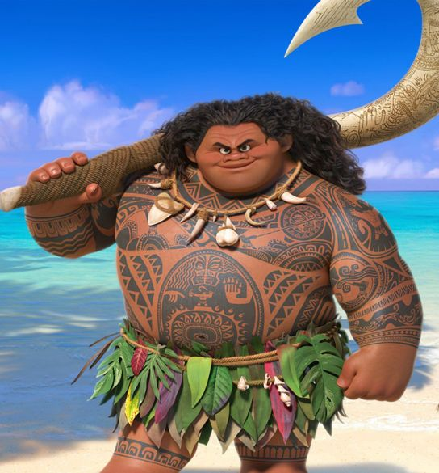
Oral Tradition and Disney’s Moana https://www.youtube.com/watch?v=79DijItQXMM
How are oral traditions, proverbs, idioms, myths, or folktales present?
What is important to the oral tradition of Polynesian people? (As represented by Disney).
What myths about Maui are referenced in the song?
Identify 3 explanations of natural phenomenon from Polynesian oral tradition.
Are any of these explanations for natural phenomena scientifically accurate?
Notes:
https://daily.jstor.org/origin-myths-behind-disneys-moana/

Slide 16
Task
In small groups:
Read and discuss the examples of Igbo oral tradition. For each example, explain it’s meaning/wisdom or purpose.
Then determine if they are all proverbs, idioms, myths, OR folktales.
Individual Questions:
How could proverbs, idioms, myths, and folktales provide insight into a story?
How and why might an author use proverbs, idioms, myths, and folktales in a novel?

Slide 17
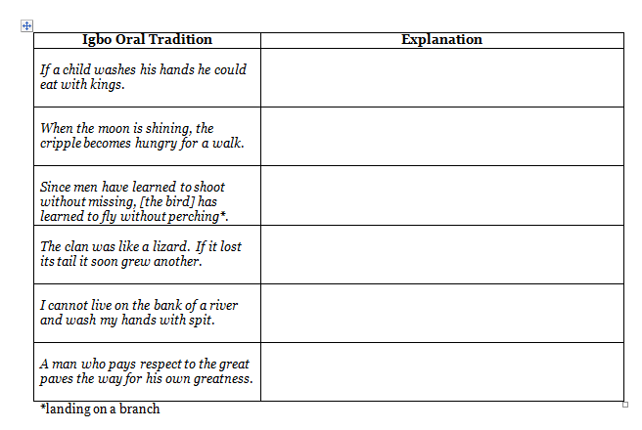

Slide 19
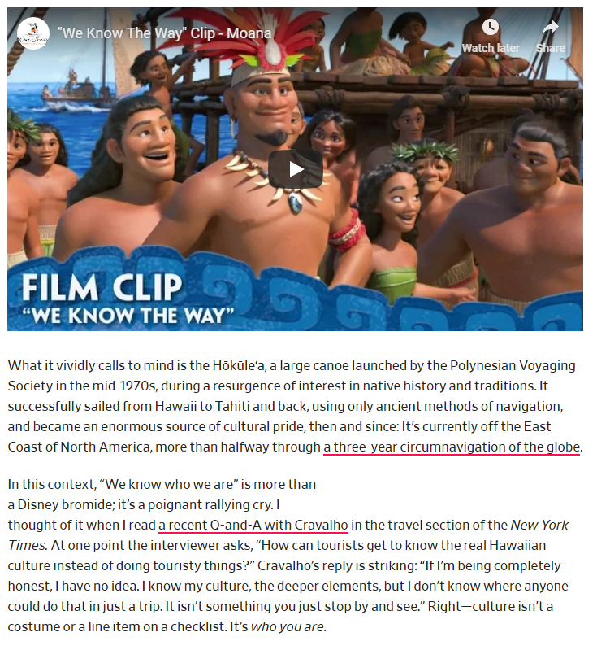
Disney’s Moana (pt.2) https://www.youtube.com/watch?v=unoJii5PJV4
How are oral traditions, proverbs, idioms, myths, or folktales present?
What is important about oral traditions in these clips?

Slide 21
Disney’s Moana
One of the greatest feats of human migration in history was the spread of the Polynesian peoples over the vast Pacific Ocean. They achieved it thanks to their sophisticated knowledge of astronomy and celestial navigation.
The Disney film Moana has drawn attention to these accomplishments and helped inform a new generation about the complexity of Indigenous astronomy.
Polynesia forms a triangle across the Pacific, with Hawaii to the north, Rapa Nui (Easter Island) to the southeast, and Aotearoa (New Zealand) to the southwest, with Tahiti in the center. But Polynesian voyaging extends beyond this triangle; there is strong evidence they reached the coast of South America and sub-Antarctic islands.
Moana touches on Polynesian voyaging, showing the main character using traditional celestial techniques to navigate across the sea.
During production, Disney created the Oceanic Story Trust – a board of experts, including Polynesian locals and elders – to advise on cultural accuracy. The film accomplished this reasonably well, especially in respect to celestial navigation, despite the producers facing criticism for cultural appropriation and commodification.
Notes:
http://www.planetary.org/blogs/guest-blogs/2017/20171122-moana-polynesian-navigation.html
https://daily.jstor.org/origin-myths-behind-disneys-moana/

Slide 22
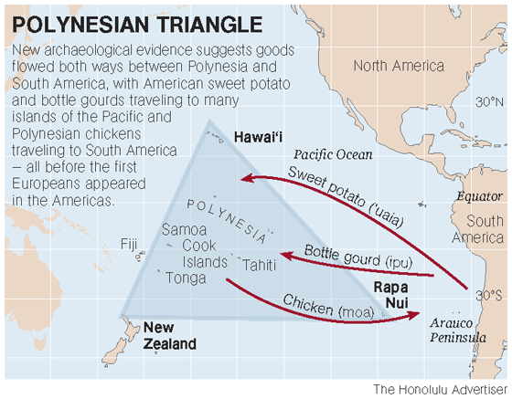
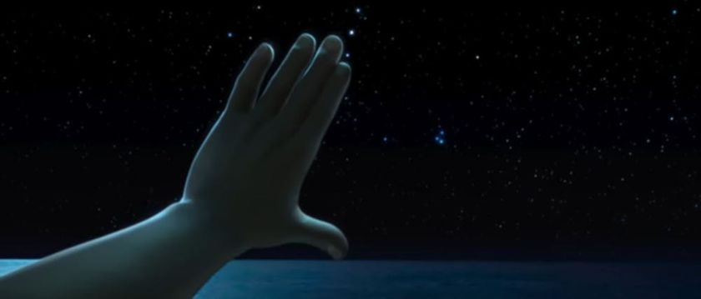
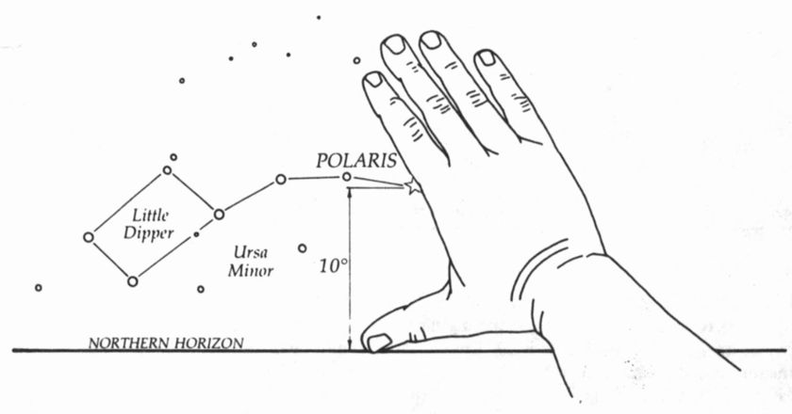
Disney’s Moana

Slide 23
Disney’s Moana
Notes:
https://www.smithsonianmag.com/smithsonian-institution/how-story-moana-and-maui-holds-against-cultural-truths-180961258/

Slide 24
Creative Task
With your table group: come up with a few proverbs and/or idioms about posting on social media!

