Slide 1
Directions:
In journal #10:
Put down the learning target and take some of the important notes about Persepolis
Read the introduction (from the actual graphic novel) and take some notes of the key events and people
We won’t start looking at the actual comic strips until we learn how to “read” a graphic novel ☺
Watch the Youtube video linked about traveling Iran and add to your notes for an open note quiz on Monday
It’s about 50 minutes long so you could watch on 1.25 speed

Slide 2
Journal #10: Iran Notes
Learning Targets:
Students will be able to identify key historical and cultural features of Iran.

Slide 3
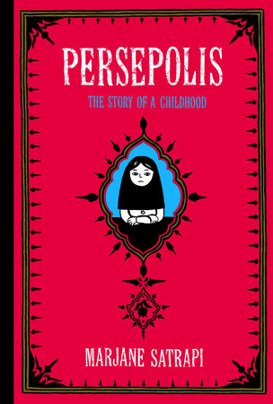
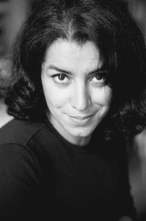
Persepolis
Persepolis is a graphic novel cataloging the aftermath of the Islamic Revolution in Iran through 1970’s and 1980’s, as well as the global context for the revolution.
Author: Marjane Satrapi, a Persian woman.
tells the story from the perspective of Marjane as a child and teenager in Iran during and after the Islamic revolution.
The novel displays issues associated with gender, individual identity, national identity, and war.

Slide 4
Persepolis (2000)
A graphic autobiography by Marjane Satrapi that depicts her childhood up to her early adult years in Iran during and after the Islamic Revolution.
The title is a reference to the ancient capital of the Persian Empire, Persepolis.
Originally published in French, the graphic novel has sold more than 1,500,000 copies worldwide.
Frequently on the list of banned or challenged books across the United States.
Ranked #2 on the ALA’s list of Top Ten Most Challenged Books of 2014.
Persepolis starts with an introduction to the life of the ten-year-old protagonist, Marji. Set in 1980, the novel focuses on her experiences of growing up revolution.
Details the impact of war and religious extremism on Iranians, especially women. Belonging to an upper-class family, Marji has access to various reading materials and is exposed to Western political thought at a very young age. By discovering the ideas of numerous philosophers, Marji reflects on her class privilege and also uncovers her family's political background.

Slide 5
Read the Intro from the beginning of Persepolis and take some notes… before watching the video HW
INTRODUCTION
In the second millennium B.C., while the Elam nation was developing a civilization alongside Babylon, Indo-European invaders gave their name to the immense Iranian plateau where they settled. The word "Iran" was derived from "Ayryana Vaejo," which means "the origin of the Aryans." These people were semi-nomads whose descendants were the Medes and the Persians. The Medes founded the frst Iranian nation in the seventh century B.C.; it was later destroyed by Cyrus the Great. He established what became one of the largest empires of the ancient world, the Persian Empire, in the sixth century B.C. Iran was referred to as Persia — its Greek name — until 1935 when Reza Shah, the father of the last Shah of Iran, asked everyone to call the country Iran.
Iran was rich. Because of its wealth and its geographic location, it invited attacks: From Alexander the Great, from its Arab neighbors to the west, from Turkish and Mongolian conquerors, Iran was often subject to foreign domination. Yet the Persian language and culture withstood these invasions. The invaders assimilated into this strong culture, and in some ways they became Iranians themselves.
In the twentieth century, Iran entered a new phase. Reza Shah decided to modernize and westernize the country, but meanwhile a fresh source of wealth was discovered: oil. And with the oil came another invasion. The West, particularly Great Britain, wielded a strong influence on the Iranian economy. During the Second World War, the British, Soviets, and Americans asked Reza Shah to ally himself with them against Germany. But Reza Shah, who sympathized with the Germans, declared Iran a neutral zone. So the Allies invaded and occupied Iran. Reza Shah was sent into exile and was succeeded by his son, Mohammad Reza Pahlavi, who was known simply as the Shah.
In 1951, Mohammed Mossadeq, then prime minister of Iran, nationalized the oil industry. In retaliation, Great Britain organized an embargo on all exports of oil from Iran. In 1953, the CIA, with the help of British intelligence, organized a coup against him. Mossadeq was overthrown and the Shah, who had earlier escaped from the country, returned to power. The Shah stayed on the throne until 1979, when he fled Iran to escape the Islamic revolution.
Since then, this old and great civilization has been discussed mostly in connection with fundamentalism, fanaticism, and terrorism. As an Iranian who has lived more than half of my life in Iran, I know that this image is far from the truth. This is why writing Persepolis was so important to me. I believe that an entire nation should not be judged by the wrongdoings of a few extremists. I also don't want those Iranians who lost their lives in prisons defending freedom, who died in the war against Iraq, who sufered under various repressive regimes, or who were forced to leave their families and fee their homeland to be forgotten.
One can forgive but one should never forget.
Marjane Satrapi
Paris, September 2002

Slide 6
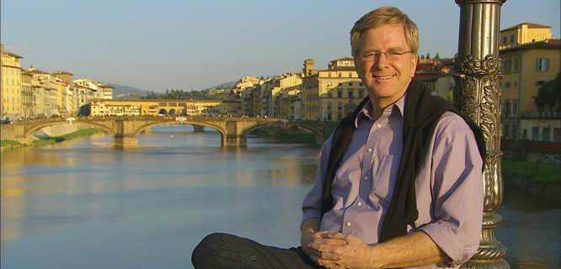
Rick Steve’s Iranian Travel Video
Rick Steves is a local (Bellevue, Wa) travel expert.
Take notes on his video about Iran, it touches on the history, culture, and important people of Iran.
Youtube link: https://www.youtube.com/watch?v=CYoa9hI3CXg&t=1103s
There will be a short open note quiz on the video ☺

