Slide 1
Journal #13: Russian Revolution Pictoral Input Chart
Learning Targets:
Students will be able to list key events from the Russian Revolution.
Students will be able to connect the Russian Redetails from Social Studies and Language volution to Animal Farm.
Students will be able to connect Arts class.

Slide 2
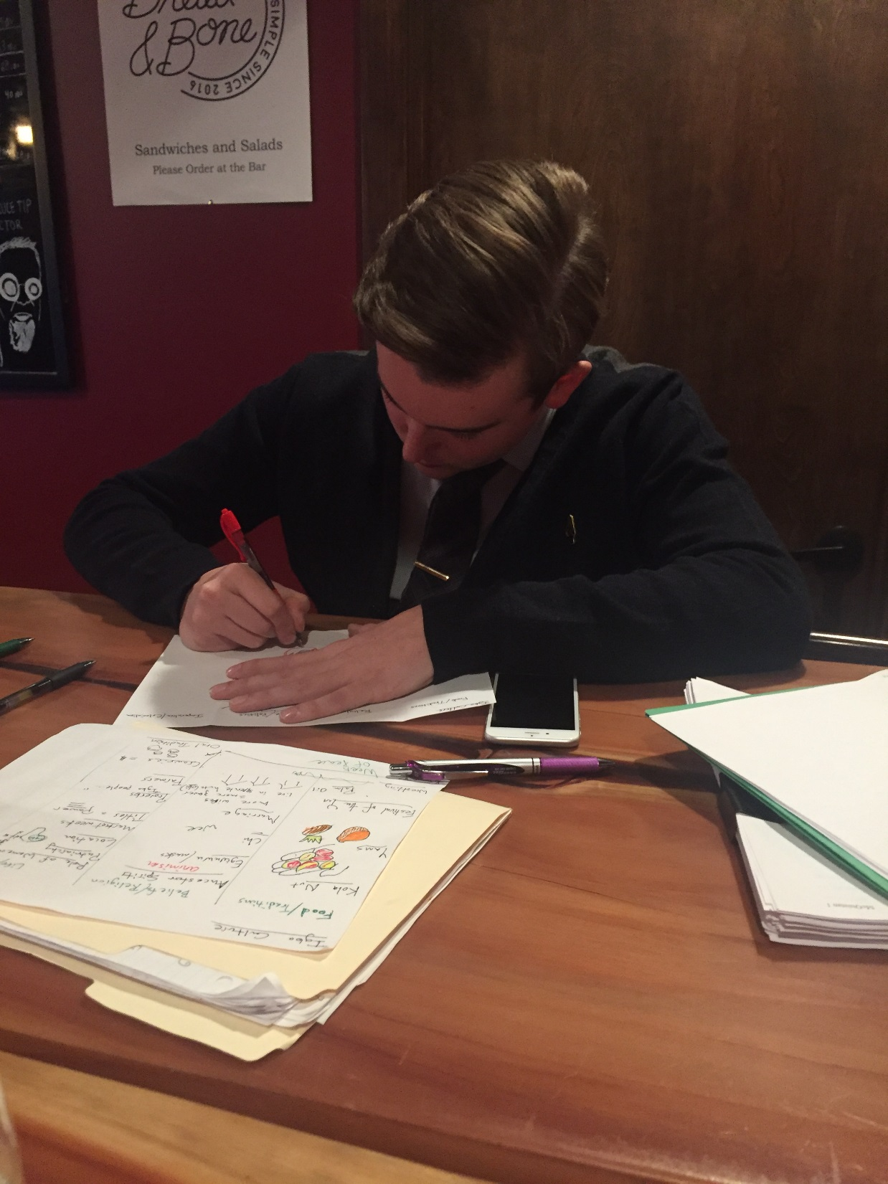
Pictoral Input Charts
Colored drawings and words that helps us organize information and serve as a great review tool.
Important to draw and listen to Smith.
Drawings are tool to review.
Smith has practiced a lot

