Slide 1
One of my friends is a courtroom-stenographer (she makes a really good salary) and posted this from a recent court case. What is your reaction to this?
In this day and age, this was actual testimony. Unbelievable…. From a scientist, nonetheless

Slide 2
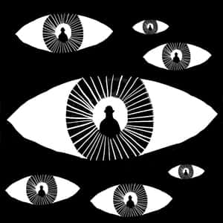
What is the truth?
How do you know it when you see it? Are there multiple truths?
Is there such a thing as objective truth?
What techniques do people use to hide the truth?
Why do people lie?
What do people mean when they say ‘speak your truth’?
What is a half-truth?

Slide 3
Determine Truth?
In his essay "On Liars," philosopher Michel de Montaigne famously wrote that the truth has a single face, while its opposite has "a hundred thousand faces.“
How many synonyms can you think of for truth?
How many antonyms?

Slide 5
Truth
What is truth?

Slide 6
Importance of Truth?
Yale Language and Propaganda expert Jason Stanley: “[Truth is] important because truth is the heart of democracy. The two ideals of democracy are liberty and equality. If your belief system is shot through with lies, you’re not free. Nobody thinks of the citizens of North Korea as free, because their actions are controlled by lies. Truth is required to act freely. Freedom requires knowledge, and in order to act freely in the world, you need to know what the world is and know what you’re doing. You only know what you’re doing if you have access to the truth. So freedom requires truth, and so to smash freedom you must smash truth.”
Notes:
Vox interview with him about fascism

Slide 7
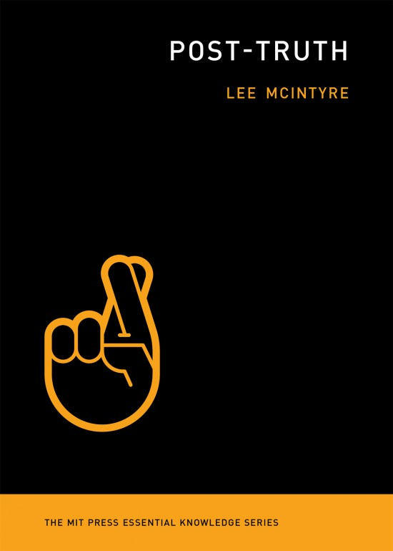
Post-Truth by Lee McIntyre:
A slender volume from MIT's Essential Knowledge Series that looks at one of the most disturbing trends of our time: the increasing dismissal of science, evidence, facts, and truth itself. The author gives us an intelligent account of why it's happened and a compelling reminder that we should all fight back against this dangerous nihilistic idea.
What, exactly, is post-truth? Is it wishful thinking, political spin, mass delusion, bold-faced lying? McIntyre analyzes recent examples—claims about inauguration crowd size, crime statistics, and the popular vote—and finds that post-truth is an assertion of ideological supremacy by which its practitioners try to compel someone to believe something regardless of the evidence.
Yet post-truth didn't begin with the 2016 election; the denial of scientific facts about smoking, evolution, vaccines, and climate change offers a road map for more widespread fact denial. Add to this the wired-in cognitive biases that make us feel that our conclusions are based on good reasoning even when they are not, the decline of traditional media and the rise of social media, and the emergence of fake news as a political tool, and we have the ideal conditions for post-truth. McIntyre also argues provocatively that the right wing borrowed from postmodernism—specifically, the idea that there is no such thing as objective truth—in its attacks on science and facts.

Slide 8
Read the opening to Post-Truth
“Rather, what seems new in the post-truth era is a challenge not just to the idea of knowing reality but to the existence of reality itself.” (10).

Slide 9
Read the opening to Post-Truth
Is this anti-Trump?
Which comments are ‘fair’ and which aren’t?
Newt Gingerich: https://www.cnn.com/videos/tv/2016/12/01/gingrich-camerota-crime-stats-newday.cnn
Who’s right?
What Orwell connections does Lee McIntyre make?
Truthiness. http://www.cc.com/video-clips/63ite2/the-colbert-report-the-word---truthiness
What does ‘Post-Truth’ mean? How is it different than lying? What is ideological supremacy?
Do you see any support in the news for “many see post-truth as part of a growing international trend where some feel emboldened to try and bend reality to fit their opinions”? (5).
What is truth? How do our bias play a role in this?
Which of McIntyre’s claims do you agree with? Disagree?

Slide 10
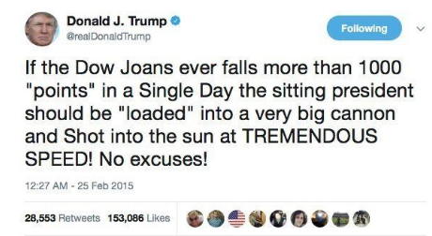
Ideological Supremacy
Determine the ideological supremacy and cognitive bias at the heart of these coronavirus lies:
Fake Trump Tweet:
Trump Coronavirus/Insurance statement:
Joy Behar on the View:

Slide 11
Orwell and Truth
Why was Orwell so concerned with lies ‘passing into history’?
What are the effects of the constant barrage of information that “had no connection with anything in the real world, not even the kind of connection that is contained in a direct lie” has on Oceania? (40-1).
What about in our lives?
How can language be used to subvert truth?
Newspeak?

Slide 12
The Dunning-Kruger effect is a type of cognitive bias in which people believe that they are smarter and more capable than they really are. Essentially, many people do not possess the skills needed to recognize their own incompetence or inaccuracies. The combination of poor self-awareness and low factual knowledge or experience leads them to overestimate their own capabilities.

Slide 13
Explain how this is a *likely* example of ideological supremacy?

Slide 14
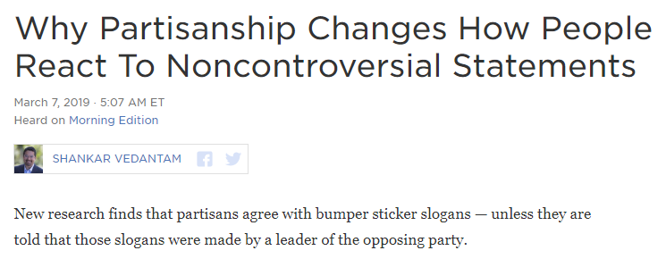
Bias and Partisanship
https://www.npr.org/2019/03/07/700625538/why-partisanship-changes-how-people-react-to-noncontroversial-statements

Slide 15
Bias and Partisanship
What is the connection between ideas?

Slide 16
Orwell and Truth
Why was Orwell so concerned with lies ‘passing into history’?
What are the effects of the constant barrage of information that “had no connection with anything in the real world, not even the kind of connection that is contained in a direct lie” has on Oceania? (40-1).
What about in our lives?
How can language be used to subvert truth?
Newspeak?

Slide 18
http://www.cnn.com/videos/politics/2017/01/21/sean-spicer-donald-trump-inauguration-crowd-bts.cnn
The NPS photographer, whose name was also redacted, told investigators he was contacted by an unidentified official who asked for “any photographs that showed the inauguration crowd sizes”. Having filed 25 photographs on inauguration day, he was asked to go back to his office and “edit a few more” for a second submission.
“He said he edited the inauguration photographs to make them look more symmetrical by cropping out the sky and cropping out the bottom where the crowd ended,” the investigators reported, adding: “He said he did so to show that there had been more of a crowd.”
The investigators said the photographer believed the cropping was what the official “had wanted him to do”, but that the official “had not specifically asked him to crop the photographs to show more of a crowd”.

Slide 19
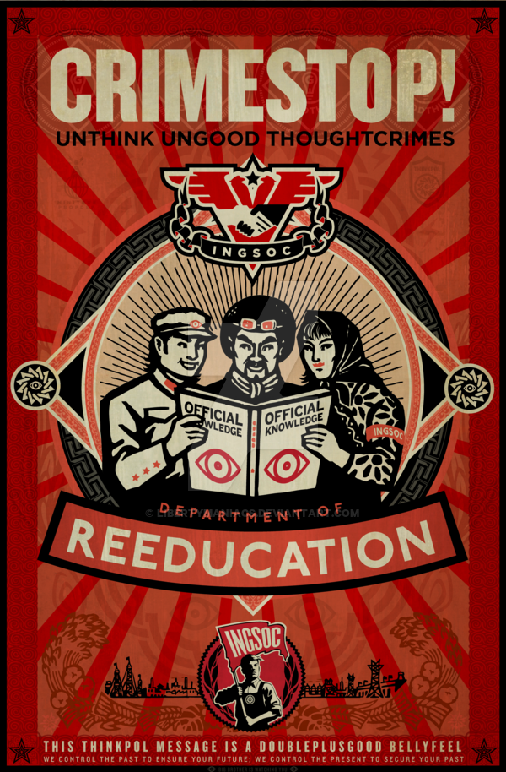
What is the relationship between TRUTH and:
Rhetoric? (ethos, logos, pathos)
Language and word choice?
Lies?
Masha Gessen on Language and Power: https://www.topic.com/masha-gessen-what-words-mean
Is this unfair about Trump?
Newspeak
Censorship?
Politically-Correct speech?
Freedom?
The job of the free press is to seek the truth and report the truth, especially the morally important truths and their consequences. If the press fails to do this job, not only does it lose its freedom, but we all do.
Freedom requires knowledge, and in order to act freely in the world, you need to know what the world is and know what you’re doing.

Slide 20
Language and Truth
Language works by activating brain structures called “frame-circuits” used to understand experience. They get stronger when we hear the activating language. Enough repetition can make them permanent, changing how we view the world.
Even negating a frame-circuit activates and strengthens it, as when Nixon said “I am not a crook” and people thought of him as a crook.
Scientists, marketers, advertisers and salespeople understand these principles. So do Russian and Islamic State hackers. But most reporters and editors clearly don’t. So the press is at a disadvantage when dealing with a super salesman with an instinctive ability to manipulate thought by (1) framing first; (2) repeating often; and (3) leading others to repeat his words by getting people to attack him within his own frame.
Language can shape the way we think. Trump knows this. Here are some of his favorite manipulation techniques.
Notes:
https://www.theguardian.com/commentisfree/2018/jun/13/how-to-report-trump-media-manipulation-language?CMP=fb_gu

Slide 21
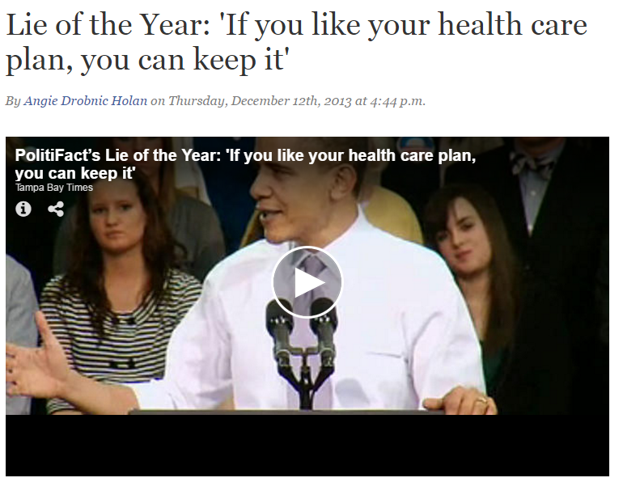
Determine Truth?

Slide 22
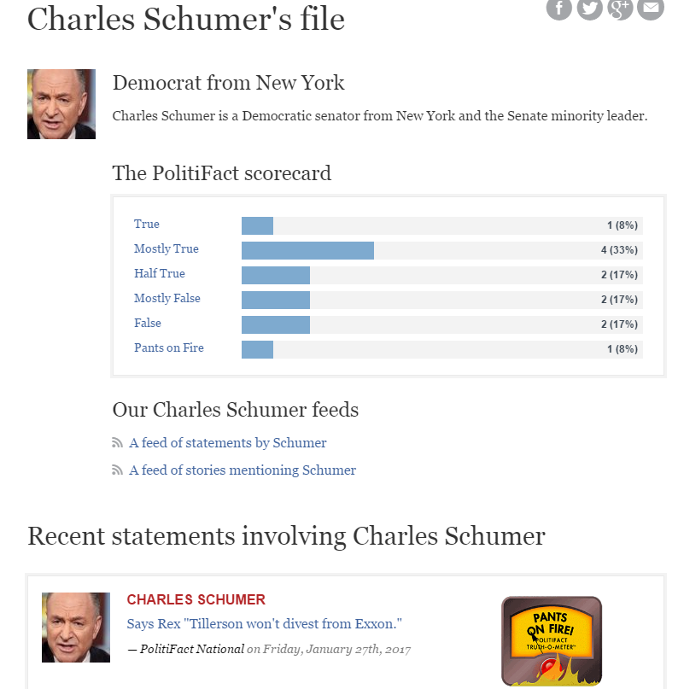
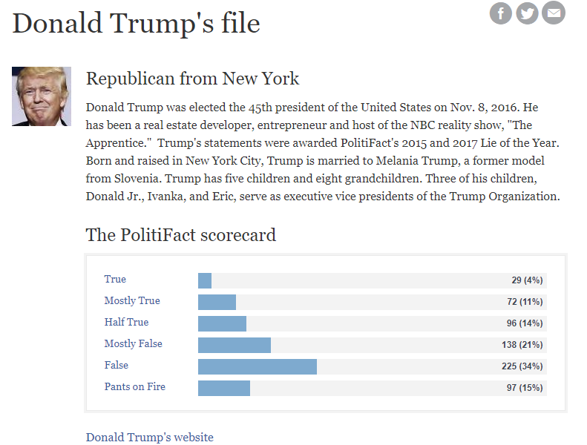
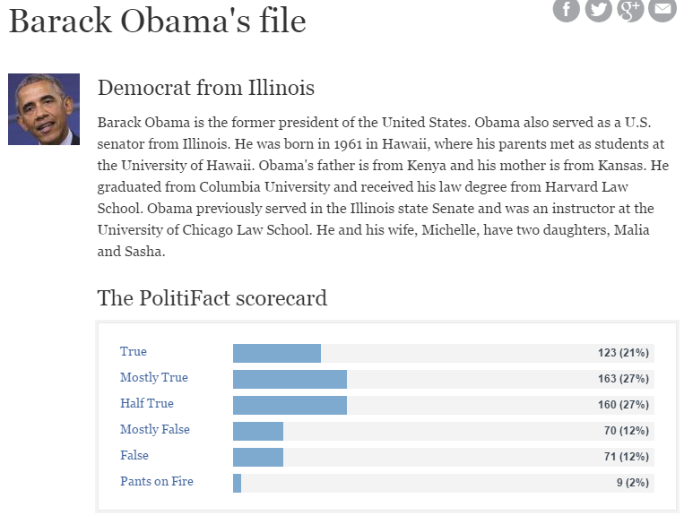
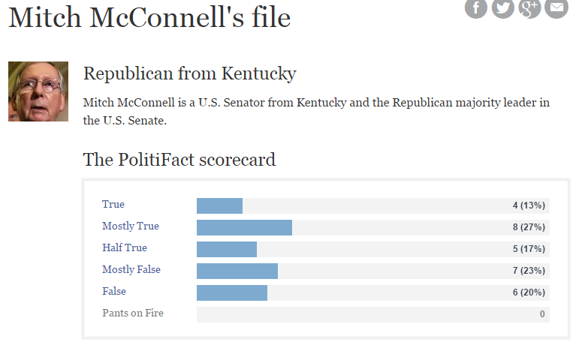
Determine Truth?

Slide 23
Determine Truth?

Slide 24
Determine Truth?

Slide 25
Determine Truth?
Newt Gingerich: https://www.cnn.com/videos/tv/2016/12/01/gingrich-camerota-crime-stats-newday.cnn
Who’s right?
“Alternative Facts”: https://www.nbcnews.com/meet-the-press/video/conway-press-secretary-gave-alternative-facts-860142147643?v=railb&
Are there such a thing as ‘alternative facts’?
Truth isn’t Truth: https://www.youtube.com/watch?v=CljsZ7lgbtw
Are there situations when ‘truth isn’t truth’?
Opinion: A Linguist's Defense Of 'Falsehood': https://www.npr.org/2018/09/06/645240941/opinion-a-linguists-defense-of-falsehood
What’s the difference between a lie and a falsehood?

Slide 26
Orwell and Truth
"Freedom is the freedom to say that two plus two make four. If that is granted, all else follows."
Is this to0 simple of an idea for truth?
What would Lee McIntyre say?
Read from 248 to 260:
Why is 2+2=5 the motif Orwell chooses to use for untruth and unfreedom?

Slide 27
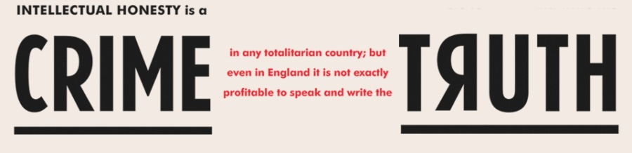
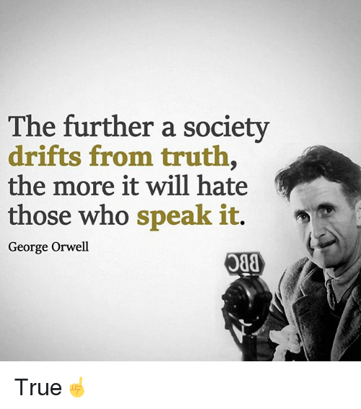
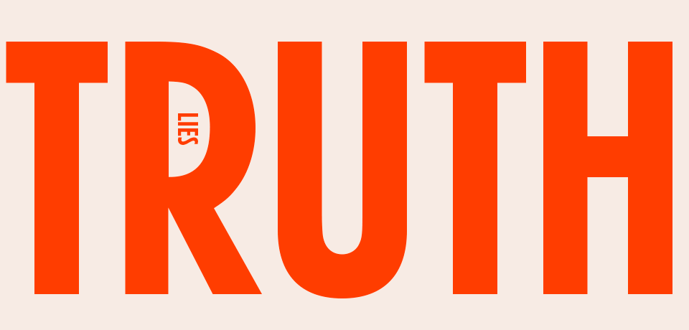
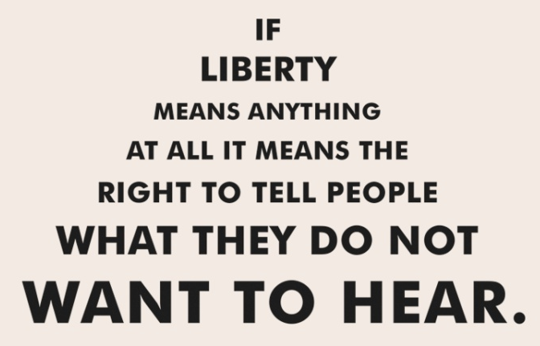
In writing, analyze one of the Orwell quotes and turn in.
“Political language – and with variations this is true of all political parties, from Conservatives to Anarchists – is designed to make lies sound truthful and murder respectable, and to give an appearance of solidity to pure wind.”

