Slide 1
THE RAMAYANA (130-140)
Epic Poetry transcribed from oral tradition to Sanskrit by Valmiki, tells the story of the struggle of Rama to rescue his wife Sita from the demon king Ravana. https://www.youtube.com/watch?v=qsuqbPda5uo
It’s didactic purpose is:
to depict the dharma (duties) in relationships, portraying ideal characters like the ideal father, the ideal servant, the ideal brother, the ideal wife and the ideal king.
Wait!! The Ramayana doesn’t look like poetry in the lit book… The version in Vedic Sanskrit, however:
consists of 24,000 verses in seven books and 500 cantos
The first letter of every 1000 verses (total 24) make the Gayatri mantra. Thematically, the Ramayana explores human values and the concept of dharma.
Verses in the Ramayana are written in a 32-syllable meter.

Slide 2
THE RAMAYANA (130-140)
How old is The Ramayana?!
It was written down in ~400 BCE and was at least 300 years old by then!
Historical Context:
100 BCE: Jesus’ grandmother was born (Middle East)
Julius Caesar was born
400 BCE: First “huts” appear in the location of present day London
710 BCE: first known lock and key (Assyria)
776 BCE: first athletic events in Olympus (Greece)
1650 BCE: the last herd of Woolly Mammoths die
2560 BCE: Pyramid of Giza completed

Slide 3
Good Guys (#TeamRama)
Bad Guys (#TeamRavana)
Rama
Lakshmana: Rama’s loyal brother
Monkey Warriors:
Hanuman
Matali: the god Indra’s chariot driver
Vibishana: Ravana’s brother on Rama’s side
Ravana
Wife: Mandodari
Brother: Kumbakarna
Son: Indrajit
Rakshasas: demons
Mahodara: giant who gets killed by Rama
Gods:

Slide 4
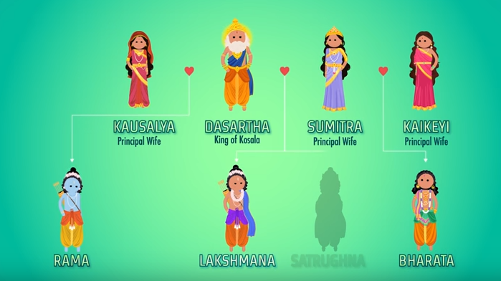
THE RAMAYANA
Some Characters: Fill out some additional details about who these characters are from the YouTube video on Smith’s website.
Lakshmana
Hanuman
King Sugriv
Rakshasas
Mahodara
Ravana
Rama (राम): the epic hero.
Rama is the “Seventh Avatar (reincarnation on earth) of Vishnu” (one of the supreme Hindu gods). He isn’t entirely a god though.
He’s blue, brave, good at archery, and honorable.
Shows up in Buddhism as well as Hinduism.
Rama’s Family

