Slide 1
Wrapping up the Privacy Discussion:
Reactions? What was scariest? Was this a good use of our class time? Is Smith too alarmist?
Does the argument for online privacy have to be about sacrificing national security or individual liberty??
What were some non-national security privacy violations?
Is our government using these tools effectively? Are we safer?
Should jobs and schools get to see your social media posts?
In their review of Terms and Conditions May Apply (the film), The Washington Post wrote ‘the problem isn’t companies like Facebook or even necessarily the government, its OUR collective apathy.’ Why do you agree or disagree?
How did you react to the idea that you have no 4th amendment rights online? What does that mean?
What does “delete” mean? What should ‘delete’ mean? What does “anonymous” mean? What should it mean?
What was China like? How does this connect to 1984? What is the relationship between privacy and freedom?

Slide 2
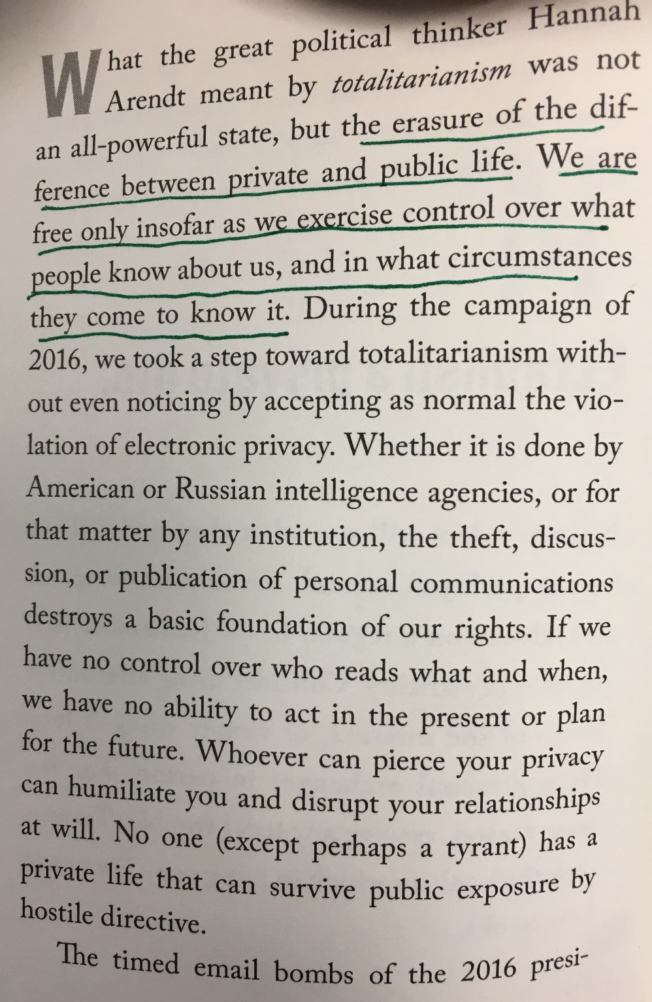
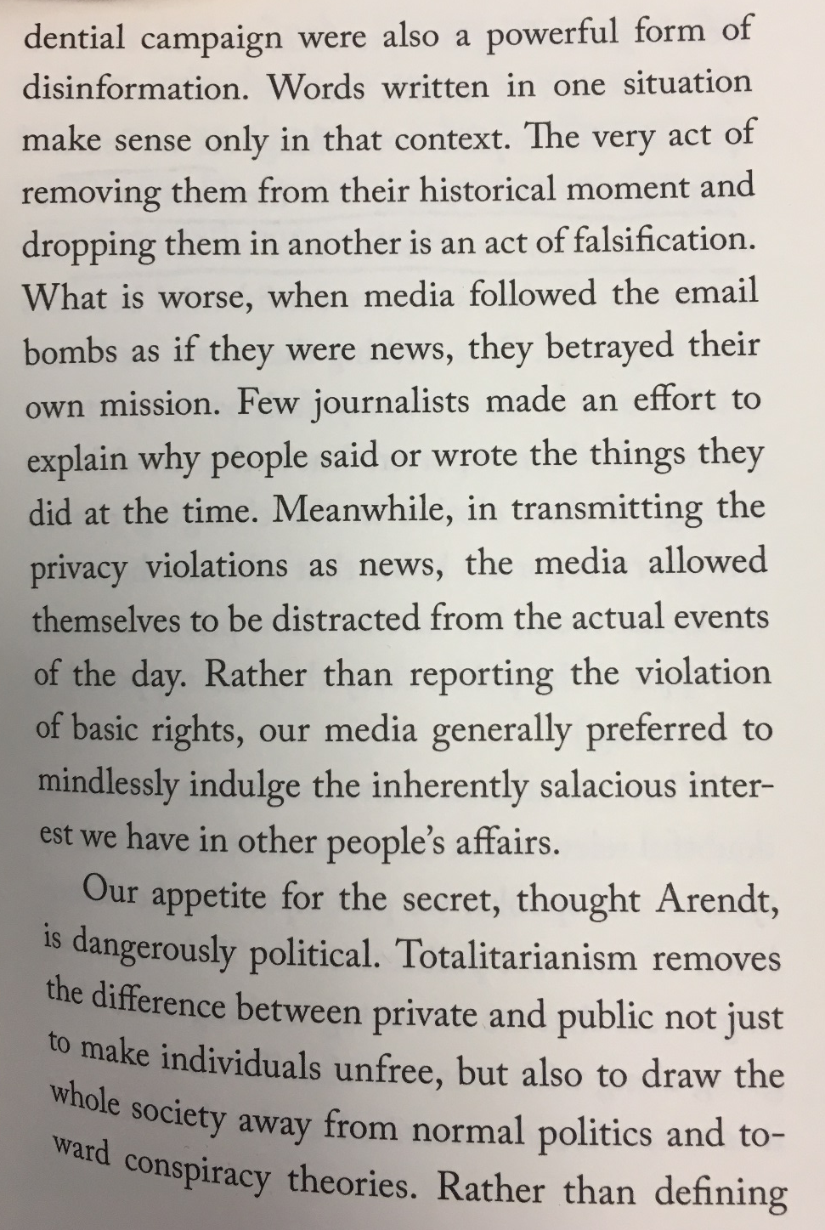
On Tyranny

Slide 3
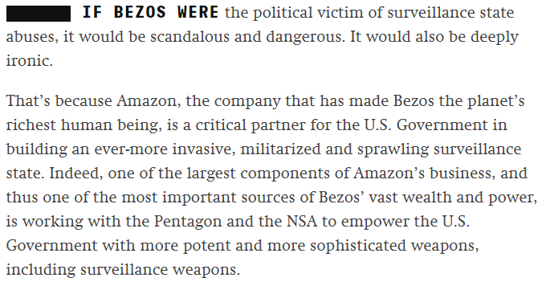

Slide 4
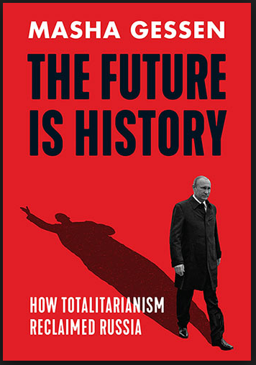
The Future is History: How Totalitarianism Reclaimed Russia by Masha Gessen
нет будущего
Budusgchego Net
What is totalitarianism? What parts of totalitarianism do you see in the world today? How does privacy play into totalitarianism?
How does totalitarianism effect a population’s personality? Is totalitarianism more or less possible in 2018?
Who is the Homo-Sovieticus?
Why does it matter that Homo-Sovieticus is still alive in Russia? What’s the irony of this?
To what extent are the characters in 1984 similar to Homo-Sovieticus?
How does revisionist history, fake news, and unreliable information play a role in creating Homo-Sovieticus?
What about violence? How bad was the Great Terror?

Slide 5
What is the connection between privacy (or doublethink) and totalitarianism?
Evidence?
½ page or less

Slide 6
We’ll be skipping 2.9, its ~40 pages

Slide 7
2.3-2.6 Back to 1984…
How has Winston and Julia’s relationship developed?
How is Orwell showing the value of sex and love to society and individuals?
“There was a direct intimate connexion between chastity and political orthodoxy. For how could the fear, the hatred, and the lunatic credulity which the Party needed in its members be kept at the right pitch, except by bottling down some powerful instinct and using it as a driving force? The sex impulse was dangerous to the Party, and the Party had turned it to account.” (133).
“Folly, folly, his heart kept saying: conscious, gratuitous, suicidal folly.” (137).
“The smell of her hair, the taste of her mouth, the feeling of her skin seemed to have got inside him, or into the air all round him. She had become a physical necessity, something that he not only wanted but felt that he had a right to.” (139).
Other relevant topics: Syme, symbolism of the paperweight, Orwell’s use of irony.

Slide 8
Back to 1984…
How has Winston and Julia’s relationship developed?
Why do Winston and Julia go together to O’Brien’s house?
Explain the living conditions of O’Brien.
What are three differences in the life of an Inner Party member versus an Outer Party member?

