Slide 1
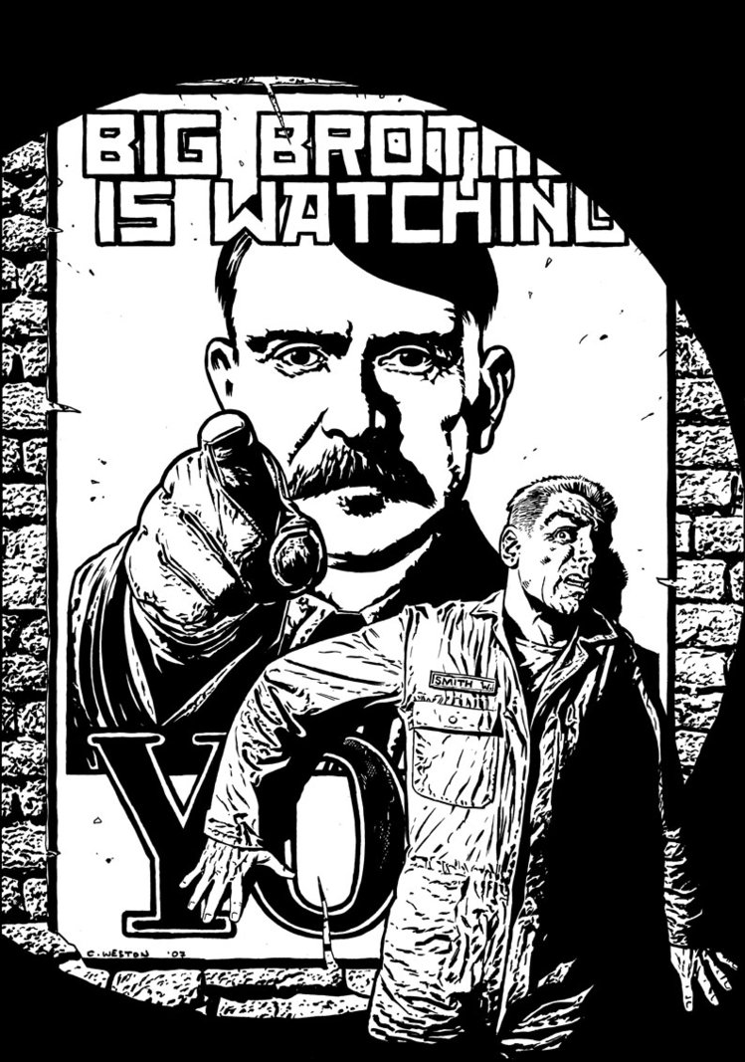
2.10 to 3.6
1984 by George Orwell

Slide 2
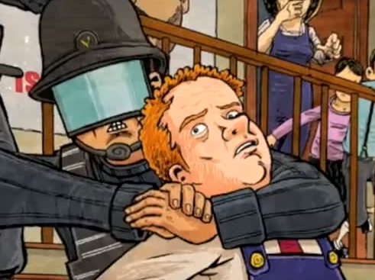
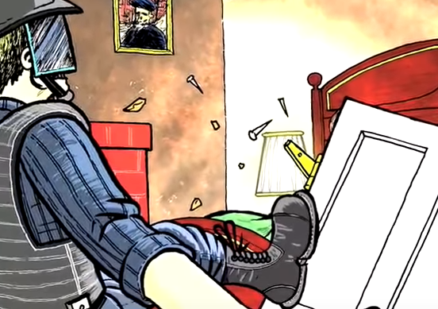
2.10
What is the deal with the “beautiful” Prole? Why does Winston find her attractive? (219-20).
Lit analysis: What is Orwell’s purpose for including this?
Is the language Orwell uses about women misogynistic?
Where was the telescreen?
Who betrayed Winston and Julia?
What questions does this leave us with?

Slide 3
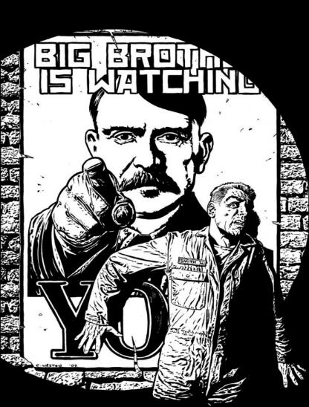
ONE + TWO [salient points] review:
Create a poster that includes specific facts, and quotes to summarize and analyze your topic from section ONE and TWO of 1984. Finalize your work with what you believe Orwell’s purpose is (feel free to conjecture).
The importance of Language
Privacy and Totalitarianism
Revisionist History/Truth
The Value of Sex to Humanity

Slide 4
3.1(225-239)
How is Winston tortured at the Ministry of Love?
What is jail like? Who is there?
Lit analysis: What effect does Orwell create by putting a Prole woman in jail with Winston? (think to juxtaposing with the last Prole woman Winston was thinking about in 2.10). (227).
Is it ironic how Oceania treats criminals? (227).
Discuss both the men Winston knows who are imprisoned with him at the Ministry of Love? Why Parsons? Is anyone safe?
How bad is Room 101? How is Orwell building tension for it?
What bombshell does Winston learn?
Lit analysis: Ultimately, is 3.1 funny or dramatic? How does Orwell weave both elements into his narrative?

Slide 5
“Beautiful” Prole Prole in jail at Miniluv 219 227

Slide 6
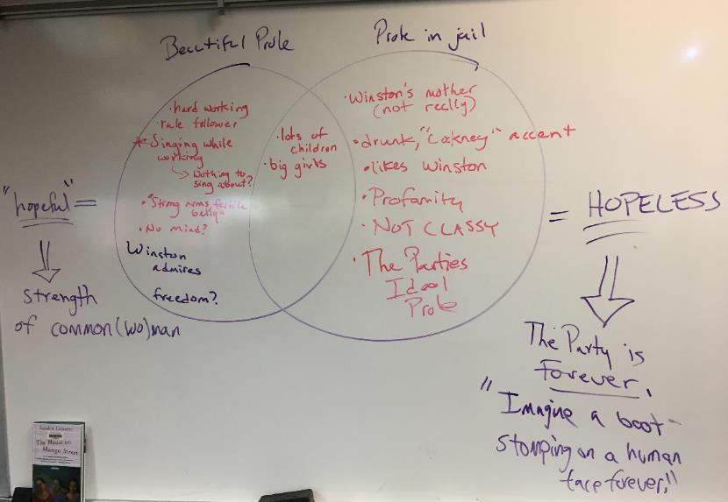

Slide 7
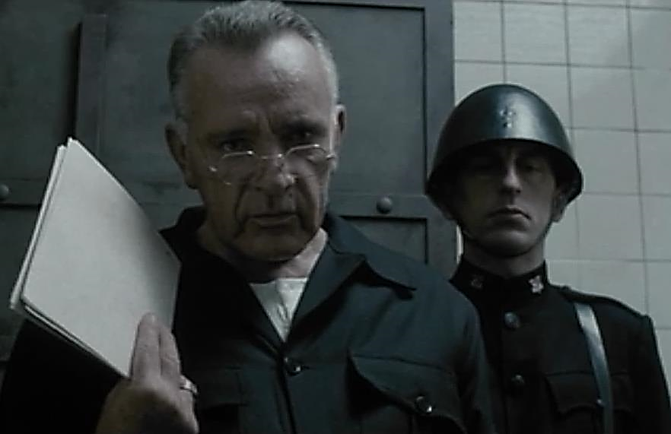
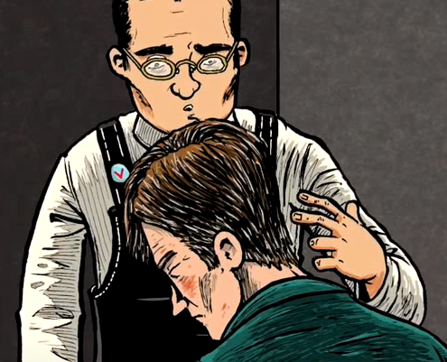
“’They got to me a long time ago,’ said O’Brien with a mild, almost regretful irony.” (Orwell 238).
Some literary criticism has really focused on this fascinating line from O’Brien
Could we see this coming? Could Winston?
What is the significance of this quote?
How does it develop O’Brien’s character?

Slide 8
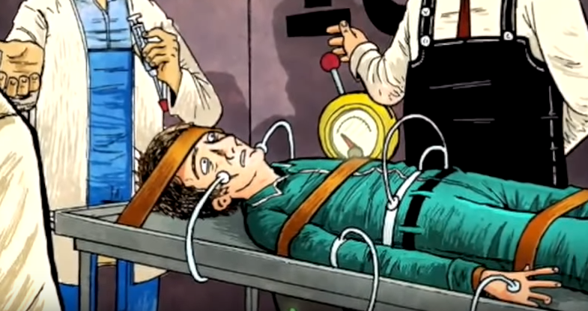
March 9th 2020
Goals:
Begin examining Orwell’s ideas about language in relationship to the current and past government of the United States

Slide 9
3.2-3.3 O’Brien Said Whaaaa?
Demonstrate your understanding and reading. Pick 2 O’Brien quotes and explain/analyze them:
“The thought is all we care about.” (253).
“But we make the brain perfect before we blow it out. The command of the old despotisms was ‘Thou shalt not.’ The command of the totalitarians was ‘Thou shalt.’ Our command is ‘THOU ART.’” (255).
“’You do not exist,’ said O’Brien” (259).
“The object of persecution is persecution. The object of torture is torture. The object of power is power.” (263).

Slide 10
3.2 (240-260)
How is Winston tortured at the Ministry of Love?
By the guards?
By O’Brien?
How is his torture managed?
How does O’Brien’s character develop?

Slide 11
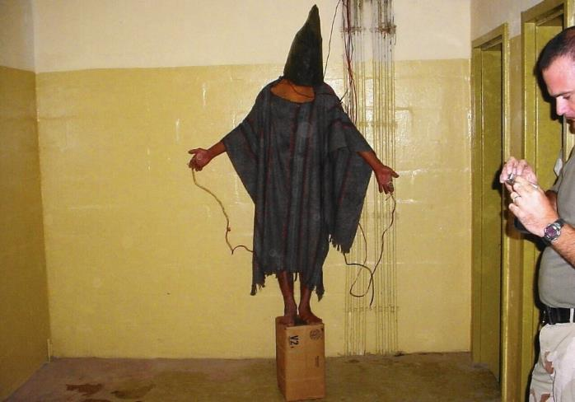
C.I.A. Torture Programs
“The Committee Study of the Central Intelligence Agency's Detention and Interrogation Program” is a report compiled by the bipartisan United States Senate Select Committee on Intelligence (SSCI) about the CIA’s Detention and Interrogation Program and its use of various forms of torture ("enhanced interrogation techniques") on detainees between 2001 and 2006.The report details actions by CIA officials including:
torturing prisoners, including waterboarding;
providing false information about classified CIA programs;
impeding government oversight;
that more detainees were subjected to torture than was disclosed;
that more forms of torture were used than previously disclosed;
and mismanaging the torture program.

Slide 12
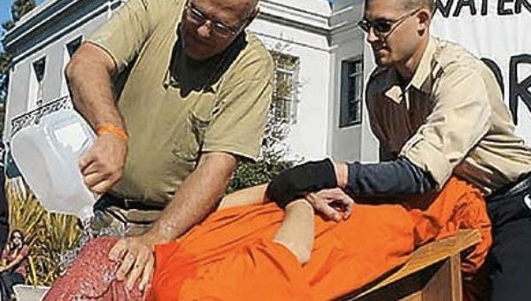
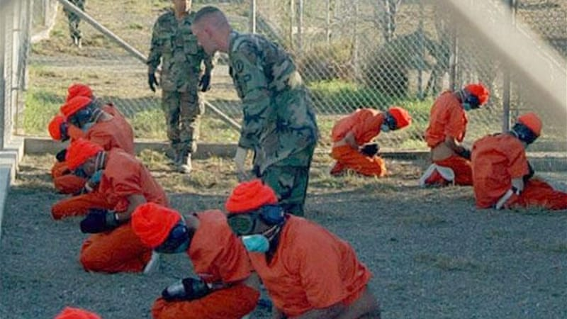
C.I.A. Torture Programs

Slide 13
C.I.A. Torture Programs
“The Committee Study of the Central Intelligence Agency's Detention and Interrogation Program” is a report compiled by the bipartisan United States Senate Select Committee on Intelligence (SSCI) about the CIA’s Detention and Interrogation Program and its use of various forms of torture ("enhanced interrogation techniques") on detainees between 2001 and 2006.The report details actions by CIA officials including:
The Senate report admits that torture was not an effective way of gathering intelligence: “At no time did the CIA’s coercive interrogation techniques lead to the collection of imminent threat intelligence,” stated committee chair Sen. Dianne Feinstein.
The CIA and its allies say the opposite. “The documents will demonstrate that the program was effective in saving American and allied lives and in preventing another mass casualty attack on American soil,” former CIA director George J. Tenet shot back.
Both miss the point. Torture isn’t about secretly collecting information. It never has been. Torture only works when it isn’t secret. Fear is only effective when it spreads. Terrorism only works when it happens in public.
The Nazis and Soviets understood this. The world’s most brutal dictators—to whom the CIA outsourced some of its torture—also understand it.

Slide 14
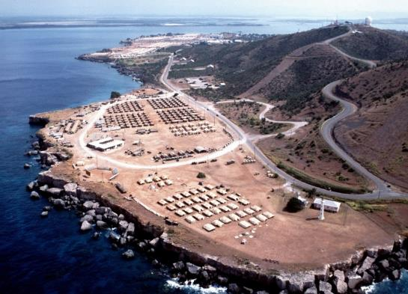
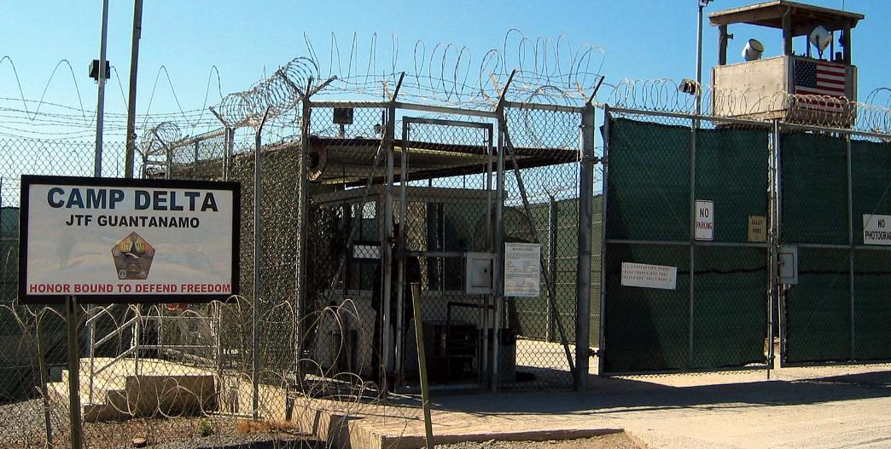
Guantanamo Bay, Pentagon Prison in Cuba
Over the 17 long years of the prison’s use for detention of prisoners (merely suspected of having something to do with terrorism): 780 men have passed through its walls. Today, 40 of those men remain; 39 of whom will never leave or face a judge.
Men being held at GTMO are not “criminals” (who have legal protections under US law) or “Prisoners of War” (who have legal protections under international law). The Pentagon and CIA called them “Enemy Combatants” and made them technically “Intelligence Assets,” not people.
The US did this to limit the prisoners’, some younger than 18 years old, legal status and ‘remove them from the battlefield’ in order to make them available for horribly harsh and cruel “advanced interrogations.”
It was designed in a way to forgo a political contest. When things are hidden when things are subverted, democratic processes can’t play out.
“The way that the human body was rendered in these opinions was not necessarily as a human body, but as a type of valuable informational asset. And so when you strip out any type of humanity, when you strip out things like the Geneva Conventions and you strip out other norms of warfare and you’re left with creating new ones, it is easy to remove the human body from that and see that only as a type of threat.”
Notes:
https://theintercept.com/2019/02/27/the-secrets-of-american-power-unitary-executive-theory-guantanamo-bay-prison-and-extraordinary-rendition/

Slide 15
Guantanamo Bay, Pentagon Prison in Cuba
Jeremy Scahill, Intercept Reporter: What does it mean that Guantanamo is still open, holding prisoners? Is this prison, as we have known its existence post-9/11, is it ever going to close?
Carol Rosenberg, Miami Harold/NYT reporter: Because Congress has said that you can’t move them to the United States and forbidden anyone who’s held as a detainee at Guantanamo to be transferred to the United States for any reason for trial, for detention, for medical care. The reality is it sounds very much like it’ll exist until the last detainee dies and they can shut it down. If you hold people as indefinite detainees in the war on terror, don’t charge them with crimes, or if you have a lifetime convict like Ali Hamza Bahlul, it doesn’t go away. Many of these men aren’t chargeable. They’re not accused of being criminals. They’re accused of being foot soldiers for an enemy force which currently has no leader to surrender. You know, that’s the way war’s end. So, if you’re asking how Guantanamo ends, I have no idea. What is Guantanamo today? Guantanamo today is 40 detainees, one of them convicted, and a revolving force of about 1,400 U.S. troops coming down there without family on nine-month tours going to the beaches and bars of the base on weekends and then going home and going back to their lives. And it’s a temporary prison, which really has no capacity to be shut down.

Slide 16
Guantanamo Bay, Pentagon Prison
What does the distinction between “criminal,” “Prisoner of War,” and “Enemy Combatant” reveal about the power of language to dehumanize?
Bonus: What do these terms reveal about the intersection between legal frameworks (“the law”) and language?
Notes:
https://theintercept.com/2019/02/27/the-secrets-of-american-power-unitary-executive-theory-guantanamo-bay-prison-and-extraordinary-rendition/

Slide 19
other techniques to use legal language to obfuscate truth
The CIA’s Legal Group, Counterterrorist Center, identified in the documents as “CTC/LGL,” has “emphasized that we should not/not rule out any method of interrogation whatsoever,” the cable explains, but adds that headquarters “will need to document in advance the legal analysis for such methods, to ensure that our officers are protected.”
“In short,” the cable concludes, “rule out nothing whatsoever that you believe may be effective; rather, come on back and we will get you the approvals. CTC/LGL officers remain available 24/7 to ensure immediate assistance and documentation on any proposals. … We lawfully may employ methods that even the Israelis may not.”
“enhanced interrogation techniques” = torture
Enhanced measures were designed to move Mohammed “toward a feeling of helplessness and hopelessness,” a cable states. Rather than engage in a battle of wills with the detainee, interrogators wanted to set Mohammed’s will against itself in a losing battle. Typically during waterboarding, detainees would fail to manage their breathing and emotions. They panicked. They lost. The CIA psychologists called this progress.

Slide 20
C.I.A. Torture Programs: “Black Sites”
U.S. forever-wars have relied on constructing regimes of secrecy in order to circumvent democratic processes — to “operate on the dark side,” as Dick Cheney once infamously said. In these hidden spaces, anything is possible: the Geneva Convention is rendered meaningless, and a vast network of systematic kidnappings and brutal torture can blossom in remote corners of the globe.
Notes:
https://theintercept.com/2019/02/27/the-secrets-of-american-power-unitary-executive-theory-guantanamo-bay-prison-and-extraordinary-rendition/

Slide 21
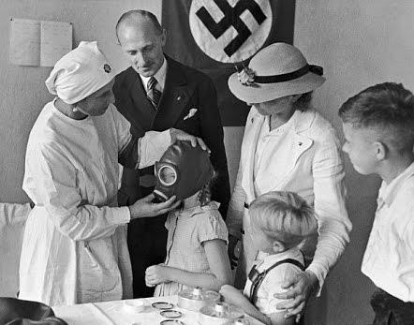
(240-241, 243) Nazi and Soviet “Efficiency”
The Soviet Union was good at torture. But the Soviets excelled at torture because they understood its usefulness. “Our task is not only to destroy you physically,” a Stalinist interrogator explained to a prisoner in 1948. “But also to smash you morally before the eyes of the society.”
“Of course it is sinister,” wrote Andrew Meier, the author of “The Lost Spy: An American in Stalin’s Secret Service,” via email. “It’s venomous, even. Stalin [was] all about optimization. Take the gulag, the greatest example, and achievement, of Soviet optimization. The lords of the gulag had charts and charts [based off medical research and experimentation] about minimum food intake and maximum work output.”
Notes:
https://medium.com/war-is-boring/guess-who-else-tortured-people-like-the-cia-did-soviets-and-nazis-e65357a309b9

Slide 22
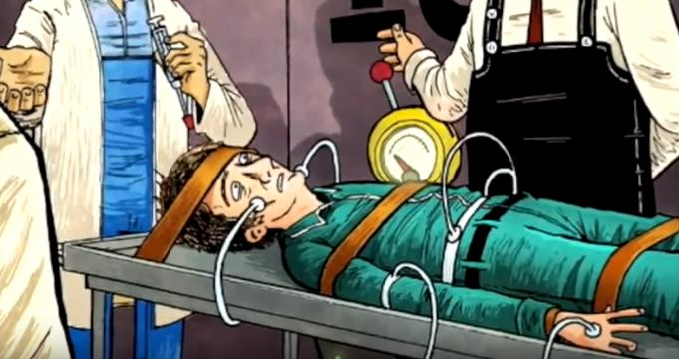
3.2 (240-260)
Does O’Brien know the ‘real’ history of the world? What might happen if the Party forgets the real history of the world? Would it matter?
What point is O’Brien trying to make about Martyrs, the Inquisition, heresy, and the totalitarians? (253-5).
What is the Party trying to avoid by doing things differently?
Why does O’Brien demand Winston submit of his own free will?
2+2=__? Is Winston actually crazy?
What would you have asked O’Brien? (259).

Slide 23
3.2-3.3 O’Brien Said Whaaaa?
Pick 2 O’Brien quotes and explain/analyze them:
“The thought is all we care about.” (253).
“But we make the brain perfect before we blow it out. The command of the old despotisms was ‘Thou shalt not.’ The command of the totalitarians was ‘Thou shalt.’ Our command is ‘THOU ART.’” (255).
“’You do not exist,’ said O’Brien” (259).
“The object of persecution is persecution. The object of torture is torture. The object of power is power.” (263).

Slide 24
3.2-3.3 According to O’Brien…
What is Power (to the Party)?
What is truth/reality?
Is O’Brien right? (248-9). What’s Orwell’s purpose?

Slide 25
Theme: Truth
Yale University Language & Propaganda expert Jason Stanley: “[Truth is] important because truth is the heart of liberal democracy. The two ideals of liberal democracy are liberty and equality. If your belief system is shot through with lies, you’re not free. Nobody thinks of the citizens of North Korea as free, because their actions are controlled by lies. Truth is required to act freely. Freedom requires knowledge, and in order to act freely in the world, you need to know what the world is and know what you’re doing. You only know what you’re doing if you have access to the truth. So freedom requires truth, and so to smash freedom you must smash truth.”
How does this idea relate to O’Brien and the Party? 1984?

Slide 26
O’Brien & the Party on power:
’The real power, the power we have to fight for night and day, is not the power over things, but over men… How does one man assert his power over another, Winston?’
Winston thought. ‘By making him suffer,’ he said.
‘Exactly. By making him suffer. Obedience is not enough. Unless he is suffering, how can you be sure that he is obeying your will and not his own? Power is in inflicting pain and humiliation. Power is in tearing human minds to pieces and putting them together again in new shapes of your own choosing.’ (266).
‘The more the Party is powerful, the less it will be tolerant; the weaker the opposition, the tighter the despotism.’ (268).
“The second thing for you to realize is that power is power over human beings. Over the body—but above all over the mind. Power over matter—external reality, as you would call it—is not important.” (264).

Slide 27
2+2=5
Explain the meaning, purpose, and effect of the repetition of “2+2=5”
New (?) Literary Device: Motif
There are three types: (1) a reoccurring object, (2) reoccurring literary devices, or (3) reoccurring plot structures in literature that figuratively represents another idea or, always related to the theme or the author’s purpose. Motifs appear in different contexts or be dynamic, separating them from symbolism or antithesis.

Slide 28
Motif:
A (1) reoccurring object, (2) literary device**, or (3) plot structure** in literature that figuratively represents another idea or thing, always related to the theme or the author’s purpose.
Motifs appear in different contexts (i.e. water appearing in different ways) or be dynamic
Motifs can be reoccurring literary devices
Three different types of Motifs:
Reoccurring Dynamic Objects*
*Difference between a motif and symbol is that symbols are static and never ideas
Literary/Language Devices
Plot Structures

Slide 29
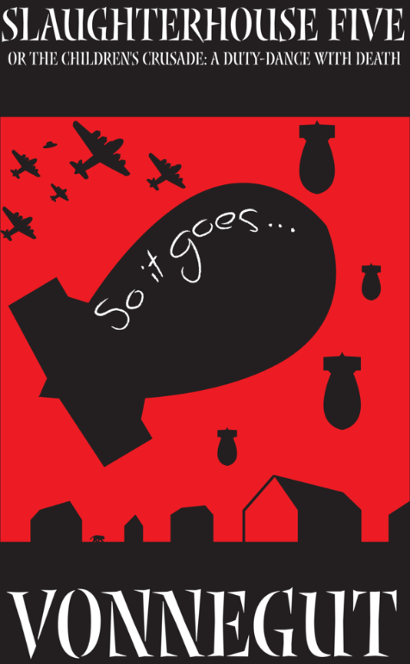
2. Repetition of Literary/Language Devices
Slaughterhouse Five is a satirical anti-war novel about a man who is ‘stuck in time’ and keeps ending up at the bombing of Dresden during WWII.
The phrase “So it goes.” appears 99 times over the 105 page novel.
Look at your page with random pieces of Slaughterhouse Five: How does Kurt Vonnegut use the motif of “So it goes.” to build his anti-war message?
Write a thesis about 2+2=5 in 1984, as it relates to truth/freedom.

Slide 30
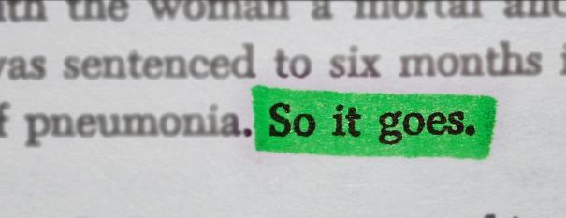
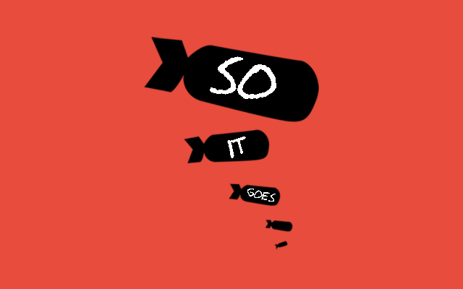
To call something a motif, it needs to:
repeat many times,
Does 2+2=5?
appear in different contexts/be dynamic,
Does 2+2=5?
and be related to the author’s purpose.
What thematic purpose is Orwell addressing?

Slide 31
Theme: Truth
Yale University Language & Propaganda expert Jason Stanley: “[Truth is] important because truth is the heart of liberal democracy. The two ideals of liberal democracy are liberty and equality. If your belief system is shot through with lies, you’re not free. Nobody thinks of the citizens of North Korea as free, because their actions are controlled by lies. Truth is required to act freely. Freedom requires knowledge, and in order to act freely in the world, you need to know what the world is and know what you’re doing. You only know what you’re doing if you have access to the truth. So freedom requires truth, and so to smash freedom you must smash truth.”
How does this idea relate to O’Brien and the Party? 1984?

Slide 32
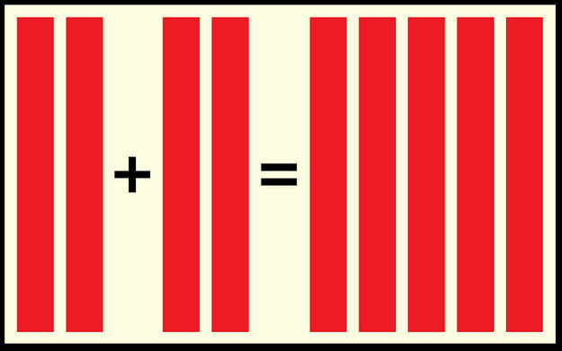
Group Paragraph Outline
Practice taking your arguments/analysis to their logical extension by writing a thesis-driven (paragraph outline) for a 2+2=5 motif paragraph.
Write a thesis about 2+2=5 (or doublethink) in 1984, as it relates to truth/freedom.
Use three quotes as evidence.
3 pieces of analysis each.

Slide 33
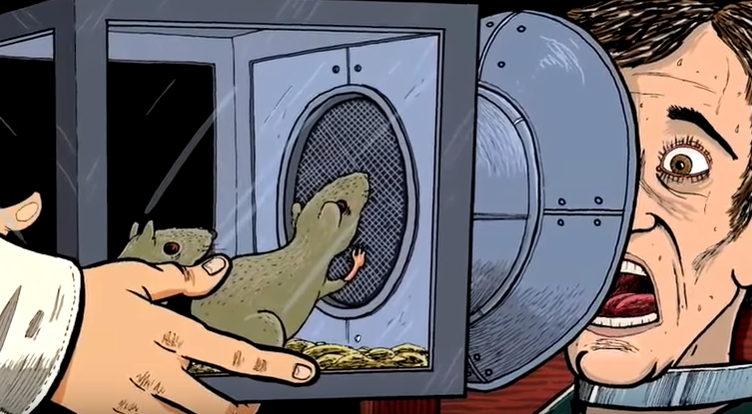
3.4 (274-282)
Beetle Metaphor!!
Is there a ‘real’ world where ‘real’ things happen?
Explain: “Stupidity was as necessary as intelligence, and as difficult to attain.” (279).

Slide 34
3.5 (282-287)
What is Room 101 like?
Why was it true that “what happens to you in here is forever”? (290).
Does Winston betray Julia? Can love conquer all? Can it conquer the Party?

Slide 35
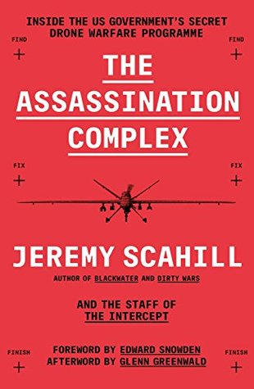
Remember the Government’s use of language (“enemy combatant,” “enhanced interrogation”) to subvert international law?
Read the selection from The Assassination Complex: Inside the US Government’s Secret Drone Warfare Program (2014).
What is the language (and thus the law) of the Terror Watchlist like?
Does it seem just or fair?
How does this connect to the intersection of law and language at Guantanamo Bay?
How does this connect to 1984?

Slide 36
IN THE DARK, nearly two-decade long history of America’s war on terror certain initiatives stand out. The rendition and torture of suspected terrorists around the world. Drone warfare. Warrantless surveillance of private citizens. And the creation of watchlists, shadowy and opaque in their construction, with devastating consequences for communities caught in the dragnet.
In the summer of 2014, The Intercept published the secret rulebook behind those lists. The 166-page “Watchlisting Guidance” detailed the process by which the U.S. national security apparatus adds individuals to the Terrorist Screening Database, or TSDB, better known as “the watchlist” from which other lists — such as the no-fly list — are built.
The document revealed a staggeringly Due Process-free system in which the government was routinely affixing the word “terrorist” to an individual’s name and disseminating that information to a sprawling network of foreign and private partners, with virtually no evidence required.
In a post-9/11 world, this murky system disproportionately impacted Muslims, though U.S. lawmakers and infants were also caught in the mix. Armed with the government’s own rulebook, and the firsthand experiences of nearly two dozen plaintiffs, lawyers at the Council on American-Islamic Relations, or CAIR, began a multiyear challenge to the secretive system. On Wednesday, the attorneys were rewarded a historic ruling, with a federal judge finding that the watchlisting process had violated their clients’ rights.

Slide 37
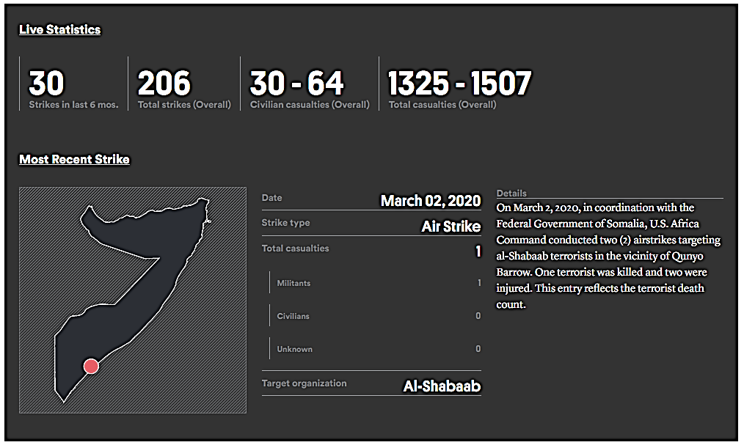
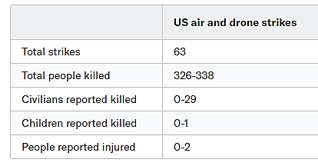

Slide 38
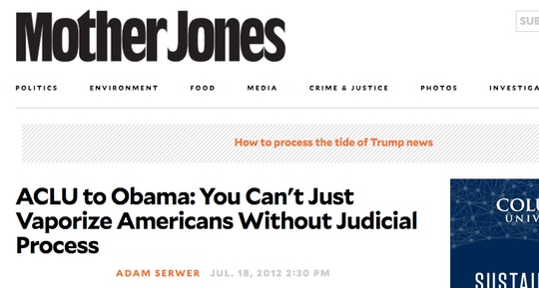
IN 2010, PRESIDENT Obama directed the CIA to assassinate an American citizen in Yemen, Anwar al-Awlaki, despite the fact that he had never been charged with (let alone convicted of) any crime, and the agency successfully carried out that order a year later with a September 2011 drone strike. While that assassination created widespread debate — the once-again-beloved ACLU sued Obama to restrain him from the assassination on the ground of due process and then, when that suit was dismissed, sued Obama again after the killing was carried out — another drone killing carried out shortly thereafter was perhaps even more significant yet generated relatively little attention.

Slide 39
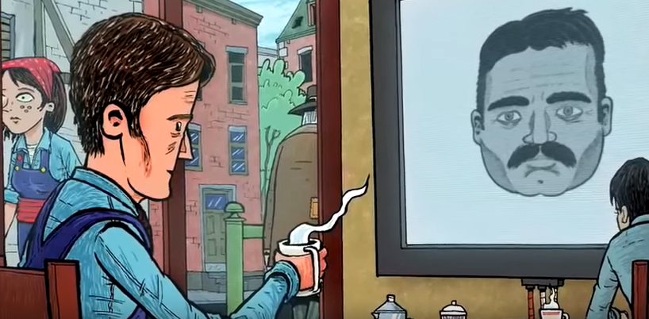
3.6 (287-298)
What is Winston’s mental state?
How has Winston and Julia’s relationship changed? What does this illustrate?
What is Winston’s final thought? What is the literary device for this?
Is the Party permanent?

Slide 40
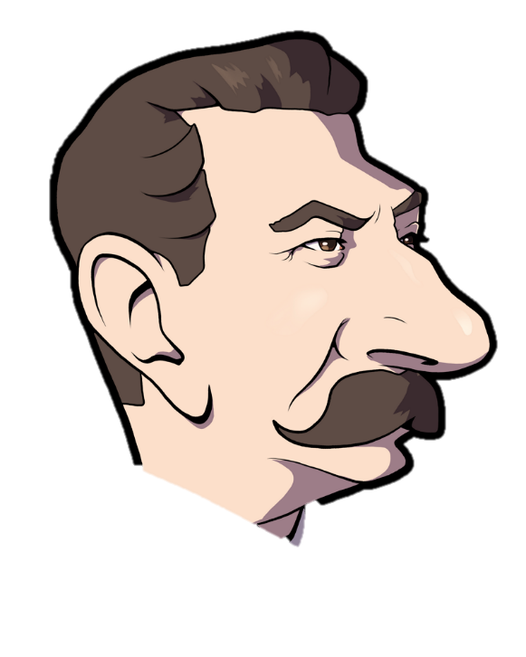
Horrible Irony?
“He gazed up at the enormous face. Forty years it had taken him to learn what kind of smile was hidden beneath the dark moustache. O cruel, needless misunderstanding! O stubborn, self-willed exile from the loving breast! Two gin scented tears trickled down the sides of his nose. But it was all right, everything was all right, the struggle was finished. He had won the victory over himself. He loved Big Brother.” (298).

Slide 41
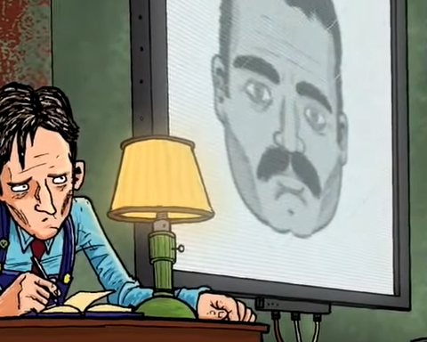
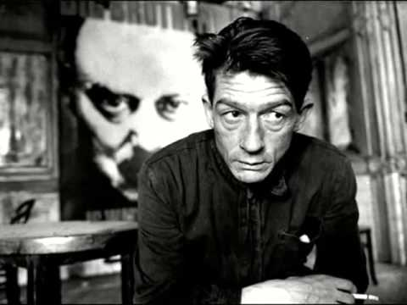
Is 1984 a Tragedy? Is Winston a Tragic Hero?
“To die hating them, that was freedom.” (281).
“But it was all right, everything was all right, the struggle was finished. He had won the victory over himself. He loved Big Brother.” (298).

