Slide 1
Journal #19: Social Commentary & Satire
Learning Targets:
Students will be able to define and analyze examples of social commentary and satire in various types of text.
Students will be able to connect rhetoric, propaganda, and persuasion to social commentary and satire.
Students will be able to identify and analyze irony and parody.

Slide 2
Discuss with a partner:
What is the term for persuasive language?
What are the three broad categories of persuasive language?
What is propaganda?
How would you use fiction to persuade someone to agree with your judgement of certain events?

Slide 3
Social Commentary:
Social Commentary is the act of using rhetorical means to provide an author’s commentary (opinion, analysis, judgment, and/or explanation) on a certain topic or issue with art.
This is done with the idea of inspiring change, awareness, or outrage by informing the general public about a given problem and appealing to a person's sense of justice through art.
What is the difference from news or informative texts and social commentary?
What types of social commentary can you think of? Specific examples?

Slide 4
Social Commentary in Graffiti
Artist: Banksy

Slide 5
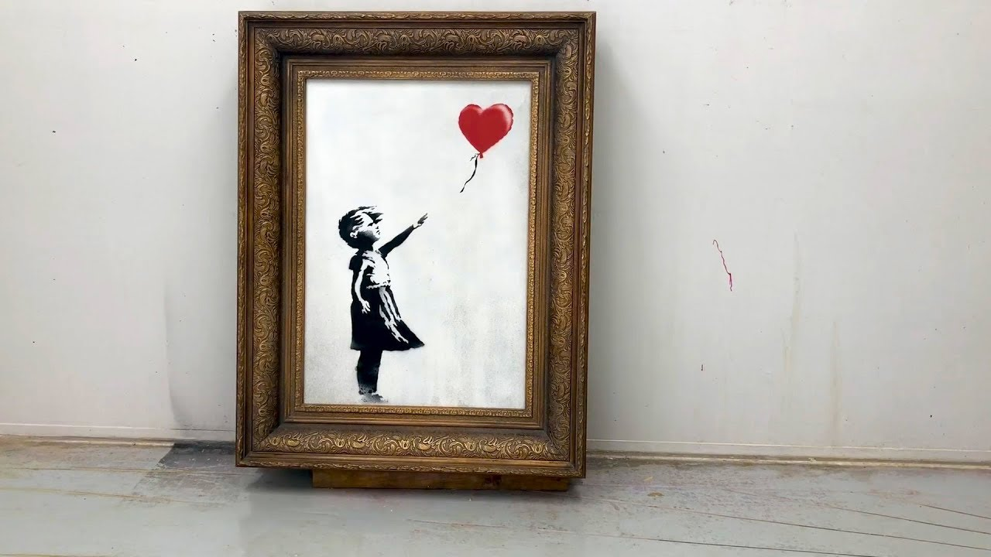
Social Commentary by Banksy
https://www.thefader.com/2018/10/18/banksy-video-shredded-painting
"Girl With Balloon" was auctioned for approximately $1.3 million. As soon as the auction ended a shredder inside the frame shredded the painting.

Slide 6
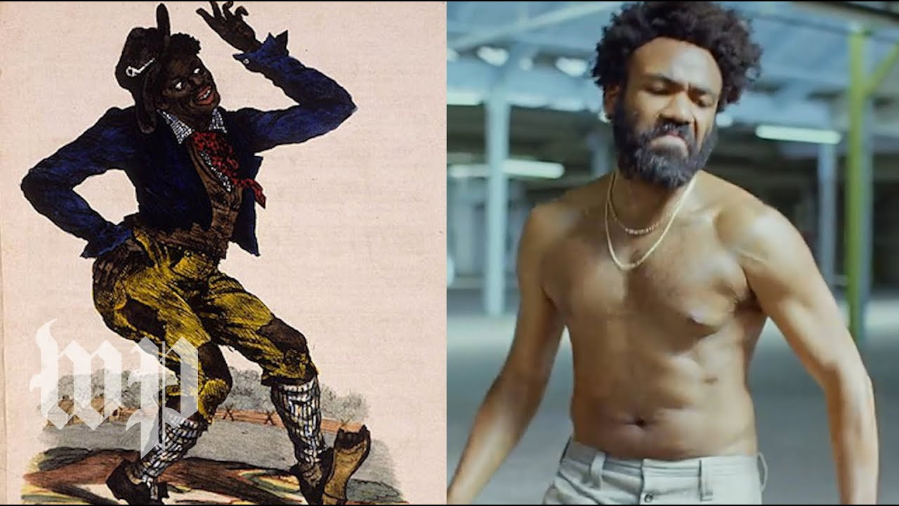
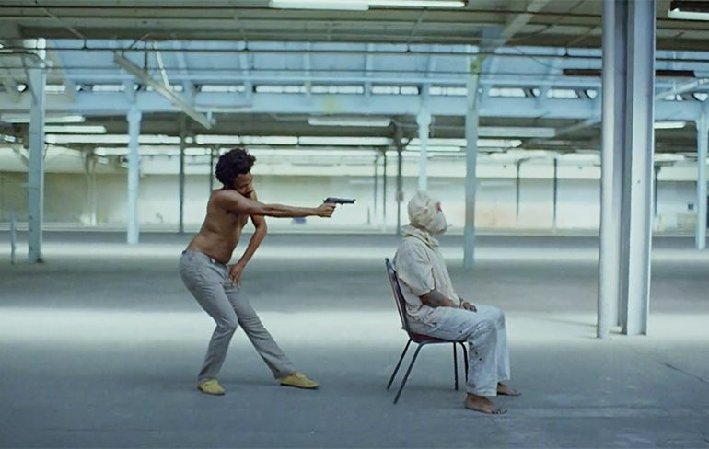
Social Commentary in Rap Music

Slide 7
Social Commentary in Political Cartoons
What is the social issue?
What is the commentary (opinion, analysis, judgment) about a societal issue?

Slide 8
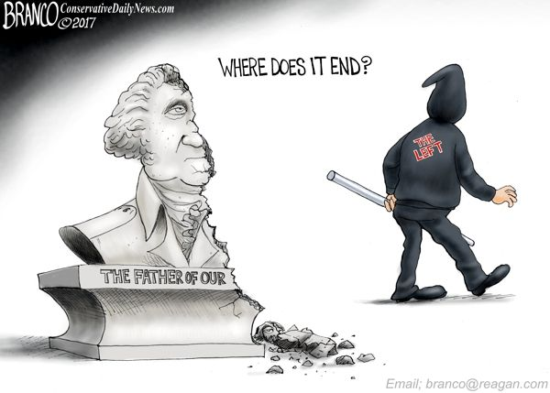
Social Commentary in Political Cartoons Dueling Opinions
How do these different authors, one progressive and one conservative, tackle this debate?
Who’s most persuasive?

Slide 9
Social Commentary in Political Cartoons Dueling Opinions
How do these different authors, one progressive and one conservative, tackle this debate?
Who’s most persuasive?

Slide 10
Social Commentary in Political Cartoons Dueling Opinions
What types of arguments are these cartoons making?
Propaganda techniques? Bias?

Slide 11
https://www.nytimes.com/2017/08/18/us/politics/right-and-left-on-removal-of-confederate-statues.html

Slide 12
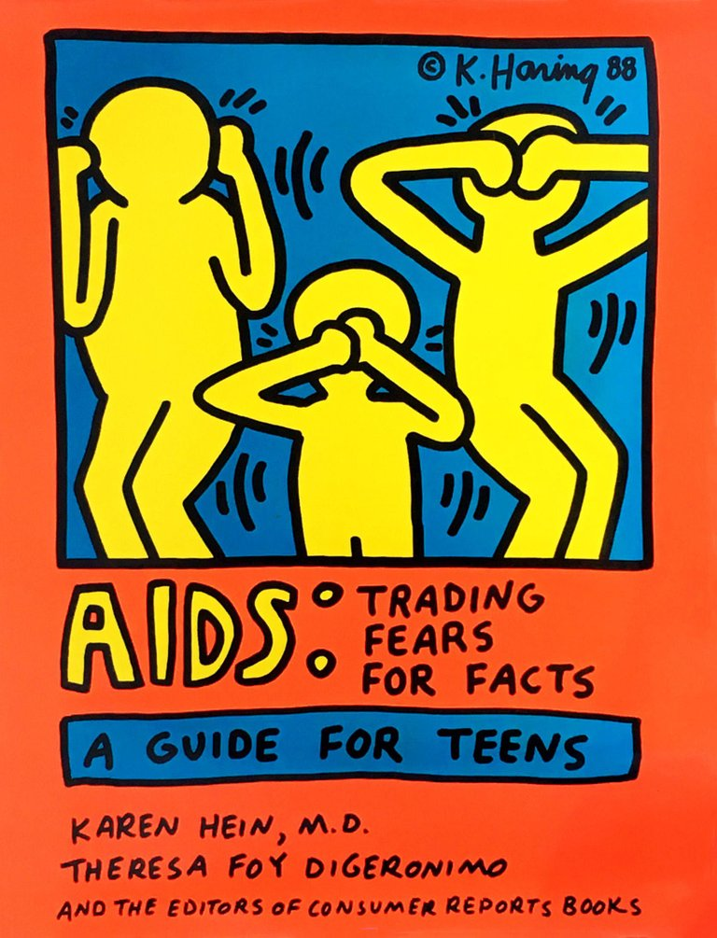
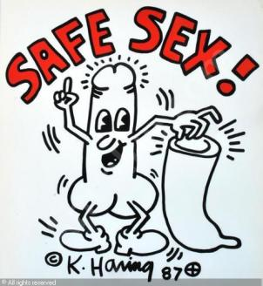
Social Commentary in Fine Arts
What is the social issue?
What is the commentary (opinion, analysis, judgment) about a societal issue?
(Censorship)
Artist: Keith Haring

Slide 13
Social Commentary in Literature
What is the social issue?
What is the commentary (opinion, analysis, judgment) about a societal issue?

Slide 14
Social Commentary in Music
Listen to Macklemore and Ryan Lewis’ “White Privilege II” song. Hip-Hop as a genre is deeply embedded in the black experience and as a result is primarily a voice for social critique.
As you listen mark the text with a star for an interesting line, a question mark for something you have a question about, and a plus for an idea you have heard before.
What is the social issue?
What questions is Macklemore asking himself?
Why does he include all of the voices he does?
Explain the commentary of the song. What is it saying? Be thorough, it’s a complex song.
Explain the analogy at the end of the song.

Slide 15
Psst, I totally get it, you're by yourself
And the last thing you want to do is take a picture
But seriously, my little girl loves you
She's always singing, "I'm gonna pop some tags"
I'm not kidding, my oldest, you even got him to go thrifting
And "One Love", oh, my God, that song - brilliant
Their aunt is gay, when that song came out
My son told his whole class he was actually proud
That's so cool, look what you're accomplishing
Even an old mom like me likes it cause it's positive
You're the only hip-hop that I let my kids listen to
Cause you get it, all that negative stuff isn't cool
Yeah, like all the guns and the drugs
The b****** and the h*** and the gangs and the thugs
Even the protest outside - so sad and so dumb
If a cop pulls you over, it's your fault if you run
Huh?
What is Macklemore’s purpose for including this fan dialogue?
How does it develop the complexity of his commentary?
What common stereotypes does this fan reveal?

Slide 16
https://www.youtube.com/watch?v=jW0lTkcGX7I Geraldo Rivera: HIP HOP IS WORSE THAN RACISM
https://consequenceofsound.net/2017/04/geraldo-rivera-responds-to-kendrick-lamar-still-believes-hip-hop-has-done-more-damage-than-racism/
Lamar responds

Slide 17
G Eazy “Endless Summer Freestyle”
Cops killin' black kids and get off scot-free What's the difference, what would happen if a cop shot me? White privilege is real, black lives matter I hope the barbecues at Lake Merritt get blacker

Slide 18
“White Privilege II”
“DNA.” by Kendrick Lamar
“Psst, I totally get it, you're by yourself And the last thing you want to do is take a picture But seriously, my little girl loves you She's always singing, "I'm gonna pop some tags“ I'm not kidding, my oldest, you even got him to go thrifting And "One Love", oh, my God, that song – brilliant Their aunt is gay, when that song came out My son told his whole class he was actually proud That's so cool, look what you're accomplishing Even an old mom like me likes it cause it's positive You're the only hip-hop that I let my kids listen to Cause you get it, all that negative stuff isn't cool Yeah, like all the guns and the drugs The bitches and the hoes and the gangs and the thugs Even the protest outside - so sad and so dumb If a cop pulls you over, it's your fault if you run”
And pessimists never struck my nerve
And that's a riff, gonna plead this case
The reason my power's here on earth
Salute the truth, when the prophet say
“This is why I say that hip-hop has done more damage to young African Americans than racism in recent years”
Tell me something’
You mother*****s can’t tell me nothing
I’d rather die than listen to you
https://www.youtube.com/watch?v=RKPtfvN0dRA

Slide 19
Social Commentary in Music
1. Macklemore and Lewis anticipated critiques of the song from white listeners and people of color alike.
“This song was a processing-out-loud,” the rapper says. “And it wasn’t, like, ‘How can we beat the critics to the punch? How can we exempt ourselves from this angle, and this angle, and this angle.’ You realize that you’re not going to beat it and you never could. And then it keeps coming back to: It’s not about me. Even though I am the subject, because I’m writing it from my point of view — which I thought was very important — starting the song at a protest, hearing ‘black lives matter’ for the first time, not knowing what to do, moving on to all of this internalized shit in my head that I’m processing, that I’m going through, hearing different people’s perspectives, coming to some sort of conclusion, still asking that question: Will I show up for black lives at the end of this? I had to do all this out loud and come to the conclusion that this is not about me. So if I’m put on blast, critiqued, broken down, questioned — all those things will happen, and they are completely valid. That’s part of the design of the conversation. If there’s a bigger teachable moment through this record, at the expense of me potentially being like, ‘Oh, I should have said this,’ or ‘I shouldn’t have said this,’ or ‘I see where that criticism is coming from,’ that’s OK.
“The question is, What type of human do I want to be? How do I want to use my platform? Do I want to be safe, under the umbrella of my white privilege? Or do I want to push back and resist? There’s not a right or wrong answer for any human out there, it’s just an individual question, and I think that, for a long time, we were safe. It’s easier, as a white person, to be silent about racial injustice. It’s easier. On paper. But it’s not easier on the whole, because injustice affects all of us, whether we know it or not, whether we acknowledge it or not. At a certain point, this song might affect sales, this might affect touring, but it doesn’t matter if I’m not speaking up – if I’m not pushing myself to speak truth.”

Slide 20
Knock-Knock…
Turn to the person next to you. Tell them your best joke*. *nothing racist, sexist, etc.
What makes that joke funny? Or, what makes it not funny?

Slide 21
Analyzing Humor
E. B. White said, “Analyzing humor is like dissecting a frog. Few people are interested and the frog dies of it.”
Although definitions of humor differ somewhat, depending on whether one approaches it from a psychological, anthropological, or literary perspective, most scholars agree that it is rooted in expectation and surprise.
One of the fundamental aspects of humor is that it disrupts expectations. It violates our logical perceptions of the normal.

Slide 22
Humor & Power
Another aspect of humor: it can be hostile. Whether playfully self-deprecating or virulently abusive, most humor has a target. Someone or something is the butt of the joke.
That being said, humor also…
Helps builds community
Allows us to discuss topics that are difficult & uncomfortable by easing that discomfort
Whatever is funny is subversive.
—George Orwell
That's the only story I got. That's why I have to keep changing locales and times and characters — because you have to keep disguising the story. And it's essentially that the Small can overcome the Large — with treachery and creativity and humor.
— Ken Kesey

Slide 23
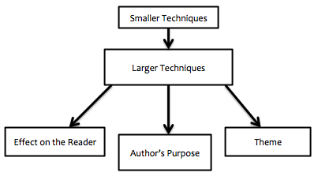
Satire:
Satire is a specific type of social commentary that uses humor to share the author’s commentary. Because humor often involves having a target, satire usually is used to expose and criticize stupidity, injustice, or vices; particularly in the context of contemporary politics and other societal issues. Satire is often developed through the following small techniques:
Sarcasm
Allegory
Juxtaposition
Tone/mood
Especially: serious handling of ridiculous subjects, or ridiculous handling of serious subjects.
Hyperbole
Irony
Parody

Slide 24
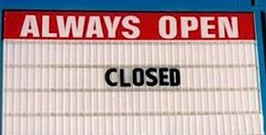
Irony
Irony is figurative language when words are used in such a way that their intended meaning is different from their actual meaning in a incongruent way. Irony is often used to create humor or drama.
Also: the expression of one's meaning by using language that normally signifies the opposite, typically for humorous or emphatic effect.
In literature, there are 3 types of irony.
Dramatic Irony: When the audience knows more than the characters do.
Situational Irony: incongruity appears between expectations of something to happen, and what actually happens instead.
Verbal Irony: occurs when a speaker says something incongruent with what they really mean; OR the speaker says something WE know is not true, but they don’t.
Types of Verbal Irony:
Sarcasm: Mr. Smith is SUCH a morning person, he loves getting up at 4:45 am.
Overstatement: an intentional exaggeration
Understatement: the opposite

Slide 25
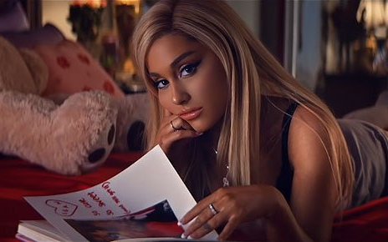
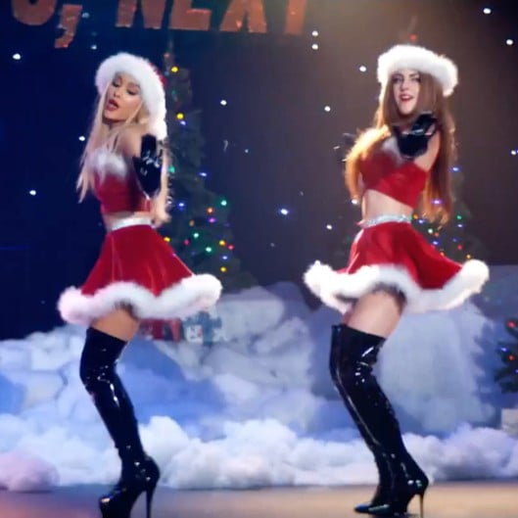
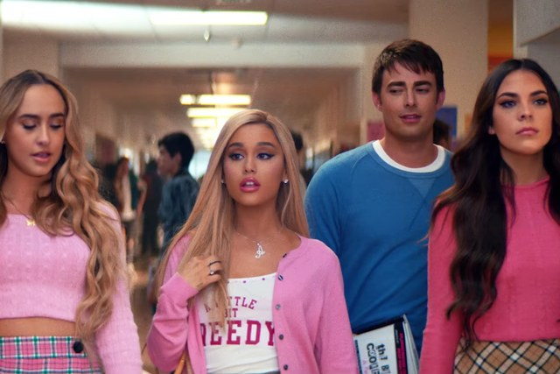
Parody:
Parody is an imitation of the style of a particular writer, artist, text, event, or genre with deliberate exaggeration to create humor. Not always satirical.
“Thank You, Next” Music Video
Mean Girls (movie)

Slide 26
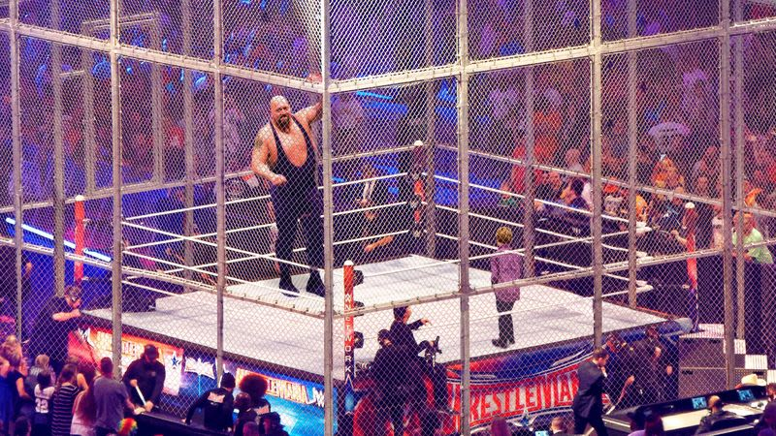
Satire Example
Read the article: WWE Staff Forced To Shoot Aggressive Wrestler After Child Climbs Into Steel Cage
What elements of satire does the Onion article use?
What social issue is it commenting on?
How is it trying to create humor?

Slide 27
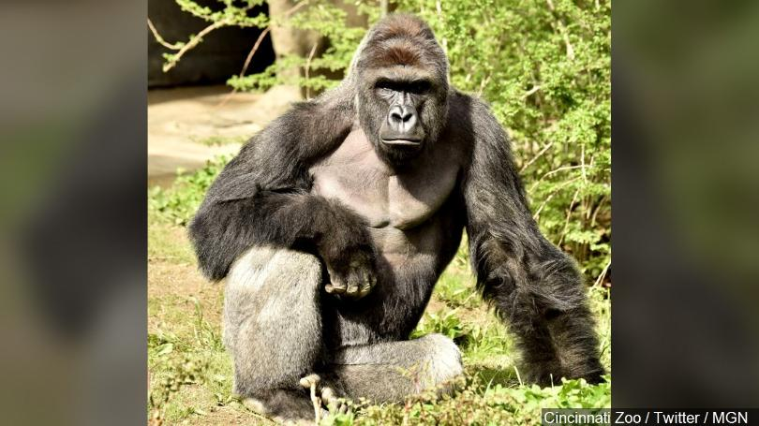
Satire Example
WWE Staff Forced To Shoot Aggressive Wrestler After Child Climbs Into Steel Cage

Slide 28
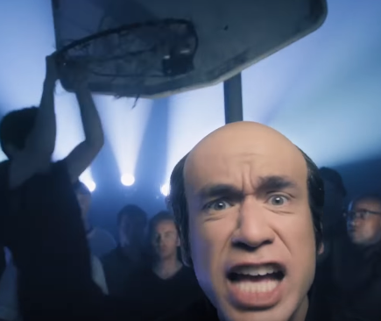
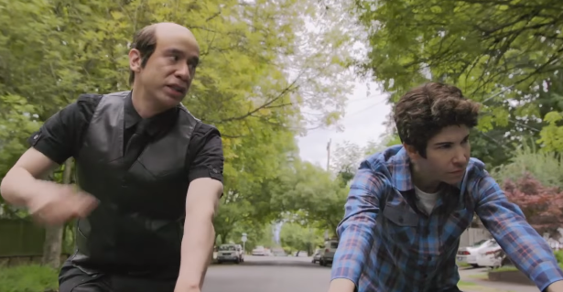
Satire Example
Watch the video from Portlandia “What about Men?”
How did they develop satire? What was their commentary? Who was the target?
How was it trying to be funny?
Was there any Irony in the clip?
How did the clip “What about Men?” use parody?

Slide 29
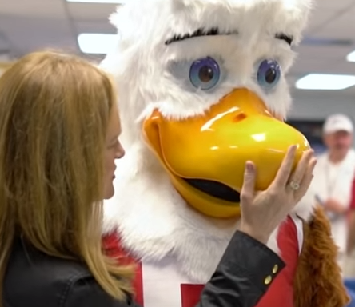
Satire Example
Watch the video from Full Frontal with Sammantha Bee
How did they develop satire? What was their commentary? Who was the target?
How was it trying to be funny?
Was there any Irony in the clip?
Where was it trying to be funny?
Juxtaposition occurs many times in the clip. List 2 specific times. Also, how does the clip use juxtaposition on a thematic level and what is the effect?
How was the clip propaganda?

Slide 30
Task…

Slide 31
“Enough has happened to justify us in believing that the pen’s response to the challenge of force is not ludicrous and hopeless; indeed, it is perhaps the one serious hope we have.”
—C.M. Woodhouse

