Slide 1
Journal #9: Social Commentary & Satire
Learning Targets:
Students will be able to define and analyze examples of social commentary and satire in various types of text.
Students will be able to connect rhetoric, propaganda, and persuasion to social commentary and satire.
Students will be able to identify and analyze irony and parody.

Slide 2
Discuss with a partner:
What is the term for persuasive language?
What are the three broad categories of persuasive language?
What is propaganda?
How would you use fiction to persuade someone to agree with your judgement of certain events?

Slide 3
Social Commentary:
Social Commentary is the act of using rhetorical means to provide an author’s commentary (opinion, analysis, judgment, and/or explanation) on a certain topic or issue with art.
This is done with the idea of inspiring change, awareness, or outrage by informing the general public about a given problem and appealing to a person's sense of justice through art.
What is the difference from news or informative texts and social commentary?
What types of social commentary can you think of? Specific examples?

Slide 4
Social Commentary in Graffiti
Artist: Banksy

Slide 5
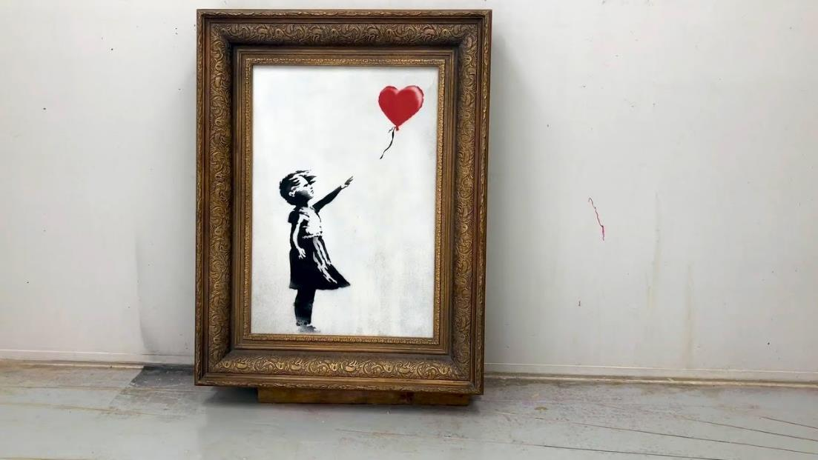
Social Commentary by Banksy
https://www.thefader.com/2018/10/18/banksy-video-shredded-painting
"Girl With Balloon" was auctioned for approximately $1.3 million. As soon as the auction ended a shredder inside the frame shredded the painting.

Slide 6
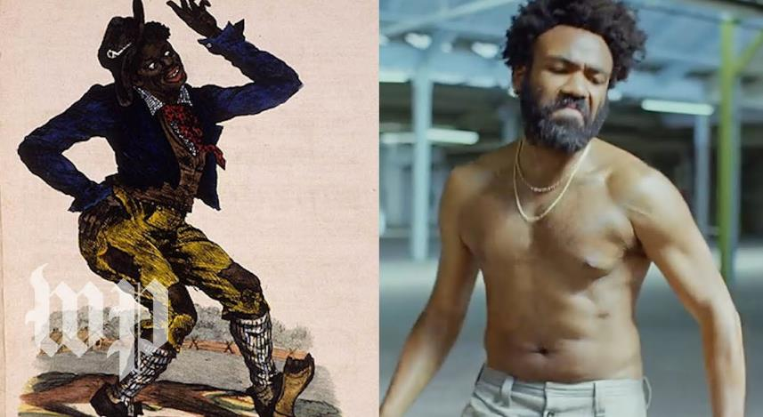
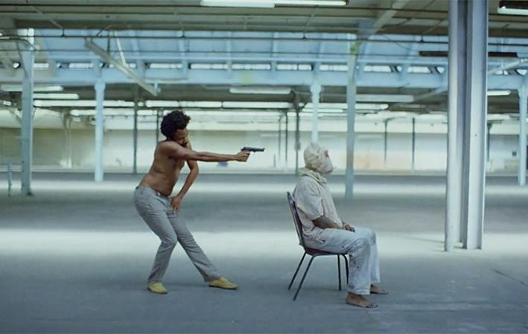
Social Commentary in Rap Music

Slide 7
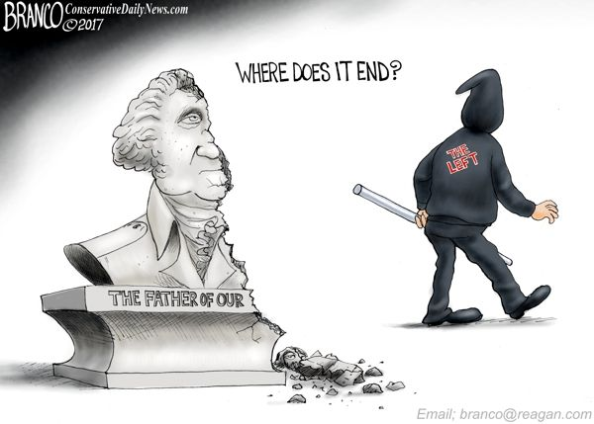
Social Commentary in Political Cartoons Dueling Opinions
Politically LEFT Supports removing Confederate statues
Politically RIGHT Supports keeping Confederate statues

Slide 8
Knock-Knock…
Turn to the person next to you. Tell them your best joke*. *nothing racist, sexist, etc.
What makes that joke funny? Or, what makes it not funny?

Slide 9
Analyzing Humor
E. B. White said, “Analyzing humor is like dissecting a frog. Few people are interested and the frog dies of it.”
Although definitions of humor differ somewhat, depending on whether one approaches it from a psychological, anthropological, or literary perspective, most scholars agree that it is rooted in expectation and surprise.
One of the fundamental aspects of humor is that it disrupts expectations. It violates our logical perceptions of the normal.

Slide 10
How does this tweet meet the requirements for humor?
Although definitions of humor differ somewhat, depending on whether one approaches it from a psychological, anthropological, or literary perspective, most scholars agree that it is rooted in expectation and surprise.
One of the fundamental aspects of humor is that it disrupts expectations. It violates our logical perceptions of the normal.

Slide 11
Humor & Power
Another aspect of humor: it can be hostile. Whether playfully self-deprecating or virulently abusive, most humor has a target. Someone or something is the butt of the joke.
That being said, humor also…
Helps builds community
Allows us to discuss topics that are difficult & uncomfortable by easing that discomfort
Whatever is funny is subversive.
—George Orwell
That's the only story I got. That's why I have to keep changing locales and times and characters — because you have to keep disguising the story. And it's essentially that the Small can overcome the Large — with treachery and creativity and humor.
— Ken Kesey

Slide 12
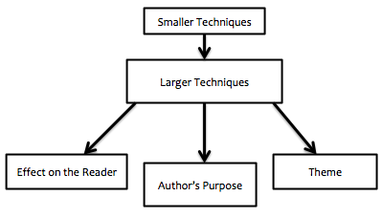
Satire:
Satire is a specific type of social commentary that uses humor. Because humor often involves having a target, satire usually is used to expose and criticize stupidity, injustice, or vices of the powerful; particularly in the context of contemporary politics and other societal issues. Satire is often developed through the following small techniques:
Sarcasm
Allegory
Juxtaposition
Tone/Mood
Especially: serious handling of ridiculous subjects, or ridiculous handling of serious ones.
Hyperbole
Irony
Parody
“Satire is meant to ridicule power. If you are laughing at people who are hurting, it’s not satire, it’s bullying.” –Terry Pratchett

Slide 13
Social Commentary & Satire

Slide 14
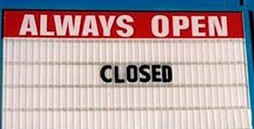
Irony
Irony is figurative language when words are used in such a way that their intended meaning is different from their actual meaning in a incongruent way. Irony is often used to create humor or drama.
Also: the expression of one's meaning by using language that normally signifies the opposite, typically for humorous or emphatic effect.
In literature, there are 3 types of irony.
Dramatic Irony: When the audience knows more than the characters do.
Situational Irony: incongruity appears between expectations of something to happen, and what actually happens instead.
Verbal Irony: occurs when a speaker says something incongruent with what they really mean; OR the speaker says something WE know is not true, but they don’t.
Types of Verbal Irony:
Sarcasm: Mr. Smith is SUCH a morning person, he loves getting up at 4:45 am.
Overstatement: an intentional exaggeration
Understatement: the opposite

Slide 15
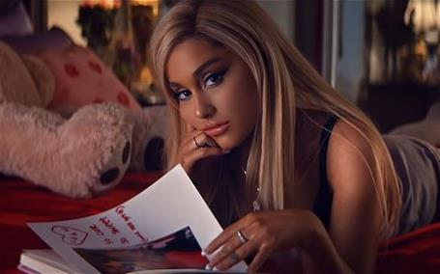
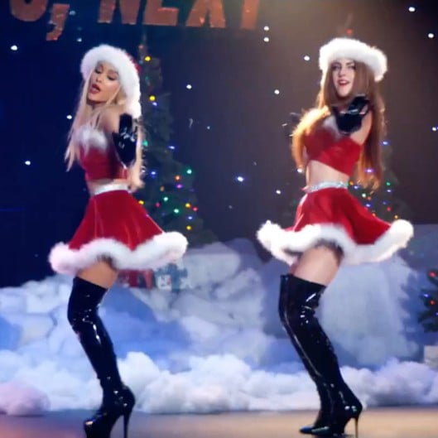
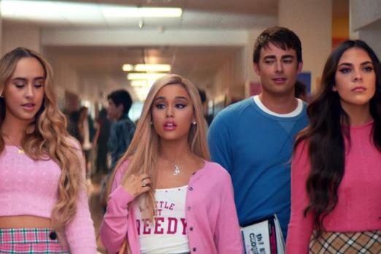
Parody:
Parody is an imitation of the style of a particular writer, artist, text, event, or genre with deliberate exaggeration to create humor. Not always satirical.
“Thank You, Next” Music Video
Mean Girls (movie)

Slide 16
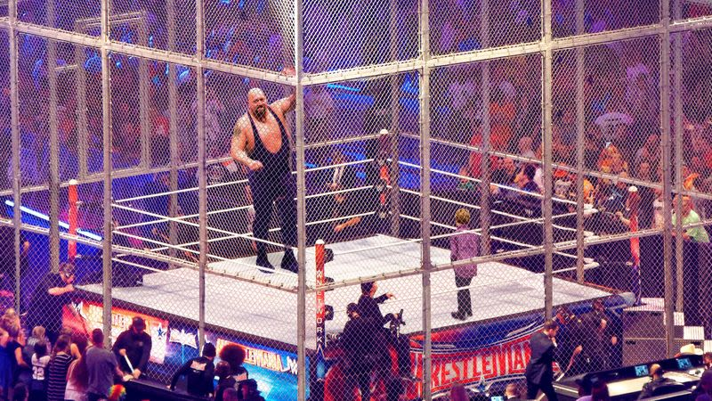
Satire Example
Read the article: “WWE Staff Forced To Shoot Aggressive Wrestler After Child Climbs Into Steel Cage”
What elements of satire does The Onion article use?
What social issue is it commenting on?
How is it trying to create humor?

Slide 17
“WWE Staff Forced To Shoot Aggressive Wrestler After Child Climbs Into Steel Cage” & Satire

Slide 18
Lead Students through this discussion to get a thesis

Slide 19
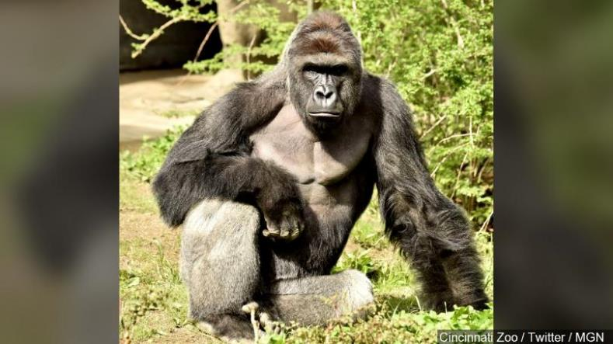
Satire Example
WWE Staff Forced To Shoot Aggressive Wrestler After Child Climbs Into Steel Cage

Slide 20
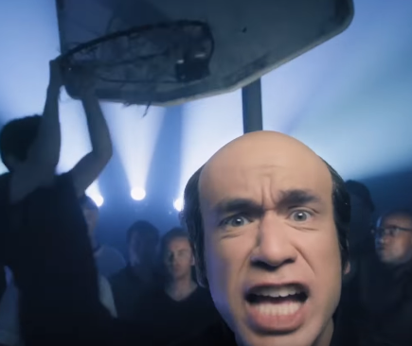
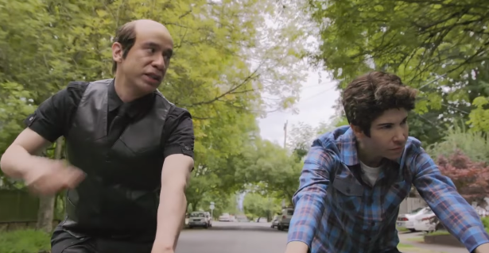
Satire Example
Watch the video from Portlandia “What about Men?”
How did they develop satire? What was their commentary? Who was the target?
How was it trying to be funny?
Identify Irony in the clip?
How did the clip “What about Men?” use parody?

