Slide 1
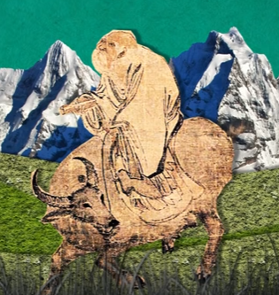
Weekly Schedule
Monday: Set up journal and watch video about Lao-Tzu
+ ActivelyLearn article
Tuesday: Santos time
Wednesday: Finish notes, watch video about Yin & Yang, start reading the TaoTeChing
Thursday: TaoTeChing + fill in chart
Friday: TaoTeChing + fill in chart

Slide 2
FYI: STYLE OF YOUR CHINA QUIZ:
Which famous ancient Chinese philosopher would have said: "The usefulness of a pot comes from its emptiness“?
Lao-tzu
Confucius
Sun Tzu
Which famous ancient Chinese philosopher would have said: “…..”?
Lao-tzu
Confucius
Sun Tzu

Slide 3
Journal 27: Taoism
Students will be able to label Yin and Yang.
Students will be able to explain and differentiate Yin from Yang.
Students will be able to define pantheism and differentiate pantheism from monotheism and polytheism.
Students will be able to identify the key ideas of Taoism and differentiate them from Confucianism.

Slide 4
Taoism (Daoism)
An ancient religion and philosophy of China
About 20,000,000 Taoists around the world
Believe in following “the tao” → The Way
Pantheism: ‘god’ is in all things but not one single being, more of an energy or spark of life than an idol
Like “The Force” from Star Wars
Monotheism: one god
Polytheism: many gods
Confucianism’s goal was to bring China to a more advanced stage of social and cultural progress and teach them to live moral lives together in society.
Taoism is the antithesis of that.
If Confucianism wanted people to live in civilization under a strong ruler, Taoism wanted people to live in harmony with nature.

Slide 5
Lao-Tzu
Watch this (6 min) video and take notes: https://www.youtube.com/watch?v=dFb7Hxva5rg
If you want more, try this (10 min) video: https://www.youtube.com/watch?v=JtGtqmC5wU4
Actively Learn Article: “The Wisdom of Wu-Wei: Letting Good Things Happen”

Slide 6
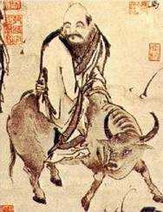
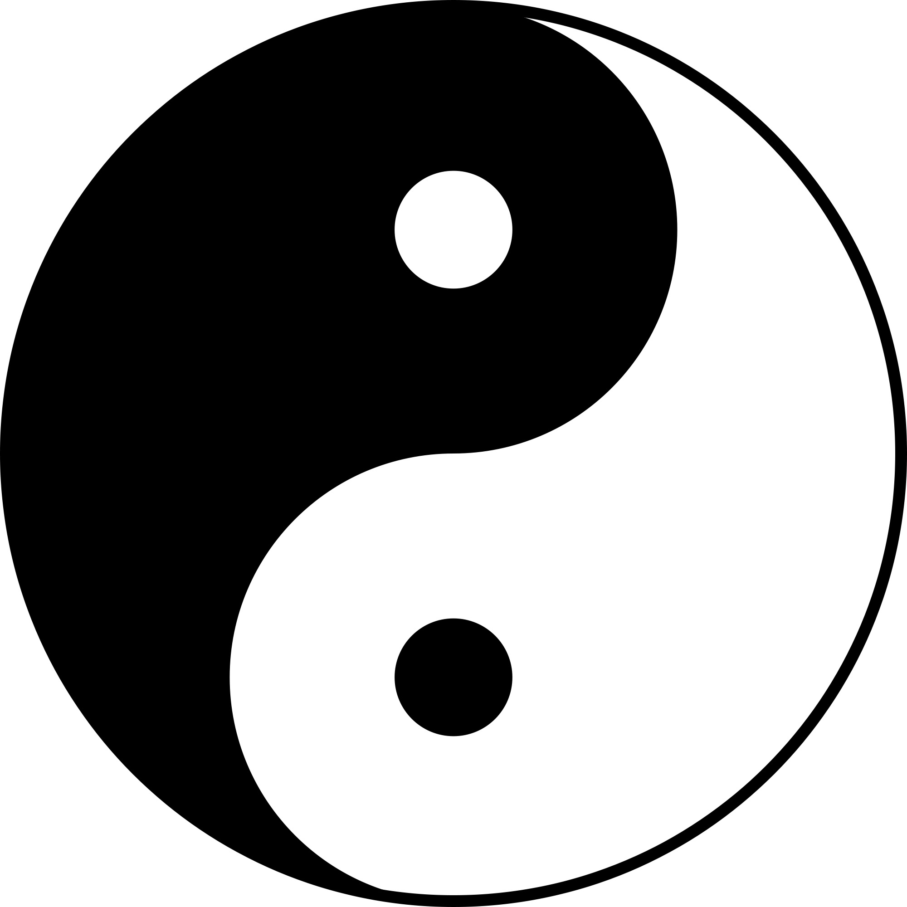
Taoism
Taoism (pronounced Daoism) is a religious, spiritual, and philosophical belief system in China and much of Asia.
It’s creation is credited to Lao Tzu, who may not even have ever existed. (We’re going to assume he did).
Tao means “the Way” or “the Path”
Inspired by the balance seen in nature.
Pantheistic.
Important concepts: “Qi” (chi) and “Wu Wei” and yin and yang

Slide 7
Think about:
What is this called?
What religion does it belong to?
What does it mean?
https://ed.ted.com/lessons/the-hidden-meanings-of-yin-and-yang-john-bellaimey

Slide 8
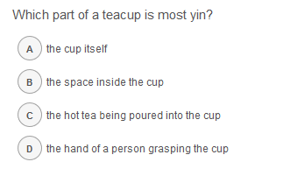

Slide 9
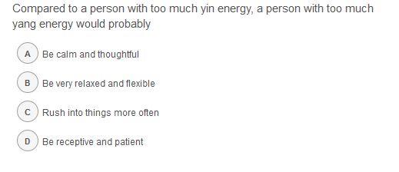

Slide 10
What do you think are the pros and cons of a religion or philosophy in which the "God" is not personal? What is the word for this?

Slide 11
Basic Concepts Defining the Nature of Yin Yang:
Neither Yin nor Yang are absolute. Nothing is completely Yin or completely Yang. Each aspect contains the beginning point for the other aspect. For example: day becomes night and then night becomes day…Yin and Yang are interdependent upon each other so that the definition of one requires the definition for the other to be complete.
Yin Yang is not static. The nature of Yin and Yang flows and changes with time. A simple example is thinking about how the day gradually flows into night. However, the length of day and night are changing. As the earth ages, its spin is slowing causing the length of day and night to get longer. Day and night are not static entities. Sometimes changes in the relationship between Yin and Yang can be dramatic where one aspect can literally just transform into the other. As an example: some species of fish have females that transform quickly into males when the population of males aren’t enough.
The summation of Yin and Yang form a whole. One effect of this is: as one aspect increases the other decreases to maintain overall balance of the whole.
These imbalances can be paired: so an excess of Yin can also simulate a Yang deficiency and vice versa. As an example this concept is especially important for Chinese healing practices. So an excess of Yang results in a fever. An excess of Yin could mean the accumulation of fluids in the body. Chinese healing examines a person’s health is in terms of the eight principles: Internal and External stimuli, Deficiency and Excesses, Cold and Heat and Yin and Yang.
Additional principles defining Yin and Yang qualities exist. The concepts listed here are merely a starting point to illustrate the nature of Yin and Yang. Usually as a practice Taoism does a good job of not codifying life. Which is ironic since many Taoist’s can happily list out what is Yin and what is Yang. Typically Taoist texts will list a few examples of Yin and Yang and then meander off to the next topic. Which makes sense as from a Taoist perspective it’s for the reader to reveal life from their own perspective. As an example go back to the Taoist passage quoted above from the Tao Te Ching. You will discover a few additional aspects to Yin and Yang, but the passage isn’t a complete definition either. The author of this passage fully expects you as the reader to go out and to explore the ideas on your own.

Slide 12
Tao Te Ching
The most important piece of literary tradition for Taoism is the or Tao Te Ching. The Tao Te Ching is like the bible to Taoism, or the Analects to Confucianism.
The Tao Te Ching is very complicated– multiple translations and versions exist ranging as far back as the 4th century BCE.
It contains many paradoxes: such as “Thus being and non-being produce each other”
What does this particular paradox remind you of?
Taoist virtues:
Compassion
Moderation
absolute simplicity of living
Less is more
Nature and learning from the natural world
Balance

Slide 13
Annotate Chapter 42 of the Tao Te Ching with learning about Yin yang (with a partner)
Highlight/Underline information about Yin and Yang from the text.
Identify details you learned about from the video or Smith’s short lecture.
Identify details that you have questions about or find interesting.
https://ed.ted.com/lessons/the-hidden-meanings-of-yin-and-yang-john-bellaimey

Slide 14
This chart

Slide 15
Taoism + Tao Te Ching
Read the assigned selections of the Tao Te Ching and answer the questions for your chapter:
Find lines that represent the Taoist philosophy of Wu-Wei
At least 6
Find clues to pantheism, Qi, and Tao.
At least 6
Find things about Yin-Yang.
At least 2 other things not from Chapter 42
Record 5 Paradoxes
Didactic Advice: find connections to:
Compassion
Moderation
absolute simplicity of living
Less is more
Nature and learning from the natural world
Balance
Leadership
What do you think each chapter means? Explain 4 in your journal.
What is Taoist advice about: leadership, war, and other topics Confucius looked at? Explain 4 in your journal.

Slide 16
Tao Te Ching: Chapter 57
Use justice to rule a country Use surprise to wage war. Use non-action to govern the world.
How do I know it so? As for the world, The more restrictions there are, The poorer the people will be. The more sharp weapons people have in a country, The bigger the disorder will be. The more clever and cunning people are, The stranger the events will be. The more laws and commands there are, The more thieves and robbers there will be.
Therefore the sages says: I do not act, And people become reformed by themselves. I am at peace, and people become fair by themselves. I do not interfere, And people become rich by themselves. I have no desire to desire, And people become like the uncarved wood by themselves.

Slide 17
Tao Te Ching: Chapter 14
Look at it, it cannot be seen It is called colorless Listen to it, it cannot be heard It is called noiseless Reach for it, it cannot be held It is called formless These three cannot be completely unraveled So they are combined into one
Above it, not bright Below it, not dark Continuing endlessly, cannot be named It returns back into nothingness Thus it is called the form of the formless The image of the imageless This is called enigmatic Confront it, its front cannot be seen Follow it, its back cannot be seen
Wield the Tao of the ancients To manage the existence of today One can know the ancient beginning It is called the Tao Axiom

Slide 18
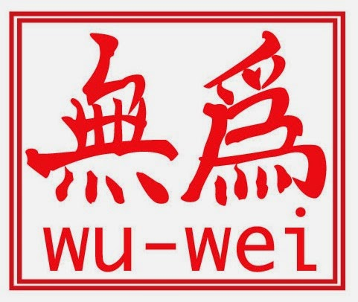
Wu-Wei
https://www.youtube.com/watch?v=NvZi7ZV-SWI&list=PLwxNMb28XmpeUL1vz9Su7OmeghBDgmj7X&index=1
How is Wu-Wei more complicated than doing nothing?
What does going against the “natural flow of the universe” look like?
What situations in your life might be improved by following Wu-Wei?
https://www.youtube.com/watch?v=lLWEXRAnQd0

Slide 19
Qi (chi)
Important Tao concept
Qi is life-force -- that which animates the forms of the world.
Notes:
Use an excerpt from The Lion King- Rafiki’s lesson about what is in the past is in the past.

Slide 20
Wu-Wei
Important Tao concept: do nothing or “wu-wei”
The idea of wu-wei does not mean that people should sit around and do nothing, rather people should not indulge in useless efforts or actions and do anything that contradicts nature or the natural flow of the world and Tao.
Notes:
Use an excerpt from The Lion King- Rafiki’s lesson about what is in the past is in the past.

Slide 21
Application Task
Choose ONE:
Pick your favorite chapter from the Tao Te Ching and create an annotated poster to show the Taoist concepts in it. You must have 7 detailed annotations explaining the Taoist philosophies in your chapter.
OR
Create your own chapter for the Tao Te Ching (#82) and, copying the style of the text, include 2 paradoxes, the concept of wu-wei, the idea of ‘less is more’ and the “tao.”
Label the ideas (less than a detailed annotation)

