Slide 1
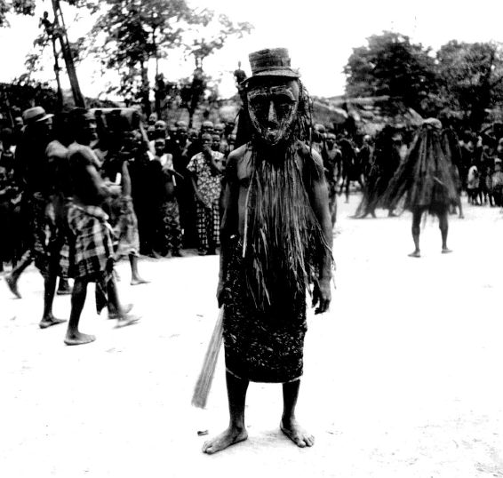
Things Fall Apart chapter 10 (87-94)
What are the Egwugwu like?
What is the name of their leader?
Why does Evil Forest address Uzowulu saying, “Uzowulu’s body, I salute you”? (90).
How do the Igbo people suspend disbelief when the Egwugwu are present?
What things do we learn about Igbo culture from this chapter?
Laws? How does Igbo patriarchy get more complicated as result of the case?
Why will Uzowulu listen to the decision of the Egwugwu?

Slide 2
1. Why does Evil Forest address Uzowulu saying, “Uzowulu’s body, I salute you”? (p. 64)
2. Why does Evil Forest say, “Uzowulu’s body, do you know me?” (p. 64)
3. What is the law of Umuofia concerning the bride-price of a woman who runs away from her husband?
4. How does Evil Forest keep order when the crowd roars with laughter during the trial?
5. What role do Uzowulu’s neighbors play in the trial?
6. Why do Evil Forest and the other egwugwu run a few steps in the direction of the women?
7. What are some of the names Evil Forest gives himself?
8. What is the purpose of the metal gong, the drums, and the flute?
9. Why will Uzowulu listen to the decision of the egwugwu?
10. The egwugwu hear a land case after Uzowulu’s case. What is a land case?
Answers
1. Spirits always address humans as bodies.
2. Evil Forest asks Uzowulu if he recognizes him as one of the living. Uzowulu responds, “How can I know you father? You are beyond our knowledge.” (p. 64) Evil Forest emphasizes the point that he is not one of the living.
3. The law of Umuofia says that if a woman runs away from her husband, the bride-price must be returned.
4. Evil Forest keeps order when the crowd roars with laughter during the trial by rising to his feet. A steady cloud of smoke rises from his head.
5. The neighbors testify that Uzowulu beat his wife.
6. The women flee in terror, but they return to their places almost immediately. The egwugwu instill fear in the women.
7. Evil Forest calls himself “Dry-meat-that-fills-the-mouth,” and “Fire-that-burns-without-faggots.” A faggot is a dry stick. (p. 66)
8. The metal gong, the drums, and the flute all contribute to the excitement of the trial in the presence of the egwugwu. The instruments announce different sections of the trial.
9. Uzowulu will listen to the decision of the egwugwu because they represent the ancestral spirits.
10. A land case is a dispute over property.

Slide 4
Things Fall Apart chapter 10 (87-94)
What is ironic about Okonkwo being one of the Egwugwu?
Do we have Egwugwu in America? Similarities? Differences?

Slide 5
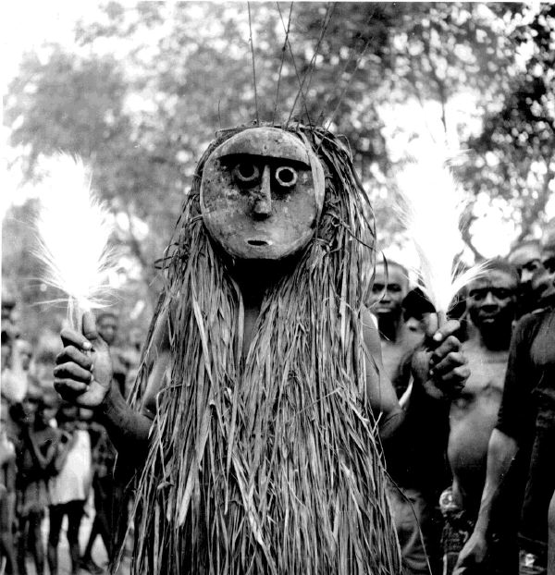
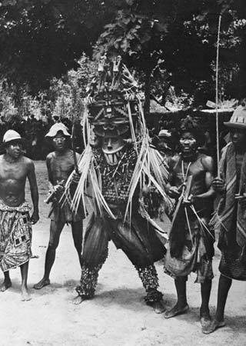
Egwugwu

Slide 6
HW: Create a scene from the Igbo Oral Tradition in chapter 11 that:
Shows what the story’s purpose for the Igbo people is

