Slide 1
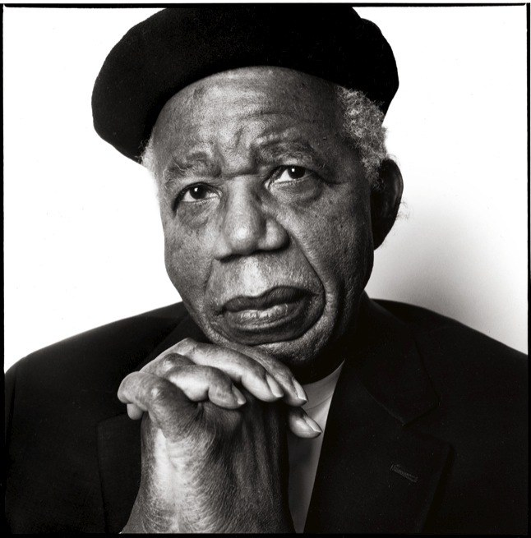
Chinua Achebe
Born 1930 in Nigeria; died March 21st, 2013
Writes about the breakdown of traditional African Culture in the face of European Colonization in the 1800s. Does not necessarily view colonialism as completely evil.
Achebe is trying not only to inform the outside world about Igbo cultural traditions, but to remind his own people of their past and to assert that it contained much of value.
Also sought to educate his fellow Nigerians about their culture and traditions.
Wants audience to appreciate complex African society, rather than viewing it as “savage” or “bizarre.”
He wants readers to see cultural similarities and appreciate the Igbo.
Achebe HATES the stereotype of Africa as undifferentiated “primitive” and the willingness for people to accept European judgments about African history and culture.
Chinua Achebe has been described as a “social novelist” in that he believes literature can create social change.

Slide 2
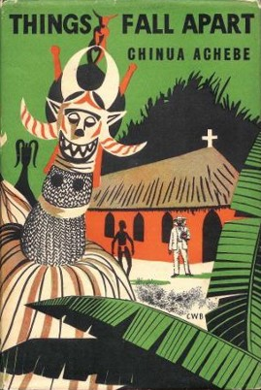
Okonkwo is a member of the Igbo people.
Traditionally, the Igbo lived in villages based on lineage; the male heads of household were all related through their fathers. A prosperous man would have two or three wives, each living in her own hut within the family compound.
Because of their proximity to West African ports, many Igbos were captured and enslaved by European and African slave traders. In 1807, the British Parliament outlawed the slave trade, and many British merchants began trading in palm oil and other goods.
The British missionary and military presence increased, with the aims of converting Africans to Christianity, enforcing the ban on slave trading, and protecting British economic interests. Things Fall Apart takes place during this early period of British colonization.

Slide 3
Early Western Views of Africans: the creation of ‘blackness’ and ‘the other’
By the sixth century B. C. economic and military contact between Africa and Greece was fairly common and several Greeks, most famously Herodotus, prepared "traveler's reports" that included discussion of Africa. Herodotus's reports, which intermingled experience and myth, reported the presence of "dog-eared men" and headless men with eyes in their chests (Miller 1985).
Primarily Greeks did not view Africans through a racial lens of skin-color.
While other Greek authors did not even give Africans human form, Herodotus described a broad range of human beings in Africa running from the noble to the beastly, influencing much of what followed in the Ancients' construction of the African other. For instance, Diodorus also described different types of Africans ranging from the relatively civilized Egyptians to Africans who were savages wearing no clothing, sharing wives, and sporting long nails like the claws of beasts (Snowden, 1970; Miller, 1985).

Slide 4
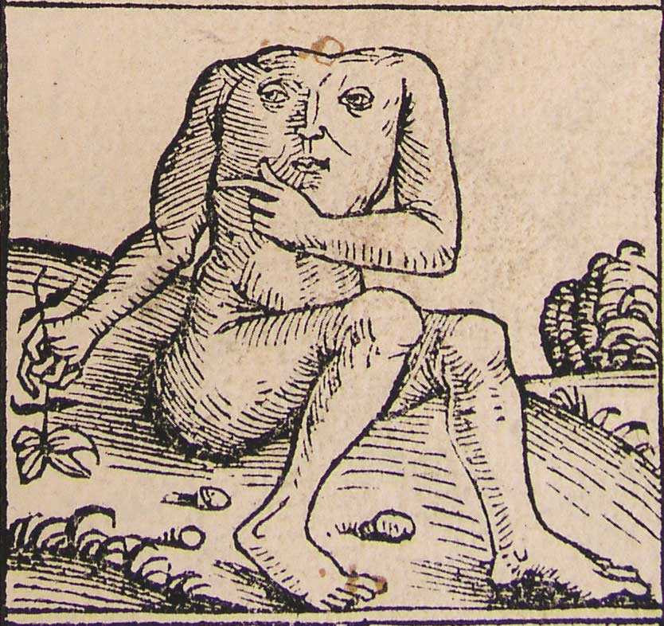
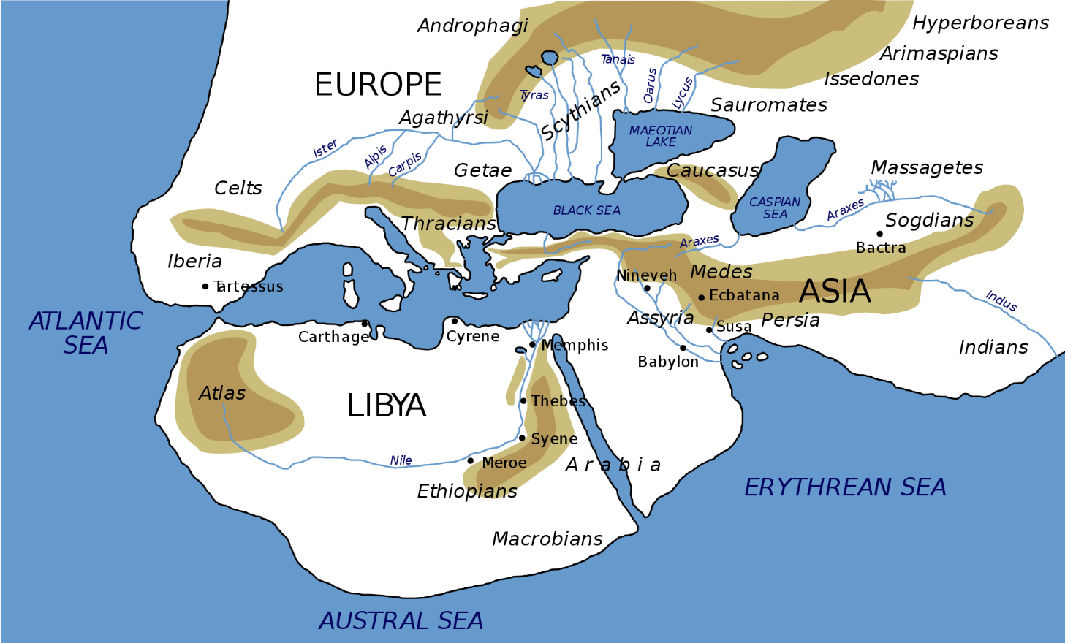
Nile River
Map of the world according to Herodotus

Slide 5
Early Western Views of Africans: the creation of ‘blackness’ and ‘the other’
Before and after Colonialism in the 1500s, European analysis of Africans in writing promoted ‘savagery,’ hyperbolized black skin, low intelligence, and a division of all Africans into two categories: human and inhuman.
The process always has been defined and driven by the interests and needs of Europe, with little attention given to the point of view of the Africans or reality.
Jordan (1974) notes that it was only around the 1680s, after contact with peoples of color, that Europeans begin to identify themselves as "white." Others have seen that it is by defining the African other as a "black body" that the European identified itself as a "white soul.“
Because the social construction of the African “other” emphasized fabricated difference symbolized by the African's black skin color most Europeans were able to avoid too serious a contemplation of the complexity of real differences within human being.

Slide 6
Early Western Views of Africans
In large part, it is this discourse - along with its many normative trappings portraying Africans as sinful heathens or undeveloped primitives with a lesser intelligence - that frames even representations of Africa today.
As many have previously noted, blackness and primitive savagery came together in the European mind as opposed to Whiteness and civilization.
Kovel (1970) argues brilliantly that the negative connotations of the color black are part of the infrastructure of the European psyche. Using Freudian theory, he shows that Europeans think of death and dirt as being dark, black. Kovel suggests that the African's black skin became a "secondary symbol" symbolizing the repressed negative experiences - grounded in the blackness of death and "dirt" (feces) - of white Europeans.
He proposes very persuasively that the negative meanings of blackness shared by most Europeans derived from unconscious fears of their own deaths. Death was fantasized and feared as the dark unknowns at the boundary of European life and whiteness came to symbolize Christian Europe's virtuous and disciplined superego. Thus blackness became the color of death and sin while whiteness represented life and virtue.

Slide 7
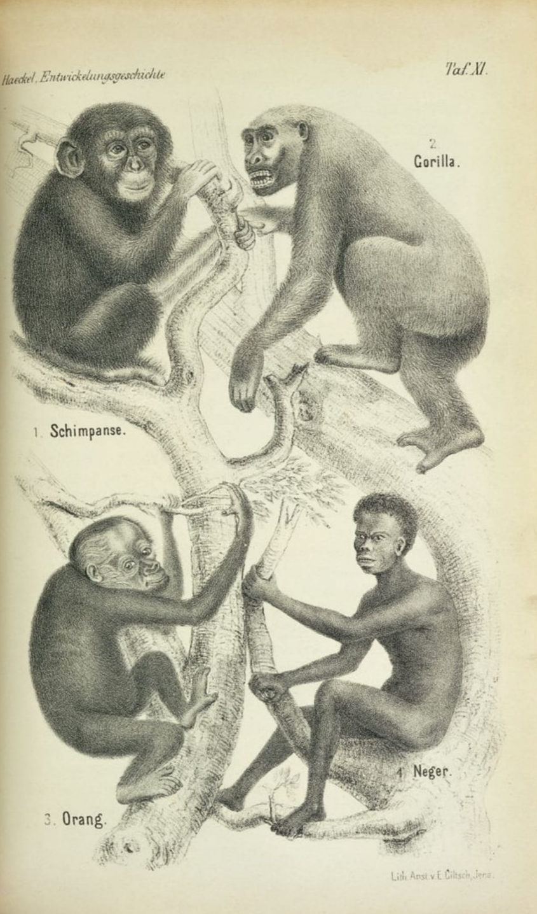
Comment on the scientific and artistic flaws in this image and speculate as to why the artist made the choices they did.

Slide 8
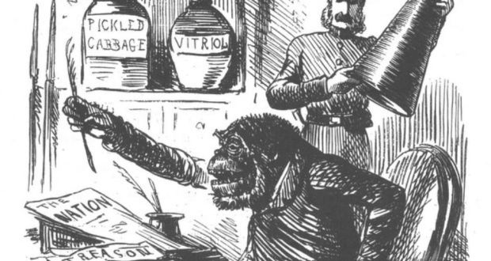
This use of “race” or “otherness” as a political tool to dehumanize and exploit people is the norm throughout history.
Muslims in medieval Europe were transformed from military enemies into non-humans. The renowned theologian, Bernard of Clairvaux, who co-wrote the Rule for the Order of the Templars, announced that the killing of a Muslim wasn’t actually homicide, but malicide—the extermination of incarnated evil, not the killing of a person. Muslims, Islam, and the Prophet were vilified in numerous creative ways, and the extraterritorial incursions we call the Crusades coalesced into an indispensable template for Europe’s later colonial empires of the modern eras.
Literature justifying England’s colonization of Ireland in the twelfth century depicted the Irish as a quasi-human, savage, infantile, and bestial race—a racializing strategy in England’s colonial domination of Ireland that echoes from the medieval through the early modern period centuries later.

Slide 9
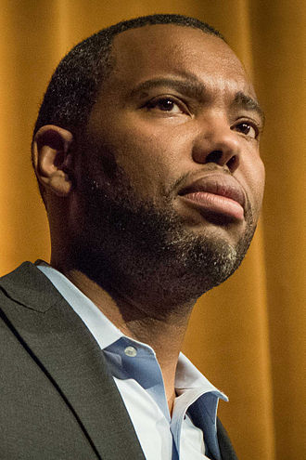
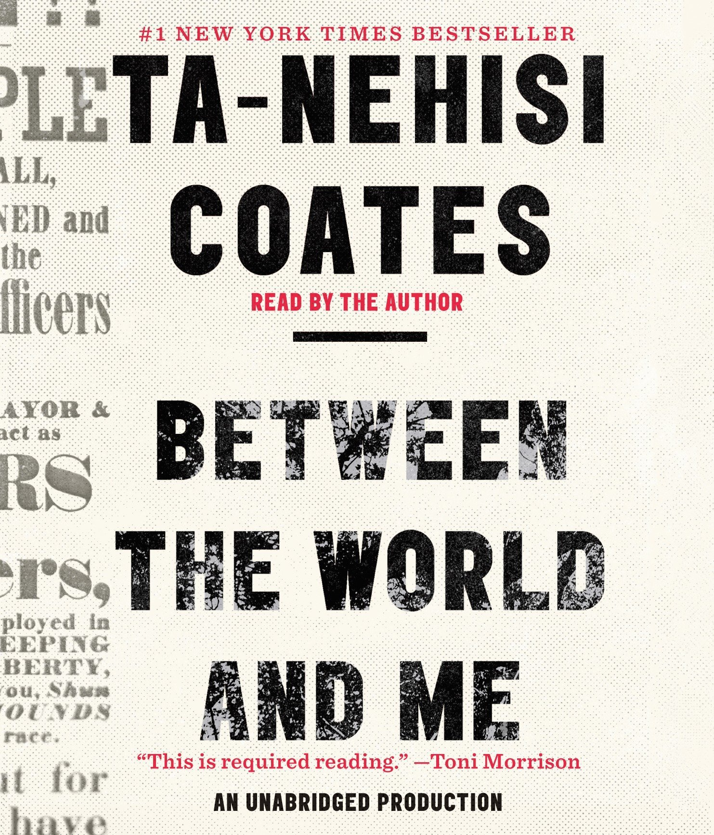
Genius Grant Winner Ta-Nehisi Coates:
Between the World and Me
Written as a letter to the author's teenage son about the feelings, symbolism, and realities associated with being Black in the United States. Coates explains to his son the "racist violence that has been woven into American culture."
Coates draws from an abridged, autobiographical account of his youth in Baltimore, detailing the ways in which institutions like the school, the police, and even "the streets" discipline, endanger, and threaten to disembody Black men and women. The work takes structural and thematic inspiration from James Baldwin.
Unlike Baldwin, Coates sees white supremacy as an indestructible force, one that Black Americans will never evade or erase, but will always struggle against.
NYT Best Seller
Pulitzer Prize Finalist
NAACP Book of the Year

Slide 10
Considering that, comment in writing on the following quote from Genius Grant Winner Ta-Nehisi Coates:
“But race is the child of racism, not the father. And the process of naming ‘the people’ has never been a matter of genealogy and physiognomy (“person's facial features or expression, especially when regarded as indicative of character or ethnic origin”) so much as one of hierarchy. Difference in hue and hair is old. But the belief in the preeminence of hue and hair, the notion that these factors can correctly organize a society and that they signify deeper attributes, which are indelible—­this is the new idea at the heart of this new people who have been brought up hopelessly, tragically, deceitfully, to believe that they are white.”

Slide 11
Considering that, comment in writing on the following quote from Genius Grant Winner Ta-Nehisi Coates:
“But all our phrasing—race relations, racial chasm, racial justice, racial profiling, white privilege, even white supremacy—serves to obscure that racism is a visceral experience, that it dislodges brains, blocks airways, rips muscle, extracts organs, cracks bones, breaks teeth. You must never look away from this. You must always remember that the sociology, the history, the economics, the graphs, the charts, the regressions all land, with great violence, upon the body.”

Slide 12
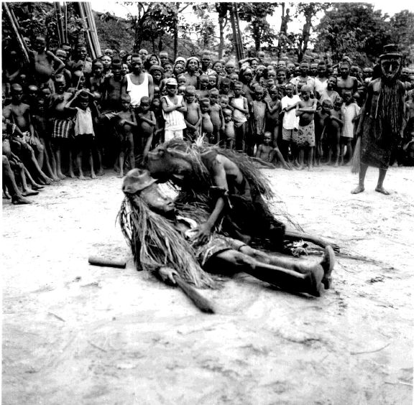
Things Fall Apart chapter 1 (13 minutes)
As you listen, create:
Character list
Record relevant characterization details about each character
Proverb list
Record any proverbs that you find.
What accomplishments have helped to make Okonkwo a great man of the village?
Compare and contrast Okonkwo with his father, Unoka.
Why does Okonkwo hate his father?

