Slide 1
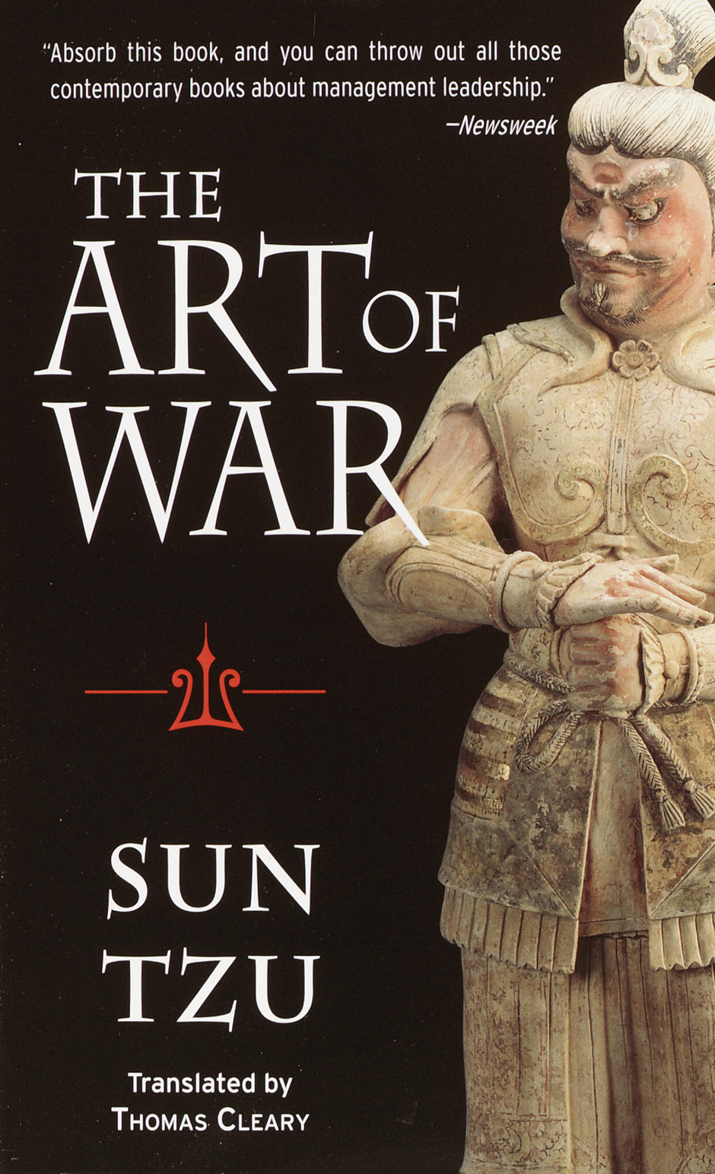
The Art of War

Slide 2
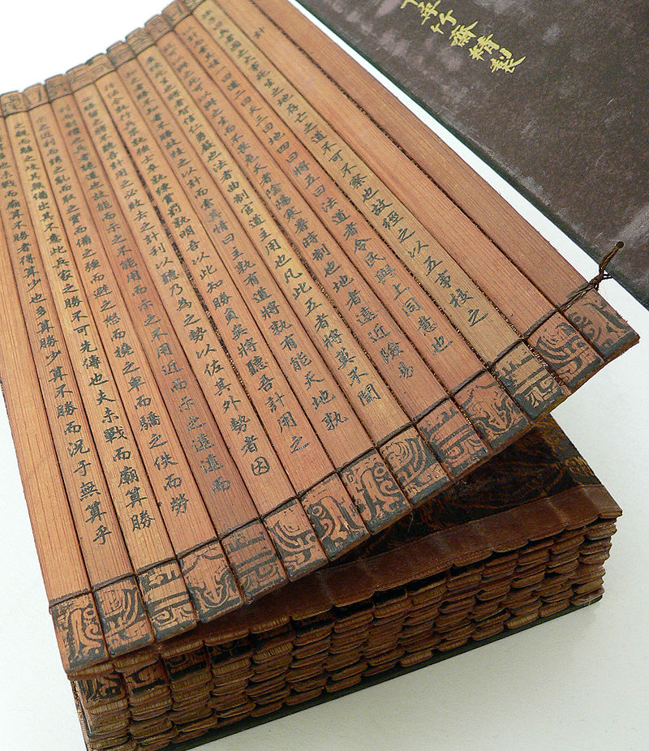

Slide 3
Notes
Chinese title translates to: "Master Sun's Rules of Warfare“
Attributed to the ancient Chinese military strategist Sun Tzu – “Master Sun”
The Art of War was written sometime between 500 and 450 BC.
It is commonly thought of as a definitive work on military strategy and tactics
The Art of War has also been applied in the world of sports. NFL coach Bill Belichick is known to have read the book and used its lessons to gain insights in preparing for games

Slide 4
Oral and Literary Tradition
Verses from the book occur in modern daily Chinese idioms, such as the last verse of Chapter 3:
So it is said that if you know your enemies and know yourself, you can win a hundred battles without a single loss. If you only know yourself, but not your opponent, you may win or may lose. If you know neither yourself nor your enemy, you will always endanger yourself.
This has been become a modern Chinese idiom:
If you know both yourself and your enemy, you can win numerous (literally, "a hundred") battles without jeopardy.

Slide 5
Art of War in 7 Charts
http://www.theatlantic.com/international/archive/2015/03/the-art-of-war-in-7-charts/387292/

Slide 6
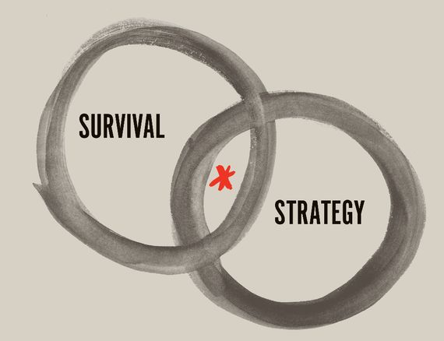
“The art of war is of vital importance to the state. It is a matter of life and death, a road either to safety or to ruin. Hence it is a subject of inquiry which can on no account be neglected."

Slide 7
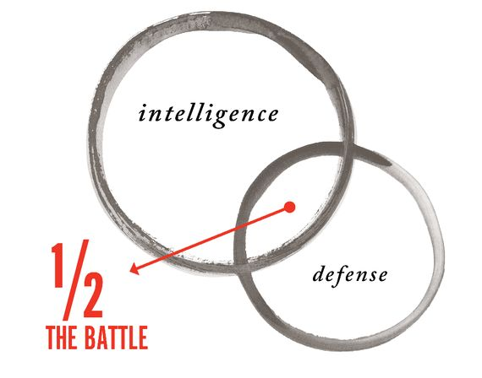
IV.3

Slide 8
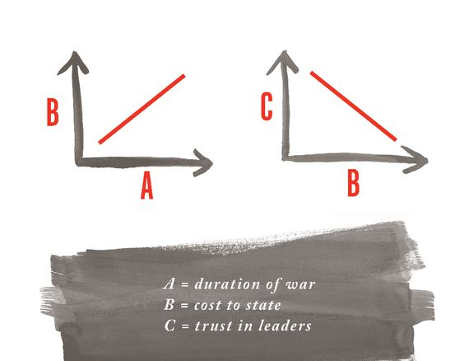
“In war, let your great object be victory, not lengthy campaigns.”

Slide 9
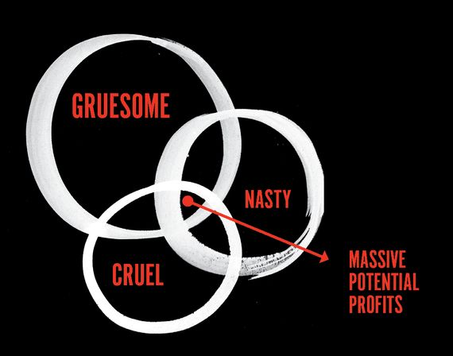
“It is only one who is thoroughly acquainted with the evils of war who can thoroughly understand the profitable way of carrying it on."

