Slide 1
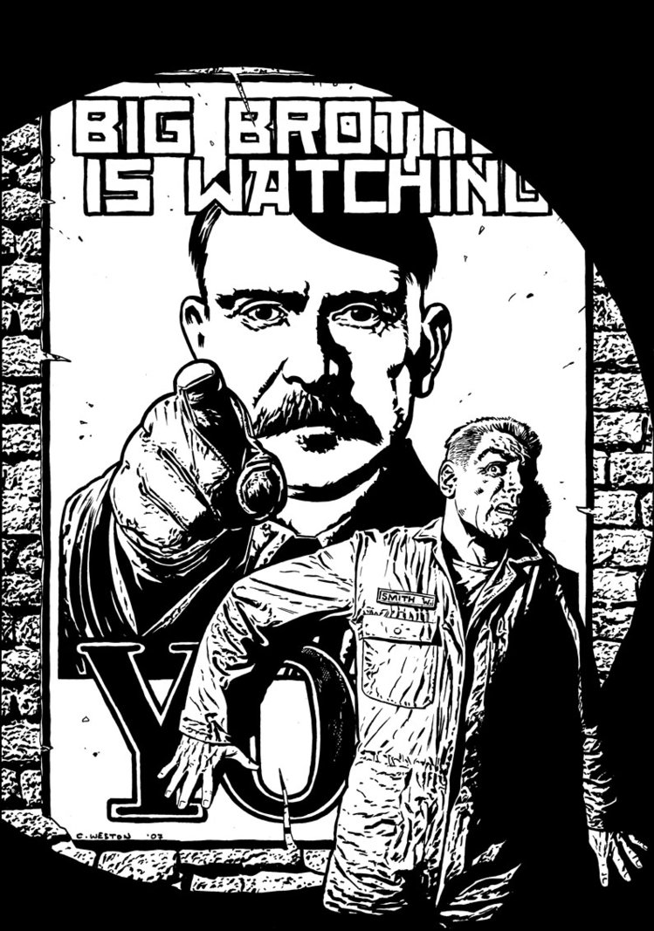
2.10 to 3.6
1984 by George Orwell

Slide 2
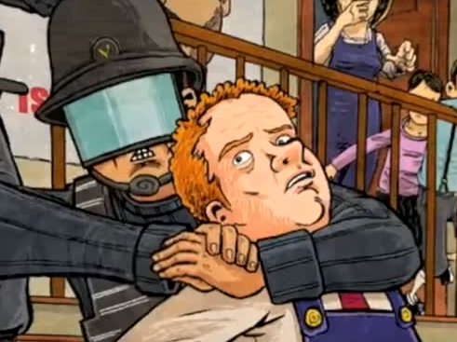
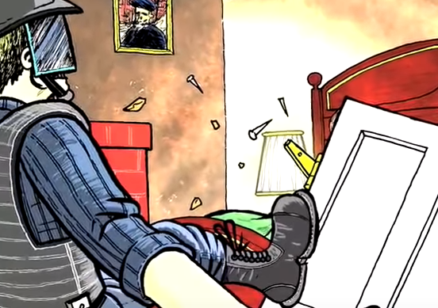
2.10
What is the deal with the “beautiful” Prole? Why does Winston find her attractive? (219-20).
Lit analysis: What is Orwell’s purpose for including this?
Is the language Orwell uses about women misogynistic?
Where was the telescreen?
Who betrayed Winston and Julia?
What questions does this leave us with?

Slide 3
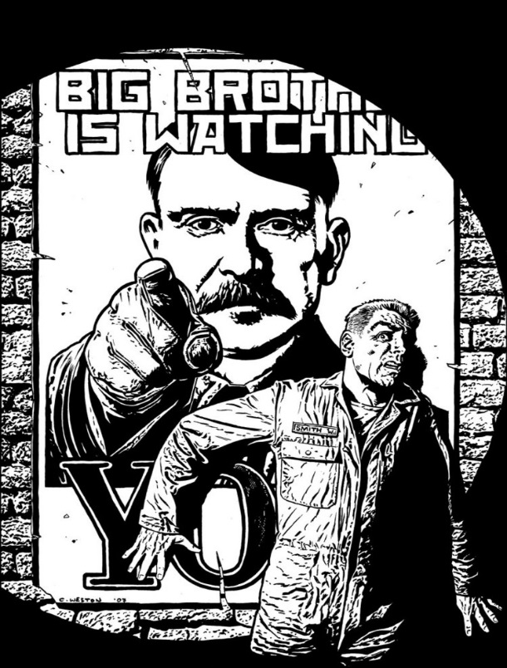
ONE + TWO [salient points] review:
Create a poster that includes specific facts, and quotes to summarize and analyze your topic from section ONE and TWO of 1984. Finalize your work with what you believe Orwell’s purpose is (feel free to conjecture).
The importance of Language
Privacy and Totalitarianism
Revisionist History/Truth
The Value of Sex to Humanity

Slide 4
3.1(225-239)
How is Winston tortured at the Ministry of Love?
What is jail like? Who is there?
Lit analysis: What effect does Orwell create by putting a Prole woman in jail with Winston? (think to juxtaposing with the last Prole woman Winston was thinking about in 2.10). (227).
Is it ironic how Oceania treats criminals? (227).
Discuss both the men Winston knows who are imprisoned with him at the Ministry of Love? Why Parsons? Is anyone safe?
How bad is Room 101? How is Orwell building tension for it?
What bombshell does Winston learn?
Lit analysis: Ultimately, is 3.1 funny or dramatic? How does Orwell weave both elements into his narrative?

Slide 5
“Beautiful” Prole Prole in jail at Miniluv 219 227

Slide 6
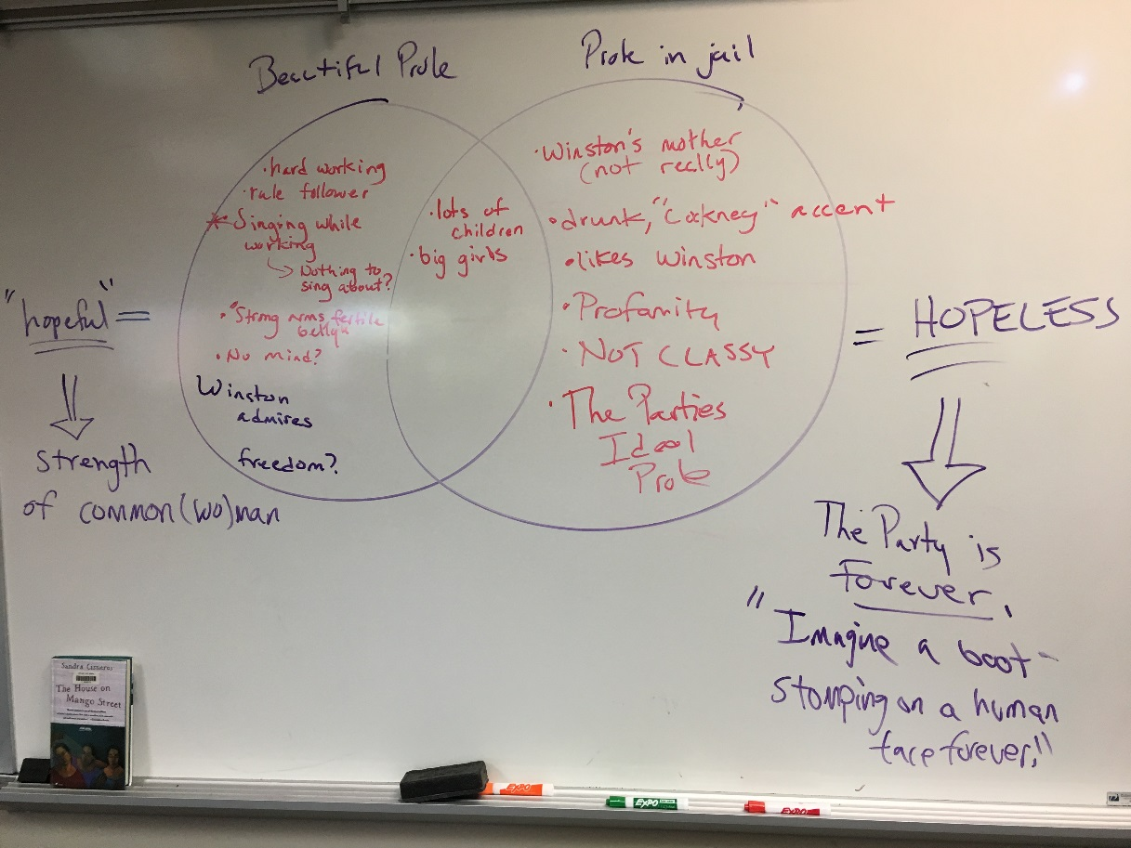

Slide 7
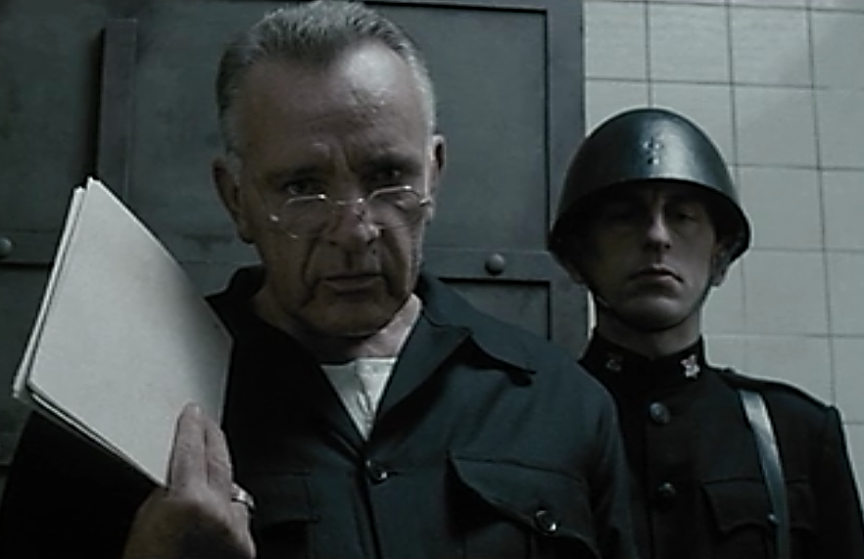
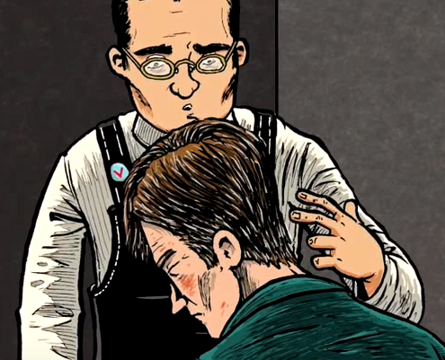
“’They got to me a long time ago,’ said O’Brien with a mild, almost regretful irony.” (Orwell 238).
Some literary criticism has really focused on this line from O’Brien as fascinating…
Could we see this coming? Could Winston?
What is the significance of this quote?
How does it develop O’Brien’s character?

Slide 8
For fully four-fifths of Nineteen Eighty-Four, O’Brien appears to be a kindred spirit to Smith, then an actual coconspirator in the fabled Brotherhood that supposedly is “dedicated to the overthrow of the State” (15). Orwell’s first description of him tantalizes the reader almost as much as Smith himself does the dissident longing for a companion:
O’Brien was a large, burly man with a thick neck and a coarse, humorous, brutal face. In spite of his formidable appearance he had a certain charm of manner. He had a trick of resettling his spectacles on his nose which was curiously disarming—in some indefinable way, curiously civilized. It was a gesture which, if anyone had still thought in such terms, might have recalled an eighteenth-century nobleman offering his snuff-box. (13)
Smith is “deeply drawn” to the enigmatic man, for “something in his face suggest[s] . . . irresistibly” that his “political orthodoxy [i]s not perfect” (13). In contrast to that of the man Smith knows as Mr. Charrington, that undercover member of the Thought Police who seems to undergo “a complete transformation” from only “tiny changes” of his face and posture (185), it seems unlikely that O’Brien’s demeanor is solely a pose to draw out the wayward Smith. The “certain charm of manner,” the “curiously disarming” and “curiously civilized” adjusting of his glasses, the “peculiar grave courtesy” and “disarming friendliness” (130), the face “so civilized” (144)—perhaps there is an occasional dash of art in the disarming aspect, but much appears unfeigned, and all generate in Smith a “wave of admiration, almost of worship” (144).
After an initial “interrogation” that includes a seemingly endless series of beatings by black-uniformed interrogators and the “formality” of confession to ever more outrageous charges (Orwell 198–200), O’Brien himself presides over the final treatments that “shall squeeze [Smith] empty, and then . . . shall fill [him] with [the Party]” (211). Even then, however, he is “gentle and patient,” with “the air of a doctor, a teacher, even a priest, anxious to explain and persuade rather than punish” (203).
At one point, despite the agony he endures, Smith experiences a strange feeling of friendship, even love, for his calm, merciless, yet “almost kindly” (Orwell 225) tormentor:
If he could have moved he would have stretched out a hand and laid it on O’Brien’s arm. He had never loved him so deeply as at this moment, and not merely because he had stopped the pain. . . . In some sense that went deeper than friendship, they were intimates; somewhere or other, although the actual words might never be spoken, there was a place where they could meet and talk. O’Brien was looking down at him with an expression which suggested that the same thought might be in his own mind. (208)
Notes:
https://online.salempress.com/articleDetails.do?articleName=CIDystopia_0009

Slide 9
Perhaps Smith, “tortured . . . to the edge of lunacy” (208), is merely projecting his confused emotions onto the older man, but it seems just as likely that he is correct: O’Brien sees Smith not merely as an object or a victim but as a person rather too much like himself. Later, O’Brien explains with apparent candor, “I enjoy talking to you. Your mind appeals to me. It resembles my own mind except that you happen to be insane” (213).
O’Brien’s definition of sanity, of course, is based upon doublethink, “the power of holding two contradictory beliefs in one’s mind simultaneously” (Orwell 176), a self-deception both conscious and yet always striving for unconsciousness, so that one therefore might avoid the unsettling lingering knowledge that the truth is not actually what one is trying to claim it is. Yes, O’Brien’s face shows intense enthusiasm for the process of Party brainwashing. And yes, O’Brien has absolutely no qualms about supporting the Party’s quest for power for the sake of power. Such sentiments are repellent, naturally.
Still, O’Brien is neither merely a madman nor a blind yes-man. Because he is the only character we see in the novel with any real understanding of how the world of Nineteen Eighty-Four arrived at the state it is in, O’Brien is actually, morals aside, the one most similar to the reader in intellectual terms; his mind “resembles [our] own.” As one of the agent provocateur coauthors of the book, the supposed “book without a title” that is “a compendium of all of the heresies” of the Brotherhood (Orwell 15)—and that, ironically, does indeed spell out the flaws of Oceania’s police state with extraordinary thoroughness—O’Brien obviously understands history, psychology, and economics all too well to imagine that his own society is anything but “the exact opposite of the stupid hedonistic Utopias that the old reformers imagined. A world of fear and treachery and torment” (220). O’Brien knows that although Ingsoc, or English Socialism, “grew out of the earlier Socialist movement and inherited its phraseology,” when the Party collectivized all the businesses, industries, and even houses of “the capitalist class,” it gave the booty not to the public at large but to the Party itself, thus perpetuating the same inequalities it purported to abolish (170). He knows that the twenty-five-year war among the three superstates is, most fundamentally, “waged by each ruling group against its own subjects . . . not to make or prevent conquests of territory, but to keep the structure of society intact” (164); despite claims of glorious advances at the front and predictions of ultimate victory, no such victory will ever occur. He knows that whereas science increased the standard of living steadily in the first half of the twentieth century (156), now its sole focus is the strengthening of totalitarianism: research in mind control, torture, and weapons from the commonplace to the semi-fantastic (159–60). O’Brien thus recognizes fundamental truths toward which Smith has been groping uncertainly.
Was O’Brien himself ever actually a true rebel or thought-criminal, as Smith is? No, for, as he explains, during the process of reeducation that takes place in the sublevels of the windowless fortress of the Ministry of Love, “things . . . happen to you from which you could not recover, if you lived a thousand years” (Orwell 211). Clearly the powerful, nimble-minded O’Brien has never suffered that ordeal; his facility for crimestop, the “automatic, instinctive” creation of a mental “blind spot whenever a dangerous thought present[s] itself” (229), must be much better developed than Smith’s. Yet he nevertheless has the penetrating mind that at least once had the capacity for rebellion, though he rejected the notion long ago. O’Brien gives “an impression of confidence and of an understanding tinged by irony” (144)—the latter being an exceedingly rare quality among the citizens of Oceania—and during Smith’s torture, he looks down “gravely and rather sadly” (202). Though “they got [him] a long time ago,” O’Brien’s voice in explaining this is full of a “mild, almost regretful irony,” the significance of which the reader can neither overlook nor forget.
Notes:
https://online.salempress.com/articleDetails.do?articleName=CIDystopia_0009

Slide 10
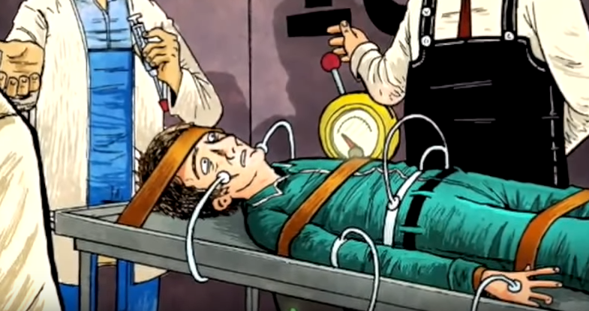
3.2 (240-260)
How is Winston tortured at the Ministry of Love?
By the guards?
By O’Brien?
How is his torture managed?
How does O’Brien’s character develop?

Slide 11
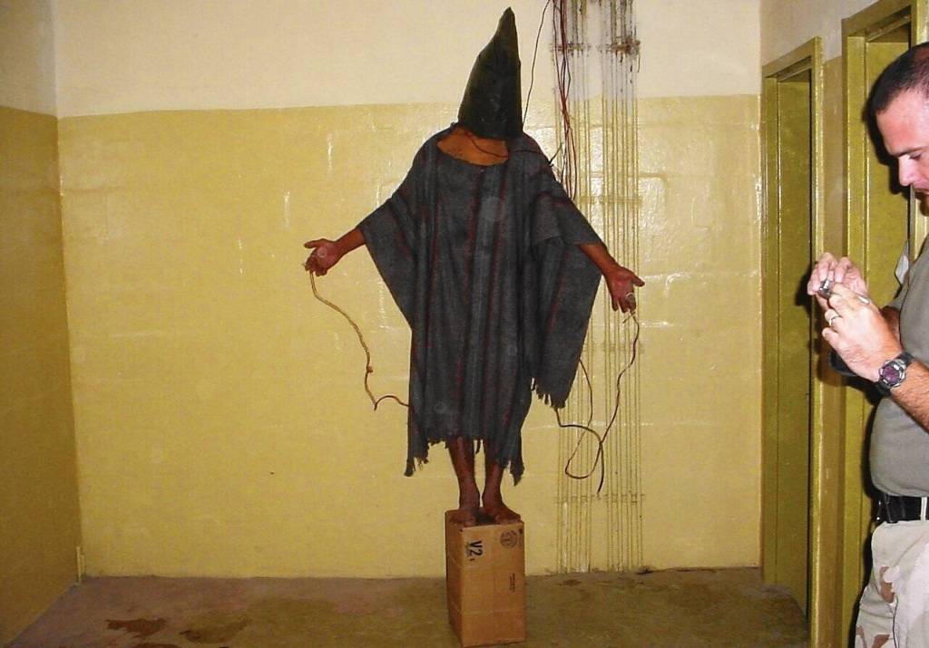
C.I.A. Torture Programs
“The Committee Study of the Central Intelligence Agency's Detention and Interrogation Program” is a report compiled by the bipartisan United States Senate Select Committee on Intelligence (SSCI) about the CIA’s Detention and Interrogation Program and its use of various forms of torture ("enhanced interrogation techniques") on detainees between 2001 and 2006.The report details actions by CIA officials including:
torturing prisoners, including waterboarding;
providing false information about classified CIA programs;
impeding government oversight;
that more detainees were subjected to torture than was disclosed;
that more forms of torture were used than previously disclosed;
and mismanaging the torture program.

Slide 12
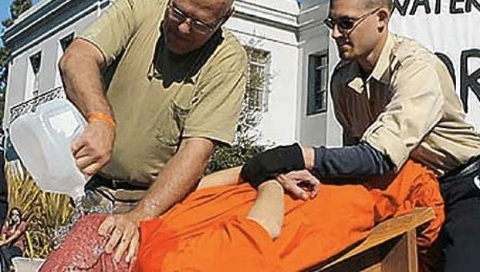
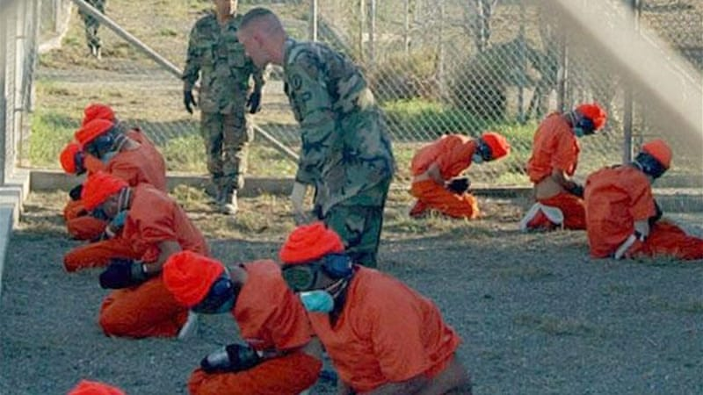
C.I.A. Torture Programs

Slide 13
C.I.A. Torture Programs
“The Committee Study of the Central Intelligence Agency's Detention and Interrogation Program” is a report compiled by the bipartisan United States Senate Select Committee on Intelligence (SSCI) about the CIA’s Detention and Interrogation Program and its use of various forms of torture ("enhanced interrogation techniques") on detainees between 2001 and 2006.The report details actions by CIA officials including:
The Senate report admits that torture was not an effective way of gathering intelligence: “At no time did the CIA’s coercive interrogation techniques lead to the collection of imminent threat intelligence,” stated committee chair Sen. Dianne Feinstein.
The CIA and its allies say the opposite. “The documents will demonstrate that the program was effective in saving American and allied lives and in preventing another mass casualty attack on American soil,” former CIA director George J. Tenet shot back.
Both miss the point. Torture isn’t about secretly collecting information. It never has been. Torture only works when it isn’t secret. Fear is only effective when it spreads. Terrorism only works when it happens in public.
The Nazis and Soviets understood this. The world’s most brutal dictators—to whom the CIA outsourced some of its torture—also understand it.

Slide 14
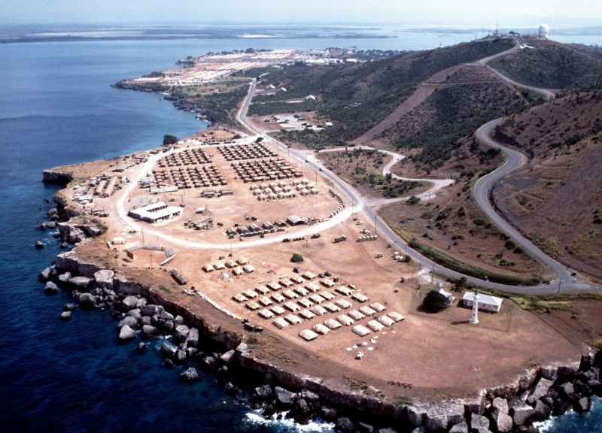
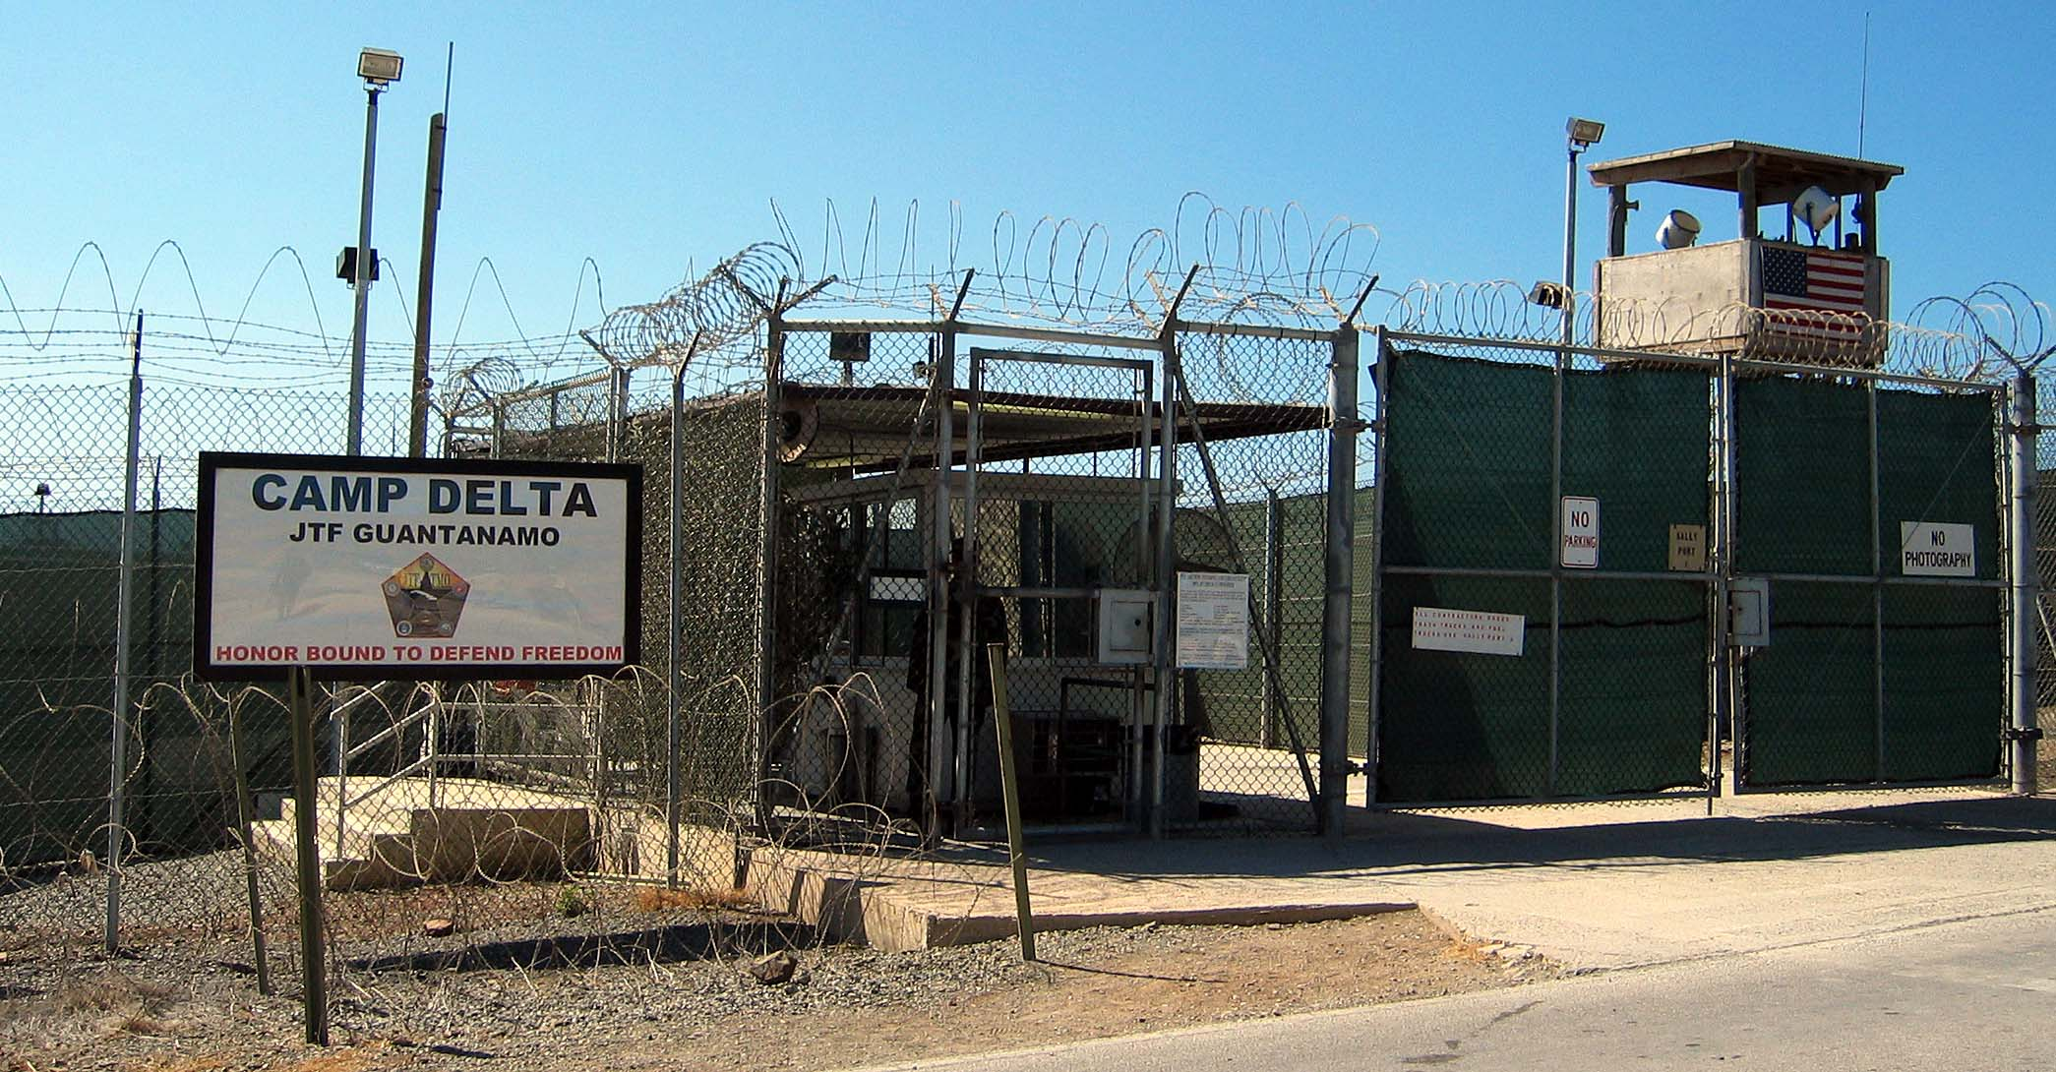
Guantanamo Bay, Pentagon Prison in Cuba
Over the 17 long years of the prison’s use for detention of prisoners (merely suspected of having something to do with terrorism): 780 men have passed through its walls. Today, 40 of those men remain; 39 of whom will never leave or face a judge.
Men being held at GTMO are not “criminals” (who have legal protections under US law) or “Prisoners of War” (who have legal protections under international law). The Pentagon and CIA called them “Enemy Combatants” and made them technically “Intelligence Assets,” not people.
The US did this to limit the prisoners’, some younger than 18 years old, legal status and ‘remove them from the battlefield’ in order to make them available for horribly harsh and cruel “advanced interrogations.”
It was designed in a way to forgo a political contest. When things are hidden when things are subverted, democratic processes can’t play out.
“The way that the human body was rendered in these opinions was not necessarily as a human body, but as a type of valuable informational asset. And so when you strip out any type of humanity, when you strip out things like the Geneva Conventions and you strip out other norms of warfare and you’re left with creating new ones, it is easy to remove the human body from that and see that only as a type of threat.”
Notes:
https://theintercept.com/2019/02/27/the-secrets-of-american-power-unitary-executive-theory-guantanamo-bay-prison-and-extraordinary-rendition/

Slide 15
Guantanamo Bay, Pentagon Prison in Cuba
Jeremy Scahill, Intercept Reporter: What does it mean that Guantanamo is still open, holding prisoners? Is this prison, as we have known its existence post-9/11, is it ever going to close?
Carol Rosenberg, Miami Harold/NYT reporter: Because Congress has said that you can’t move them to the United States and forbidden anyone who’s held as a detainee at Guantanamo to be transferred to the United States for any reason for trial, for detention, for medical care. The reality is it sounds very much like it’ll exist until the last detainee dies and they can shut it down. If you hold people as indefinite detainees in the war on terror, don’t charge them with crimes, or if you have a lifetime convict like Ali Hamza Bahlul, it doesn’t go away. Many of these men aren’t chargeable. They’re not accused of being criminals. They’re accused of being foot soldiers for an enemy force which currently has no leader to surrender. You know, that’s the way war’s end. So, if you’re asking how Guantanamo ends, I have no idea. What is Guantanamo today? Guantanamo today is 40 detainees, one of them convicted, and a revolving force of about 1,400 U.S. troops, mostly National Guard coming down there without family on nine-month tours going to the beaches and bars of the base on weekends and then going home and going back to their lives. And it’s a temporary prison, which really has no capacity to be shut down.

Slide 16
Guantanamo Bay, Pentagon Prison in Cuba
What does the distinction between “criminal,” “Prisoner of War,” and “Enemy Combatant” reveal about the power of language to dehumanize?
Notes:
https://theintercept.com/2019/02/27/the-secrets-of-american-power-unitary-executive-theory-guantanamo-bay-prison-and-extraordinary-rendition/

Slide 17
C.I.A. Torture Programs: “Black Sites”
U.S. forever-wars have relied on constructing regimes of secrecy in order to circumvent democratic processes — to “operate on the dark side,” as Dick Cheney once infamously said. In these hidden spaces, anything is possible: the Geneva Convention is rendered meaningless, and a vast network of systematic kidnappings and brutal torture can blossom in remote corners of the globe.
Notes:
https://theintercept.com/2019/02/27/the-secrets-of-american-power-unitary-executive-theory-guantanamo-bay-prison-and-extraordinary-rendition/

Slide 18
C.I.A. Torture Programs

Slide 19
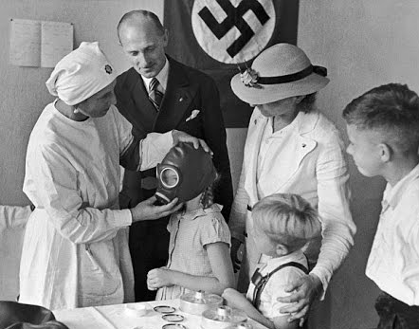
(240-241, 243) Nazi and Soviet “Efficiency”
The Soviet Union was good at torture. But the Soviets excelled at torture because they understood its usefulness. “Our task is not only to destroy you physically,” a Stalinist interrogator explained to a prisoner in 1948. “But also to smash you morally before the eyes of the society.”
“Of course it is sinister,” wrote Andrew Meier, the author of “The Lost Spy: An American in Stalin’s Secret Service,” via email. “It’s venomous, even. Stalin [was] all about optimization. Take the gulag, the greatest example, and achievement, of Soviet optimization. The lords of the gulag had charts and charts [based off medical research and experimentation] about minimum food intake and maximum work output.”
Notes:
https://medium.com/war-is-boring/guess-who-else-tortured-people-like-the-cia-did-soviets-and-nazis-e65357a309b9

Slide 20
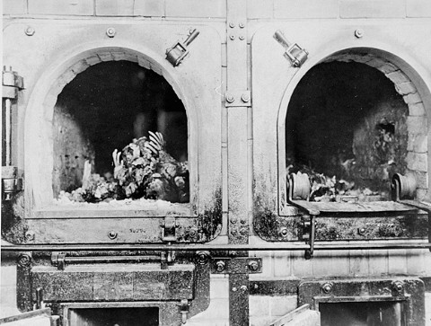
Auschwitz Photos… Nazi Efficiency

Slide 21
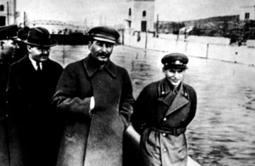
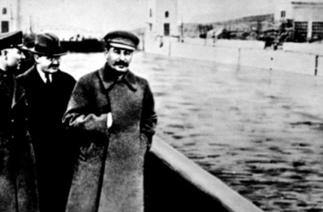
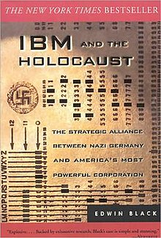
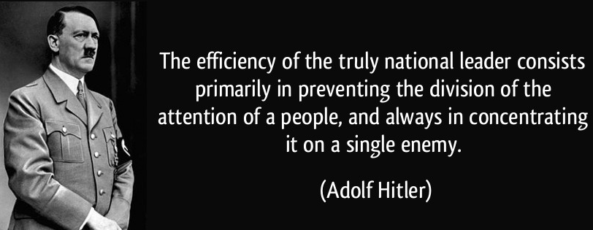
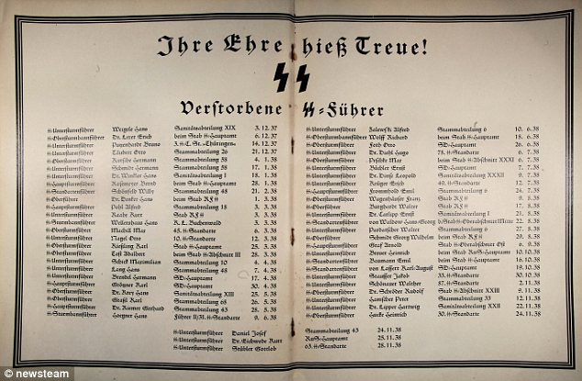
(240-241, 243) Nazi and Soviet “Efficiency”
In what ways is the Party efficient– similar to the Nazis or Soviets?
Notes:
https://medium.com/war-is-boring/guess-who-else-tortured-people-like-the-cia-did-soviets-and-nazis-e65357a309b9

Slide 23
3.2 (240-260)
Does O’Brien know the ‘real’ history of the world? What might happen if the Party forgets the real history of the world? Would it matter?
What point is O’Brien trying to make about Martyrs, the Inquisition, heresy, and the totalitarians? (253-5).
What is the Party trying to avoid by doing things differently?
Why does O’Brien demand Winston submit of his own free will?
2+2=__? Is Winston actually crazy?
What would you have asked O’Brien? (259).

Slide 24
Updated calendar: Reminder: the NYT quiz will be back Fri/Sun
15 | 16 2.7-3.2 Quiz HW: Read 3.3 | 17 Ingsoc Metaphor HW: 3.4 & 3.5 & 2+2=5 thesis | 18 Read 3.6 in class | 19 Language
22 1984 Final Socratic Seminar | 23 Children of Men | 24 Children of Men | 25 The Handmaid’s Tale HW: 1-3 from THT | 26 HW: 4-6

Slide 25
3.2-3.3 Journal #6: O’Brien Said Whaaaa?
Pick 2 O’Brien quotes and explain/analyze them:
“The thought is all we care about.” (253).
“But we make the brain perfect before we blow it out. The command of the old despotisms was ‘Thou shalt not.’ The command of the totalitarians was ‘Thou shalt.’ Our command is ‘THOU ART.’” (255).
“’You do not exist,’ said O’Brien” (259).
“The object of persecution is persecution. The object of torture is torture. The object of power is power.” (263).
“You know the Party slogan ‘Freedom is Slavery.’ Has it ever occurred to you that it is reversible? Slavery is freedom.” (264).
“If you want a picture of the future, imagine a boot stamping on a human face forever.” (267).

Slide 26
3.2-3.3 O’Brien Said Whaaaa?
Pick 2 O’Brien quotes and explain/analyze them:
“The thought is all we care about.” (253).
“But we make the brain perfect before we blow it out. The command of the old despotisms was ‘Thou shalt not.’ The command of the totalitarians was ‘Thou shalt.’ Our command is ‘THOU ART.’” (255). (210-1).
“’You do not exist,’ said O’Brien” (259). (214).
“The object of persecution is persecution. The object of torture is torture. The object of power is power.” (263).

Slide 27
3.2-3.3 Journal #6: O’Brien Said Whaaaa?
“But we make the brain perfect before we blow it out. The command of the old despotisms was ‘Thou shalt not.’ The command of the totalitarians was ‘Thou shalt.’ Our command is ‘THOU ART.’” (255).

Slide 28
3.2-3.3 According to O’Brien…
What is Power (to the Party)?
What is truth/reality?
Is O’Brien right? (248-9). What’s Orwell’s purpose?

Slide 29
Theme: Truth
Yale University Language & Propaganda expert Jason Stanley: “[Truth is] important because truth is the heart of liberal democracy. The two ideals of liberal democracy are liberty and equality. If your belief system is shot through with lies, you’re not free. Nobody thinks of the citizens of North Korea as free, because their actions are controlled by lies. Truth is required to act freely. Freedom requires knowledge, and in order to act freely in the world, you need to know what the world is and know what you’re doing. You only know what you’re doing if you have access to the truth. So freedom requires truth, and so to smash freedom you must smash truth.”
How does this idea relate to O’Brien and the Party? 1984?

Slide 30
O’Brien & the Party on power:
’The real power, the power we have to fight for night and day, is not the power over things, but over men… How does one man assert his power over another, Winston?’
Winston thought. ‘By making him suffer,’ he said.
‘Exactly. By making him suffer. Obedience is not enough. Unless he is suffering, how can you be sure that he is obeying your will and not his own? Power is in inflicting pain and humiliation. Power is in tearing human minds to pieces and putting them together again in new shapes of your own choosing.’ (266).
‘The more the Party is powerful, the less it will be tolerant; the weaker the opposition, the tighter the despotism.’ (268).
“The second thing for you to realize is that power is power over human beings. Over the body—but above all over the mind. Power over matter—external reality, as you would call it—is not important.” (264).

Slide 31
2+2=5
Explain the meaning, purpose, and effect of the repetition of “2+2=5”
New (?) Literary Device: Motif
There are three types: (1) a reoccurring object, (2) reoccurring literary devices, or (3) reoccurring plot structures in literature that figuratively represents another idea or, always related to the theme or the author’s purpose. Motifs appear in different contexts or be dynamic, separating them from symbolism or antithesis.

Slide 32
Motif:
A (1) reoccurring object, (2) literary device**, or (3) plot structure** in literature that figuratively represents another idea or thing, always related to the theme or the author’s purpose.
Motifs appear in different contexts (i.e. water appearing in different ways) or be dynamic
Motifs can be reoccurring literary devices
Three different types of Motifs:
Reoccurring Dynamic Objects*
*Difference between a motif and symbol is that symbols are static and never ideas
Literary/Language Devices
Plot Structures

Slide 33
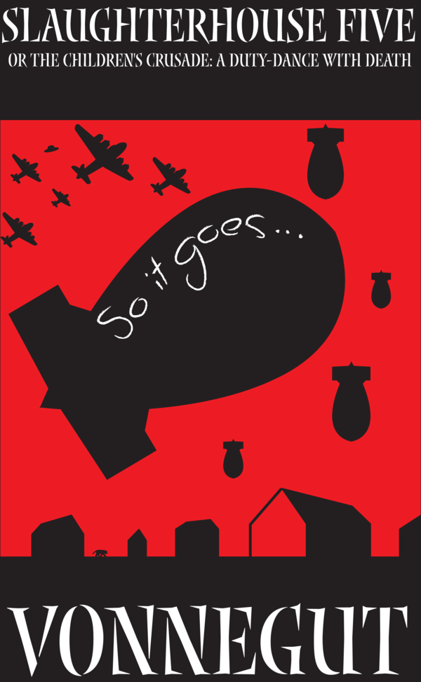
2. Repetition of Literary/Language Devices
Slaughterhouse Five is a satirical anti-war novel about a man who is ‘stuck in time’ and keeps ending up at the bombing of Dresden during WWII.
The phrase “So it goes.” appears 99 times over the 105 page novel.
Look at your page with random pieces of Slaughterhouse Five: How does Kurt Vonnegut use the motif of “So it goes.” to build his anti-war message?
Write a thesis about 2+2=5 in 1984, as it relates to truth/freedom.

Slide 34
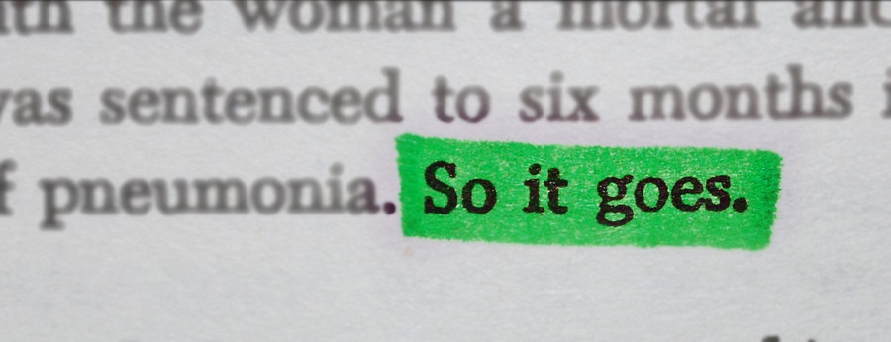
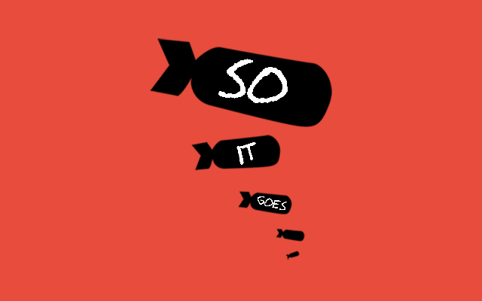
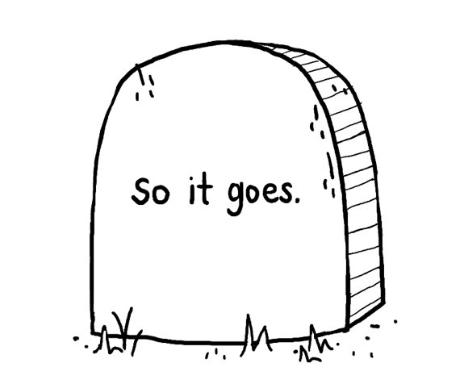
To call something a motif, it needs to:
repeat many times,
appear in different contexts,
and be related to the author’s purpose.

Slide 35
Masha Gessen on Language: https://www.topic.com/masha-gessen-what-words-mean

Slide 36
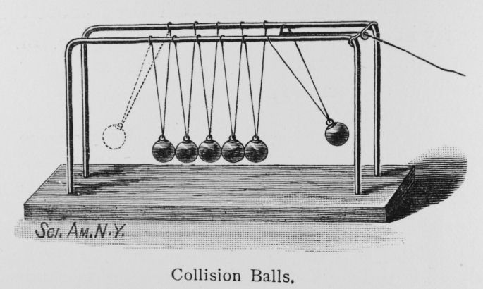
Ingsoc Metaphor:
Visually represent the Party.
Use a different metaphor than branches! No trees. No circuses.
Explain your metaphor thoroughly.
Show this information:
What Minitru, Miniluv, Minipax, and Miniplenty does for the Party
The powers and purpose of each
The main principles of Ingsoc:
Newspeak
Infallibility
Constant Warfare
Inequality
Collectivism
Altering of the Past
The 3 Slogans
Big Brother
The Proles, Outer Party, and Inner Party

Slide 37
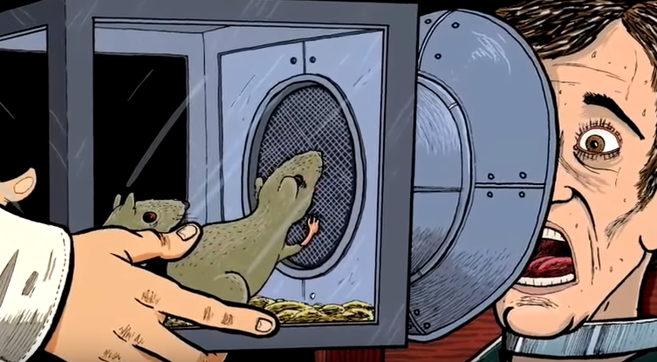
3.4 (274-282)
Beetle Metaphor!!
Is there a ‘real’ world where ‘real’ things happen?
Explain: “Stupidity was as necessary as intelligence, and as difficult to attain.” (279).

Slide 38
3.5 (282-287)
What is Room 101 like?
Why was it true that “what happens to you in here is forever”? (290).
Does Winston betray Julia? Can love conquer all? Can it conquer the Party?

Slide 39
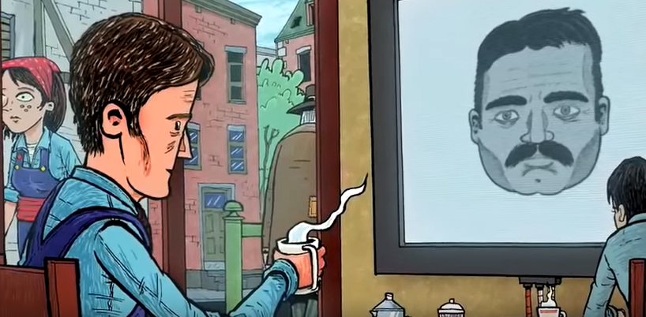
3.6 (287-298)
What is Winston’s mental state?
How has Winston and Julia’s relationship changed? What does this illustrate?
What is Winston’s final thought? What is the literary device for this?
Is the Party permanent?

Slide 40
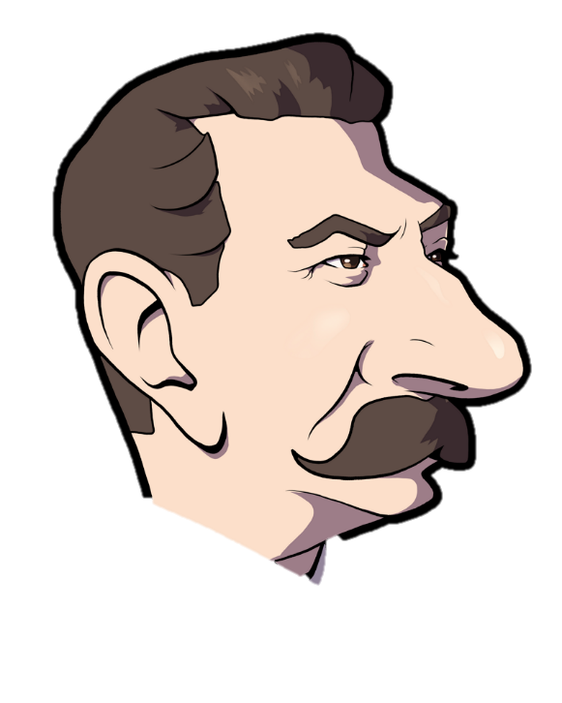
Horrible Irony?
“He gazed up at the enormous face. Forty years it had taken him to learn what kind of smile was hidden beneath the dark moustache. O cruel, needless misunderstanding! O stubborn, self-willed exile from the loving breast! Two gin scented tears trickled down the sides of his nose. But it was all right, everything was all right, the struggle was finished. He had won the victory over himself. He loved Big Brother.” (298).

Slide 41
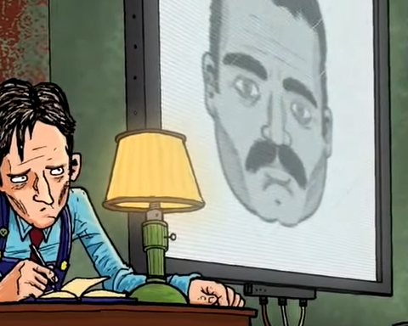
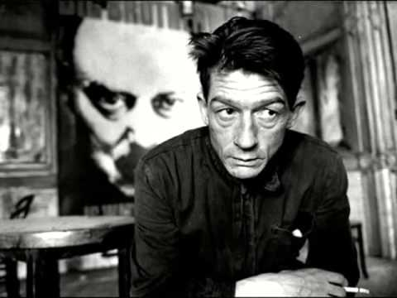
Is 1984 a Tragedy? Is Winston a Tragic Hero?
“To die hating them, that was freedom.” (281).
“But it was all right, everything was all right, the struggle was finished. He had won the victory over himself. He loved Big Brother.” (298).

