Slide 1
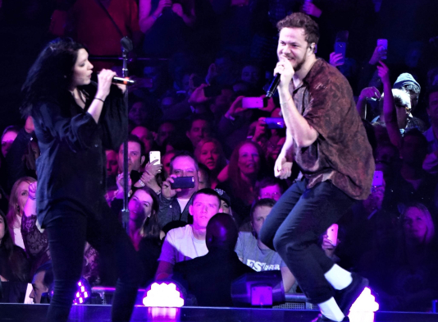
What is this song really about?
Directions: listen carefully and follow along with the lyrics.
Try and mark: repetition, literary devices, hidden meanings, and figurative language.
“Thunder” Remix) by Imagine Dragons and K. Flay

Slide 2
https://www.songmeaningsandfacts.com/meaning-of-thunder-by-imagine-dragons/
Speaking with the Las Vegas daily newspaper the Las Vegas Review-Journal, Reynolds shed more light on the meaning of the lyrics of “Thunder”. According to him, the lyrics are about how the obstacles in his life such as a “crappy” school and being “kicked” out of college pushed him to achieve success in music. He went on to add that these obstacles created a great deal of anger in him that eventually gave birth to “art”.

Slide 3
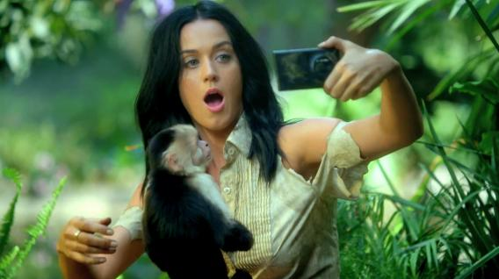
What is this song really about?
Directions: listen carefully and follow along with the lyrics.
Try and notice: repetition, literary devices, hidden meanings, and figurative language.
“Roar” by Katy Perry

Slide 4
What a “text” is really about is called it’s theme
Theme is in a story is its underlying message, or 'big idea.'
In other words, what critical belief about life is the author trying to convey in the writing of a novel, play, short story or poem?
This belief, or idea, transcends cultural barriers. It is usually universal in nature. When a theme is universal, it touches on the human experience, regardless of race or language. It is what the story means. Often, a piece of writing will have more than one theme.

Slide 5
What a “text” is really about is called it’s theme
We talk about theme in two ways:
Theme Concept: the topic the text is really about– sometimes this is hidden through figurative language
Theme Statement: the author’s specific message about that topic, this is created by how the author writes about the subject

Slide 6
What a “text” is really about is called it’s theme
Theme Concept | Theme Statement
love
revenge
good vs. evil
beauty

Slide 7
What a “text” is really about is called it’s theme
Theme Concept | Theme Statement
love | Love is blind.
revenge
good vs. evil
beauty

Slide 8
What a “text” is really about is called it’s theme
Theme Concept | Theme Statement
love | Love is blind.
revenge | Revenge is a dish best served cold.
good vs. evil
beauty

Slide 9
What a “text” is really about is called it’s theme
Theme Concept | Theme Statement
love | Love is blind.
revenge | Revenge is a dish best served cold.
good vs. evil | Good always conquers evil.
beauty

Slide 10
What a “text” is really about is called it’s theme
Theme Concept | Theme Statement
love | Love is blind.
revenge | Revenge is a dish best served cold.
good vs. evil | Good always conquers evil.
beauty | Beauty is only skin deep.

Slide 11
For the chart below, as a table, decide if each word or idea is likely to be a theme concept, or not.
1. Truth | 2. Family | 3. Revenge
4. Fear of failure | 5. Hair | 6. Cooking
7. Suitcase | 8. Trust | 9. Football
10. Power of words | 11. Love | 12. Good vs. Evil

Slide 12
For the chart below, as a table, decide if each word or idea is likely to be a theme concept, or not.
1. Truth | 2. Family | 3. Revenge
4. Fear of failure | 5. Hair | 6. Cooking
7. Suitcase | 8. Trust | 9. Football
10. Power of words | 11. Love | 12. Good vs. evil

Slide 13
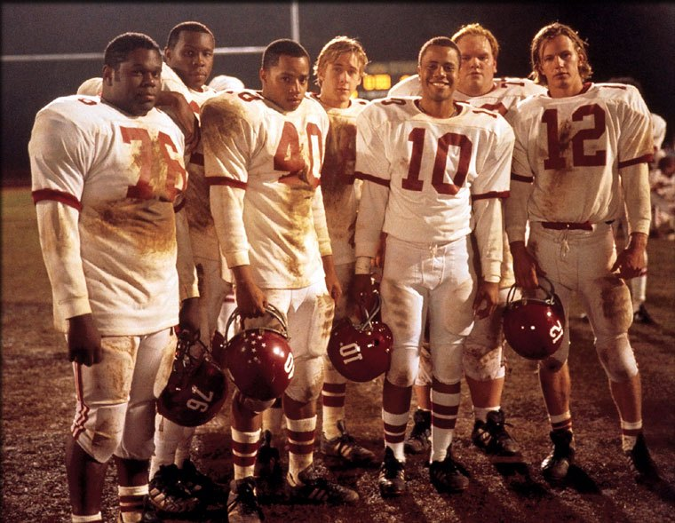
Remember the Titans: is this really about football?
https://www.youtube.com/watch?v=nPhu9XsRl4M

Slide 14
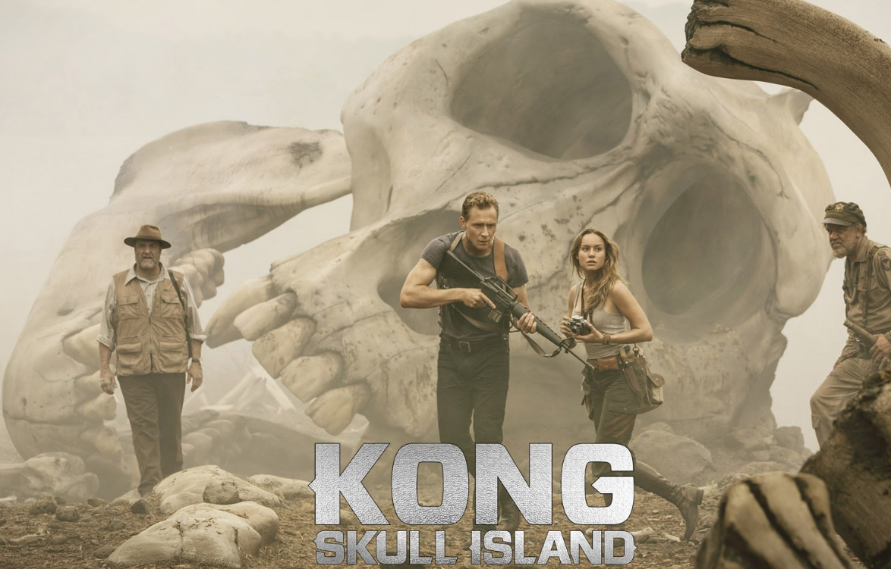
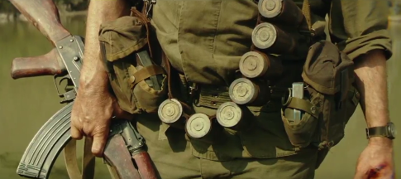
Example of Theme Statement: King Kong: Skull Island (2017)
https://twitter.com/kongskullisland/status/841333046859116544?lang=en
What theme statement did you hear??
The theme concept is “enemies”
“Sometimes an enemy doesn’t exist ‘til you go looking for one.” (Texts often have MULTIPLE THEMES)
King Kong wasn’t their enemy, until they started fighting him.
Characters DO NOT always say the theme

Slide 15
What is this song really about?
What are possible theme statements about a theme concept in “Thunder” by Imagine Dragons and K. Flay?

Slide 16
Best ideas:

Slide 17
Journal #2: Theme
Learning Targets:
Students will be able to read and interpret theme concept and theme statement.
Students will be able to provide evidence in support of a claim about a theme statement.
Students will be able to define theme, theme concept, and theme statement.

Slide 18
Definition of Theme
A text’s theme is what the text is really about, the underlying message or moral the author is trying to show readers. Most texts have several themes. Most of the content of a text can help develop the theme.
The theme of a work is often different than what the story is literally about. For example, Remember the Titans is a movie about football– but thematically it’s about:
Racism
Coming Together (integration)/Teamwork
Family
Notes:
https://www.youtube.com/watch?v=M9wnopTH5TU

Slide 19
We talk about theme in two ways:
Theme Concept: the topic the text is really about– sometimes this is hidden through figurative language
Theme Statement: the author’s specific message about that topic, this is created by how the author writes about the subject

Slide 20
Writing Theme Statement “rules”
Starts with theme concept (idea, concept) from the text.
Avoids using “I,” “you,” “one,” and any other word that could be omitted.
States a universal, which could apply to anyone. (No references to specific texts.)
Can be debatable, or require proof.
DOES NOT use figurative language

Slide 21
Theme Concept → Theme Statement
Love is blind.
Technology will cause humans to lose everything.
Beauty is only skin deep.
Speaking Up leads to empowerment.
“Roar” by Katy Perry

Slide 22
Theme Concept → Theme Statement
Now, for “Thunder,” try and write some theme statements that follow the rules.

Slide 23
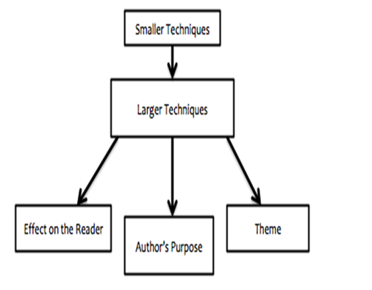
Important: I.B. writing graphic
This image is used to help students write and organize literary analysis.
The first lesson we learned, figurative language, goes at the top (or sometimes middle level) of the pyramid as “smaller techniques” the author used.
Theme goes in the most important or analytical level, as an option you can always write about.

Slide 24
Important: I.B. writing graphic
Figurative Language, word choice, plot, and other small literary devices or techniques can help authors ‘DEVELOP’ a theme concept and statement.
In the next examples, from Lord of the Rings, notice how the music and imagery (a small or medium technique) helps develop the theme.

Slide 25
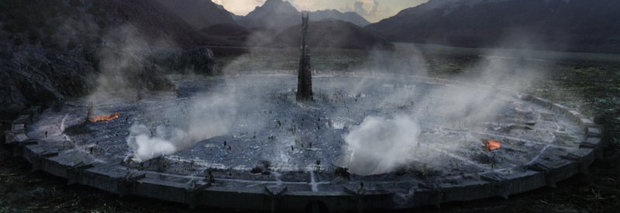
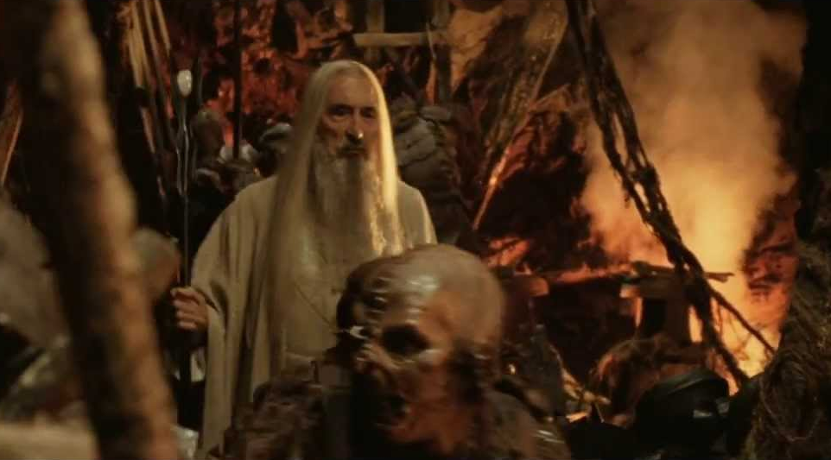
Lord of the Rings
After watching those two videos what do you think the theme of these scenes is?
LOTR
LOTR1
J.R.R. Tolkien was alive during the industrial revolution when capitalism lead to extreme deforestation and dirty factories around the world.

Slide 26
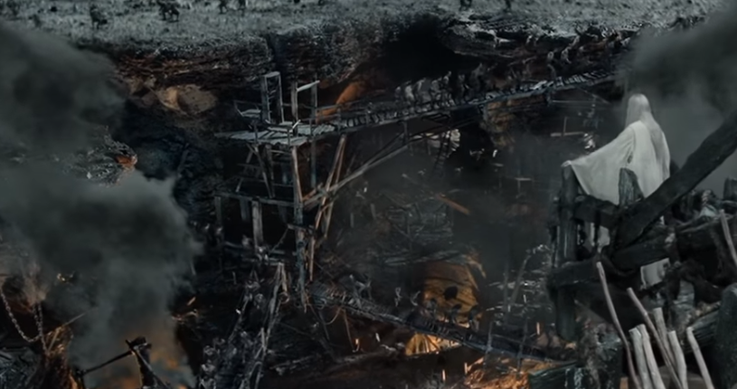
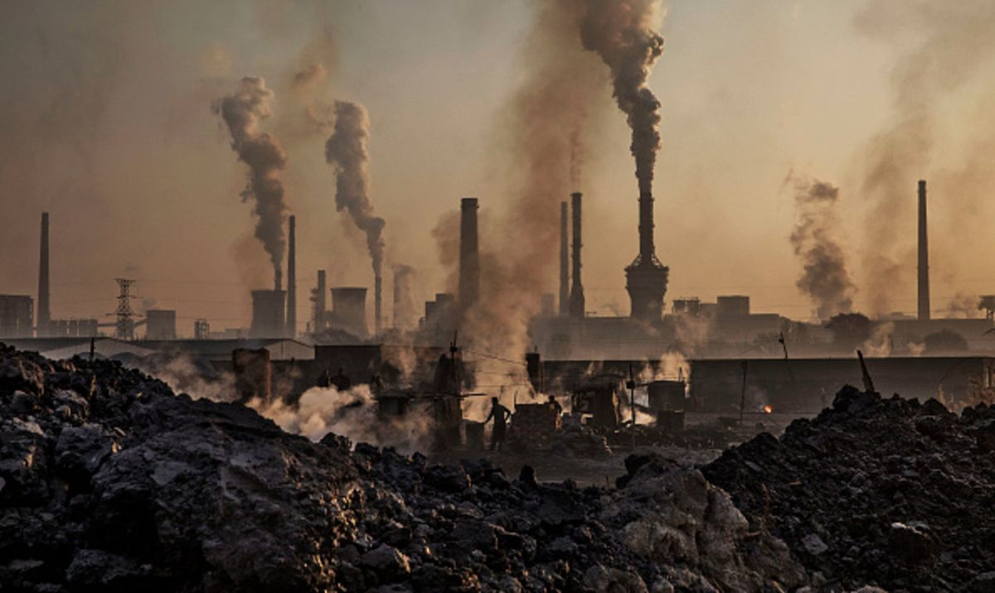
Important: I.B. writing graphic
In the example, notice how the gross industrial imagery ‘DEVELOPS’ a theme: industry is destructive to the environment.
Real Factory

Slide 27
Homework: Submit to TurnItIn.com by Friday morning (9am) →don’t spend more than ~1 hour on this
Identify a ‘text’ that is important to you; preferably a film, tv show, book, comic, religious story, or graphic novel– and not an image. Include a 2-3 sentence summary of the plot. *This is NOT meant to force you to rewatch a whole movie or reread a whole book.
List 2-3 theme concepts.
Turn one of these into a theme statement. Try and follow the rules for writing theme statements.
Briefly provide evidence to justify the theme statement you created.
Identify figurative language that helps develop the theme.
How does the plot shape this theme?
Feel free to include a screenshot or image as evidence as well.

Slide 28
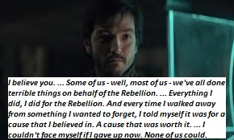
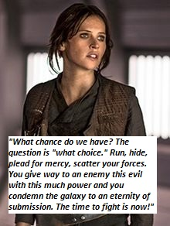
Smith’s Example:
Rogue One: A Star Wars Story. Summary: Former scientist Galen Erso lives on a farm with his wife and young daughter, Jyn. His peaceful existence comes crashing down when the evil Orson Krennic takes him away from his beloved family. Many years later, Galen becomes the Empire's lead engineer for the most powerful weapon in the galaxy, the Death Star. Knowing that her father holds the key to its destruction, Jyn joins forces with a spy and other resistance fighters to steal the space station's plans for the Rebel Alliance.
Theme concepts: Courage, Hope, Family, Doing What’s Right, Sacrifice
Courage can make anyone a hero.
Evidence:
All of the heroes for the rebellion are people who are downtrodden in society: Jyn Erso is rough around the edges and angry, Cassian Andor has done bad things, and the Rebellion is made up of other people and aliens without power.
Brave Imagery! (Smith was too lazy to write much here.)

