Slide 1
Journal #5: Oligarchy
Learning Targets:
Students will be able to analyze Goldstein’s book from 1984.
Students will be able to define oligarchy and identify conditions that lead to oligarchy.
Students will be able to analyze real world conditions and evaluate evidence.
Students will be able to create presentations and deliver lessons to their peers.

Slide 2
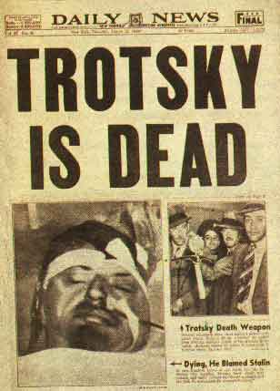
The Theory and Practice of Oligarchical Collectivism by Emmanuel Goldstein
Explains why and how the USSR is and predicts what would happen
Explains why and how the Party is through the three slogans

Slide 3
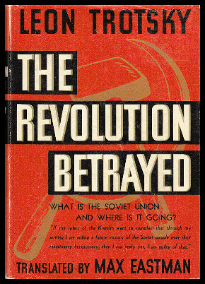
The Revolution Betrayed: What is the Soviet Union and where is it going? By Leon Trotsky
Published in 1936 (Trotsky was run out of Russia in 1928).
Came out right before the Purges started.
Trotsky added a P.S. about the Purges writing: “This book was completed … before the ‘terrorist’ conspiracy trial … was announced. … Its indication of the historic logic of this ‘terrorist’ trial, and its advance exposure of the fact that its mystery is deliberate mystification, is so much the more significant.”
First two years of the Purges (during 1937 and 1938) the Cheka detained 1,548,366 persons, of whom 681,692 were shot – an average of 1,000 executions a day
Trotsky’s view of the Soviet Union is an example of Marxist Historical Criticism.
He analyzes the triumph of Stalin, the separation of the party from Bolshevism, and the rising bureaucracy. The importance of this chapter lies in Trotsky's observation that the ruling class in the USSR are neither capitalists nor workers, but rather a section of the working class alienated from its class roots, influenced by bureaucracy.

Slide 4
The Revolution Betrayed: What is the Soviet Union and where is it going? By Leon Trotsky
One of the key predictions made by Trotsky is that the USSR would come before a disjuncture: either the toppling of the ruling bureaucracy by means of a political revolution, OR capitalist restoration led by the bureaucracy. This prediction was made at a time when most commentators, capitalist and Stalinist, predicted the continued rise of Soviet power.
Historically speaking, Trotsky was right: Reform during the 1980’s was followed by the full embrace of capitalism a decade later without any apparent ideological discomfort amongst former party members, who became the new economic oligarchs in post-Soviet Russia while living standards of the Soviet proletariat fell precipitously in the 1990s.

Slide 5
The Revolution Betrayed: What is the Soviet Union and where is it going? By Leon Trotsky
After Smith read/skimmed The Revolution Betrayed, he realized that perhaps one of the most important of Trotsky’s thesis’ was that oligarchy and bureaucracy is bad and should be feared.
This seems to be a key idea in The Theory and Practice of Oligarchical Collectivism.
What does Orwell write about oligarchy and social hierarchy?

Slide 6
Key Definitions:
Oligarchy: a small group of people who have formal and informal power based on (1) wealth; (2) connections; and (3) privilege; despite the appearance of democracy the will of the people is subverted by the powerful.
Bureaucracy: the group of professional government employees (state officials) who make many important decisions, rather than the elected representatives.

Slide 7
“Oligarchical Collectivism”
Task: With your group create a “lesson” to teach another group about your chapter of Goldstein’s book. You should carefully and critically read your half of your chapter and then discuss with your group so that you can master the whole chapter. Then prepare your lesson. Your lesson needs to prepare your group and the group you teach, for a Socratic Seminar on Fri 10/12. Monday 10/15!
A successful lesson will:
Be detailed, informative and thought provoking
Detail what information your audience should know about your section of Goldstein’s book.
Create a task for your audience: notes, questions, etc.
Critical thinking is better.
Include LTs?
Include pictures or some sort of visuals
Include original thoughtful analysis
Focus on dystopian content, oppression, and why the Party is the way it is
Take between 6 and 10 minutes

Slide 8
Packet | 1 | 2 | 3 | *
A | Clara L. Eddie R. | Jake B. Cailin F. | Caleb L. Will M. Josh W.
B | Sam A. Trenton S. | Tina F. Anton S. Jacob T. | Cole K. Manon H.
C | Sammy L. Tyler L. | Vin C. Kieran K. | Saskia S. Joe S. | Cole H.
D | Ruby B. Andrew M. | Jordan P. Kelly S. Oscar Z. | Katelyn R. Will S.

Slide 9
Packet | 1 | 2 | 3 | 4 | 5 | 6
A | Clara L. | Eddie R. | Jake B. | Cailin F. | Josh W. | Caleb L. Will M.
B | Trenton S. | Sam A. | Tina F. Jacob T. | Anton S. | Cole K. | Manon H.
C | Tyler L. | Sammy L. | Vin C. | Kieran K. | Joe S. | Saskia S.
D | Andrew M. | Ruby B. | Jordan P. | Kelly S. Oscar Z. | Will S. | Katelyn R.
Take some notes in journal #5 for Soc. Sem.

Slide 10
Packet | 1 | 2 | 3 | 4
A | Ryan A. Kenta D. | Ryan E. Mauricio H. | David L. | Vlad M. Sebastian M.
B | Braden C. Elijah S. | Irelin H. Grace L. | Marc J. Dylan K. | Holly S. Alexa W.
C | Aidan B. Brandon E. | Rhys H. Tony H. | Bo H. Connor S. | Max M. Evan S.
D | Makenna D. Spencer W. | Caitlin H. Josh H. | Calvin J. Nadiya M. | Sam J.

Slide 12
 | 1 | 2 | 3 | 4 | 5 | 6 | 7
A | Ryan A. | Kenta D. | Ryan E. | Mauricio H. | David L. | Vlad M. | Sebastian M.
B | Braden C. Elijah S. | Alexa W. | Grace L. | Marc J. Elijah S. | Irelin H. | Dylan K. | Holly S.
C | Brandon E. | Evan S. Max M. | Bo H. | Aidan B. | Rhys H. | Tony H. | Connor S.
D | Calvin J. | Nadiya M. | Makenna D. | Josh H. | Spencer W. | Sam J. | Caitlin H.
Take some notes in journal #5 for Soc. Sem.

Slide 13
Ignorance is Strength: A (oligarchy)
In principle, membership of these three groups is not hereditary. The child of Inner Party parents is in theory not born into the Inner Party. Admission to either branch of the Party is by examination, taken at the age of sixteen. Nor is there any racial discrimination, or any marked domination of one province by another. Jews, Negroes, South Americans of pure Indian blood are to be found in the highest ranks of the Party, and the administrators of any area are always drawn from the inhabitants of that area. In no part of Oceania do the inhabitants have the feeling that they are a colonial population ruled from a distant capital.
The essence of oligarchical rule is not father-to-son inheritance, but the persistence of a certain world-view and a certain way of life, imposed by the dead upon the living. A ruling group is a ruling group so long as it can nominate its successors. The Party is not concerned with perpetuating its blood but with perpetuating itself. WHO wields power is not important, provided that the hierarchical structure remains always the same.
“inequality was the unalterable law of human life”

Slide 14
Ignorance is Strength: B (doublethink and altering the past)
“The alteration of the past is necessary for two reasons, one of which is subsidiary and, so to speak, precautionary. The subsidiary reason is that the Party member, like the proletarian, tolerates present-day conditions partly because he has no standards of comparison. He must be cut off from the past, just as he must be cut off from foreign countries, because it is necessary for him to believe that he is better off than his ancestors and that the average level of material comfort is constantly rising. But by far the more important reason for the readjustment of the past is the need to safeguard the infallibility of the Party.”
The Ministry of Peace concerns itself with war, the Ministry of Truth with lies, the Ministry of Love with torture and the Ministry of Plenty with starvation. These contradictions are not accidental, nor do they result from ordinary hypocrisy; they are deliberate exercises in DOUBLETHINK. For it is only by reconciling contradictions that power can be retained indefinitely. In no other way could the ancient cycle be broken. If human equality is to be forever averted—if the High, as we have called them, are to keep their places permanently—then the prevailing mental condition must be controlled insanity.

Slide 15
War is Peace: C (current world/constant war)
None of the three super-states could be definitively conquered even by the other two in combination. They are too evenly matched, and their natural defenses are too formidable.
The primary aim of modern warfare (in accordance with the principles of DOUBLETHINK, this aim is simultaneously recognized and not recognized by the directing brains of the Inner Party) is to use up the products of the machine without raising the general standard of living. Ever since the end of the nineteenth century, the problem of what to do with the surplus of consumption goods has been latent in industrial society.
But it was also clear that an all-round increase in wealth threatened the destruction—indeed, in some sense was the destruction—of a hierarchical society.

Slide 16
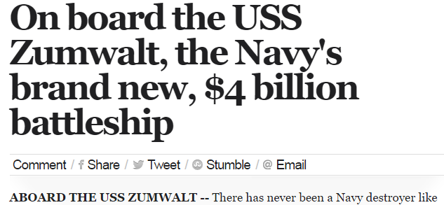
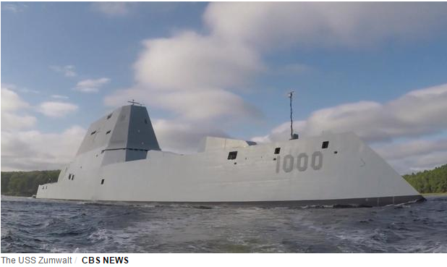
http://www.cbsnews.com/videos/pentagon-400b-f-35-jet-program-most-expensive-in-history/

Slide 17
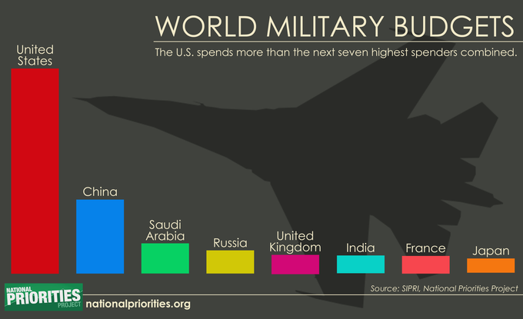
The 2018 Defense Budget was signed into law on December 12, 2017 by President Trump. The defense budget authorizes just under $700 billion in defense spending and a 2.4% increase in military pay and a .7% increase in BAH.
The $700 billion plan exceeded the budget cap of $549 billion as established Budget and Control Act (BCA) of 2011. On February 9, 2018 President Trump signed in law the final spending bill after two stopgap measures were passed.

Slide 18
War is Peace: D
It does not matter whether the war is actually happening, and, since no decisive victory is possible, it does not matter whether the war is going well or badly. All that is needed is that a state of war should exist.
In Oceania at the present day, Science, in the old sense, has almost ceased to exist. In Newspeak there is no word for ‘Science’. The empirical method of thought, on which all the scientific achievements of the past were founded, is opposed to the most fundamental principles of Ingsoc. And even technological progress only happens when its products can in some way be used for the reduction of human liberty.
But when war becomes literally continuous, it also ceases to be dangerous. When war is continuous there is no such thing as military necessity. Technical progress can cease and the most palpable facts can be denied or disregarded.

Slide 19
Key Definitions:
Oligarchy: a small group of people who have formal and informal power based on (1) wealth; (2) connections; and (3) privilege; despite the appearance of democracy the will of the people is subverted by the powerful.
Bureaucracy: the group of professional government employees (state officials) who make many important decisions, rather than the elected representatives.

Slide 20
The Revolution Betrayed: What is the Soviet Union and where is it going? By Leon Trotsky

Slide 22
Is the USA an Oligarchy?

Slide 23
Oligarchy and the USA?
The US is dominated by a rich and powerful elite. Concludes a recent study by Princeton University Professor Martin Gilens and Northwestern University Professor Benjamin Page. The two professors have conducted exhaustive research to try to present data-driven support for this conclusion. Here's how they explain it:
“In the United States, our findings indicate, the majority does not rule—at least not in the causal sense of actually determining policy outcomes. When a majority of citizens disagrees with economic elites and/or with organized interests, they generally lose. Moreover … even when fairly large majorities of Americans favor policy change, they generally do not get it.”
The wealthy few control public policy, while the average American has little power.

Slide 24
Quick Reminder:
Oligarchical Societies, like other flawed forms of government, such as monarchy, authoritarianism, or plutocracy do NOT share these (inherently good) goals. US supreme court justice Louis Brandeis once observed: “We may have democracy, or we may have wealth concentrated in the hands of a few, but we can’t have both.”
The goal of democratic society is to grant citizens the right to liberty, representation in government policy, freedom of speech and expression, equality of opportunity, safety, and the opportunity to earn and keep wealth.

Slide 25
Oligarchy ≠ Democracy
Prologue to On Tyranny: History and Tyranny
“History does not repeat, but it does instruct. As the Founding Fathers debated our Constitution, they took instruction from the history they knew. Concerned that the democratic republic they envisioned would collapse, they contemplated the descent of ancient democracies and republics into oligarchy and empire. As they knew, Aristotle warned that inequality brought instability, while Plato believed that demagogues exploited free speech to install themselves as tyrants. In founding a democratic republic upon law and establishing… checks and balances, the Founding Fathers sought to avoid the evil that they… called tyranny. They had in mind the usurpation of power by a single individual or group, or the circumvention of law by rulers for their own benefit. Much of the succeeding political debate in the United States has concerned the problem of tyranny within American society: over slaves and women for example.
It is thus a primary American tradition to consider history when our political order seems imperiled. If we worry today that the American experiment is threatened by tyranny, we can follow the example of the Founding Fathers and contemplate the history of other democracies and republics… the history of modern democracy is also one of decline and fall… European history has seen three major democratic moments: after the First World War in 1918, after the second World War in 1945, and after the end of communism in 1989. Many of the democracies founded at these junctures failed…”

Slide 26
Can we see the signs of Oligarchy in the USA?

Slide 27
Oligarchy: A small group of people having formal and informal power based on (1) wealth; (2) connections; and (3) privilege; oftentimes, even despite the appearance of democracy, the will of the people is subverted by the powerful.
Orwell: “The essence of oligarchical rule is not father-to-son inheritance, but the persistence of a certain world-view and a certain way of life… A ruling group is a ruling group so long as it can nominate its successors.”
Wealth | Connections | Privilege
Money Wins Elections | The Two Party System | Career Politicians and their Families
Priorities of the Wealthy are Overrepresented in Legislation
Goldman Sachs Bank’s Influence
Trump’s Cabinet
 | Revolving Door
Media and Corporate Consolidation
 | Unelected Bureaucrats Running Politics
Lobbying and Special Interest Power

Slide 28
Money Wins Elections
Video: https://www.youtube.com/user/UnitedRepublicVideo

Slide 29
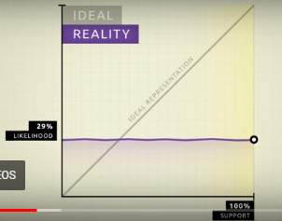
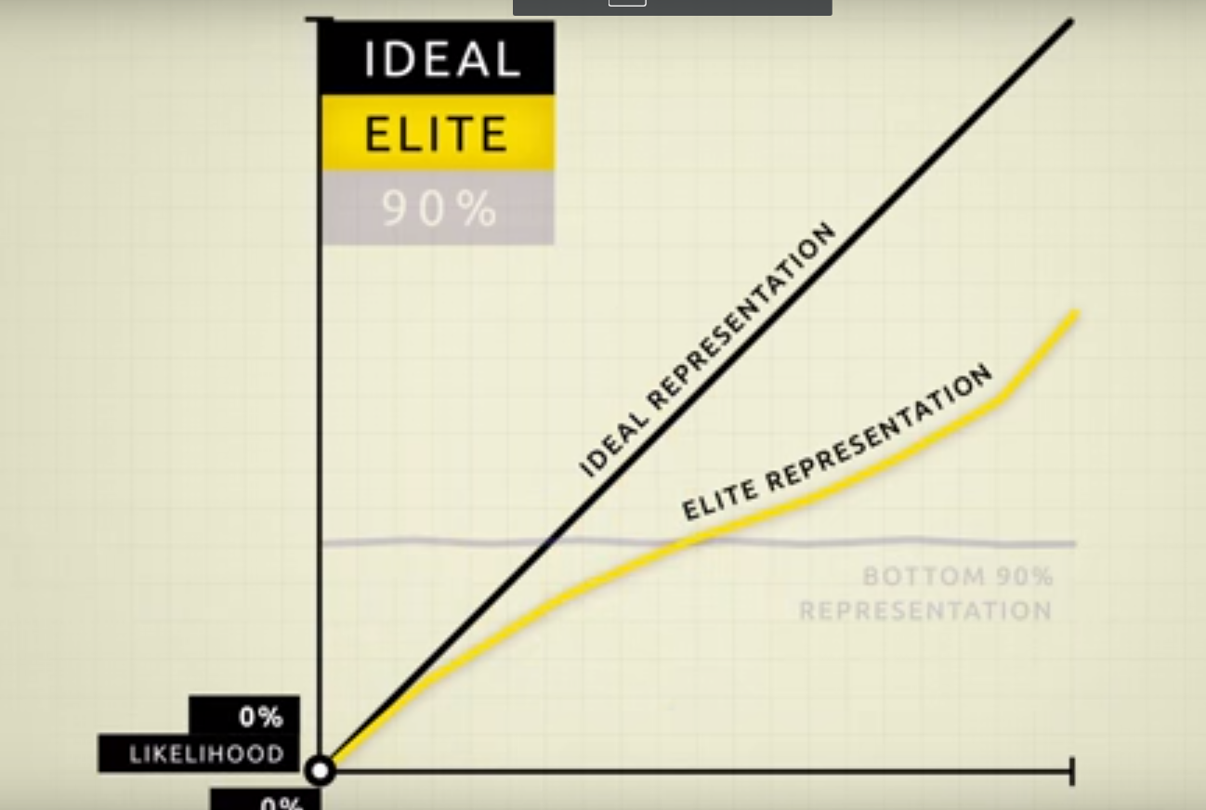
Money Wins Elections
What is the significance of these two images?
“The preferences of the average American appear to have only a miniscule, near-zero, statistically non-significant impact upon public policy.” –Princeton University study

Slide 30
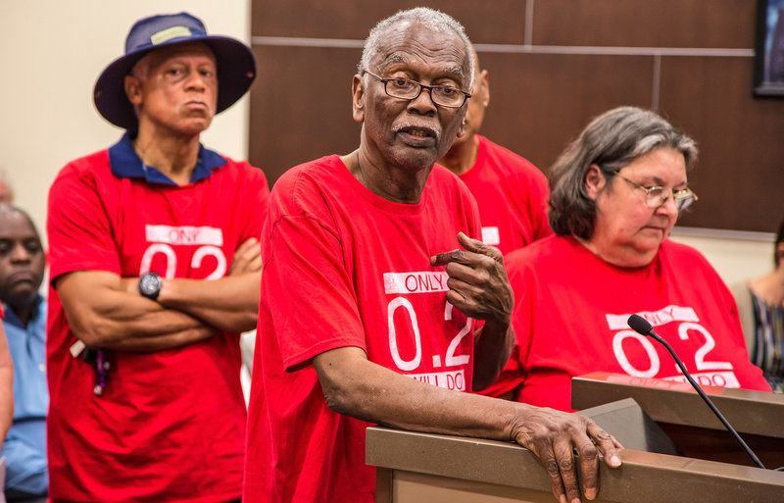
The Environment is a great example of the powerful subverting the will of the many
https://www.npr.org/sections/health-shots/2018/03/06/583973428/after-decades-of-air-pollution-a-louisiana-town-rebels-against-a-chemical-giant
Exxon, Shell, BP, etc. have know that Climate Change is caused by burning fossil fuels and that the effects can and will be catastrophic since the 1970’s yet they hid research, bribed politicians, and spread misinformation rather than invest in new energy sources and cleanup acts.

